Slide 1
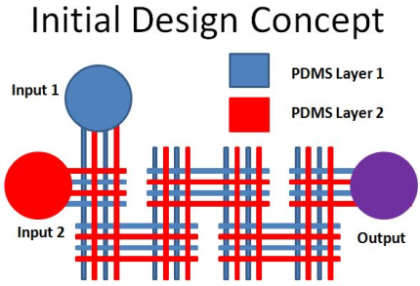
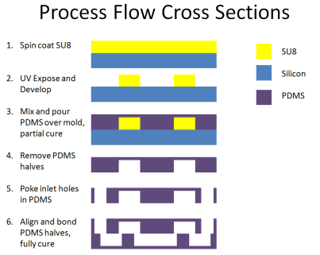
Utah Nanofab Design Review Meeting
Concept
Concept
Architecture
Device Architecture (Top View Layout and Layer Cross Section)
Researcher brings this to meeting
Fabrication Processes
DEPOSITION: ALD, PECVD, LPCVD, Sputter, E-beam
ETCH: XeF₂, DRIE, RIE, Wet Etch, Laser Ablation
PHOTOLITHOGRAPHY: Spin Coat, UV Alignment
MEASURE: Thickness, Resistivity, Stress, Uniformity
PACKAGING: Dicing, Wire Bonding, Encapsulation
Fabrication Processes
Nanofab Staff help determine this during meeting
Equipment & Tools
Equipment & Tools
Recipes & Settings
Standard
Custom
Recipes & Settings
TIME POWER PRESSURE
FLOW TEMPERATURE FORCE
GASES CHEMICALS FREQUENCY

Slide 2
Title of Research Project or Device To Be Fabricated
Researcher Name
PI Name
Date

Slide 3
Abstract

Slide 4
Design Concept
Goals:
Approach

Slide 5
Applicable Graphs, Data, or Figures

Slide 6
Device Architecture Top View and Cross Section Process Flow

Slide 7
Proposed Materials and Fabrication Processes
Materials
Substrate
Thin films/coatings
Chemicals
Processes
Deposition
Thin Films
Coatings
Patterning
Photoresists
Etching
Packaging
Dicing
Wirebonding
Test and Measurement
Electrical
Mechanical
Optical
Fluidic

Slide 8
References

Slide 9
Example: Microfluidic Mixer
Brian Baker
Dr. Bruce Gale
July 4, 2016

Slide 10
Example: Abstract
Mixing fluids over a wide range of flows inside microfluidic systems is challenging due to the laminar nature of fluids at the microscale. This study evaluates the design, fabrication, and testing of a passive three-dimensional micromixer that incorporates split and recombine structures that promote mixing at low flows with chaotic advection features that mix well at high flows. Comsol multi-physics simulations were performed to optimize the number of parallel channels, the channel width, and the number of split and recombine stages in the mixer. Overall mixer area was less than 4 mm², and consisted of 19 stages of two parallel overlapping channels with a depth of 100 microns and a width of 50 microns. Soft lithography was used to fabricate the two-layer device, and during the assembly process a partial cure of PDMS was found to be especially useful for enabling successful alignment. Test results show mixing efficiencies above 92% across a range of flows from 0.1 mL/hr to 10 mL/hr, with a range of Reynold’s numbers from 0.28 to 28. At an intermediate flow rate of 1 mL/hr, a pressure drop of 1.7 kPa was measured, and the mixing speed was 98 milliseconds. Results show that combining two types of mixer structures in this manner can create high mixing efficiency with reduced overall mixer size.

Slide 11
Example: Design Concept
PDMS Layer 1
PDMS Layer 2
Input 1
Input 2
Output
Goals:
Increase mixing effectiveness/decrease time to mix at three flow rates
Minimize pressure drop
Minimize total area and length of mixer
Simplify fabrication
Build and test mixer based on simulation results
Approach
Split and recombine multiple times results in many laminate layers
Long, narrow channels increase diffusion
Multiple parallel channels decrease pressure drop

Slide 12
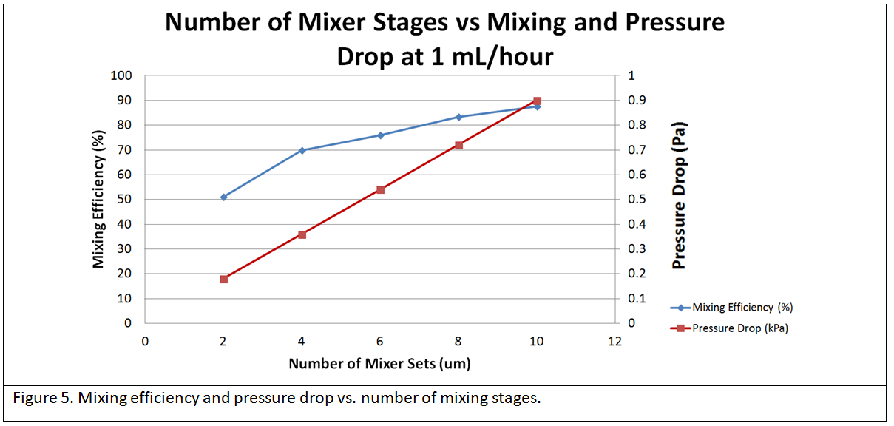
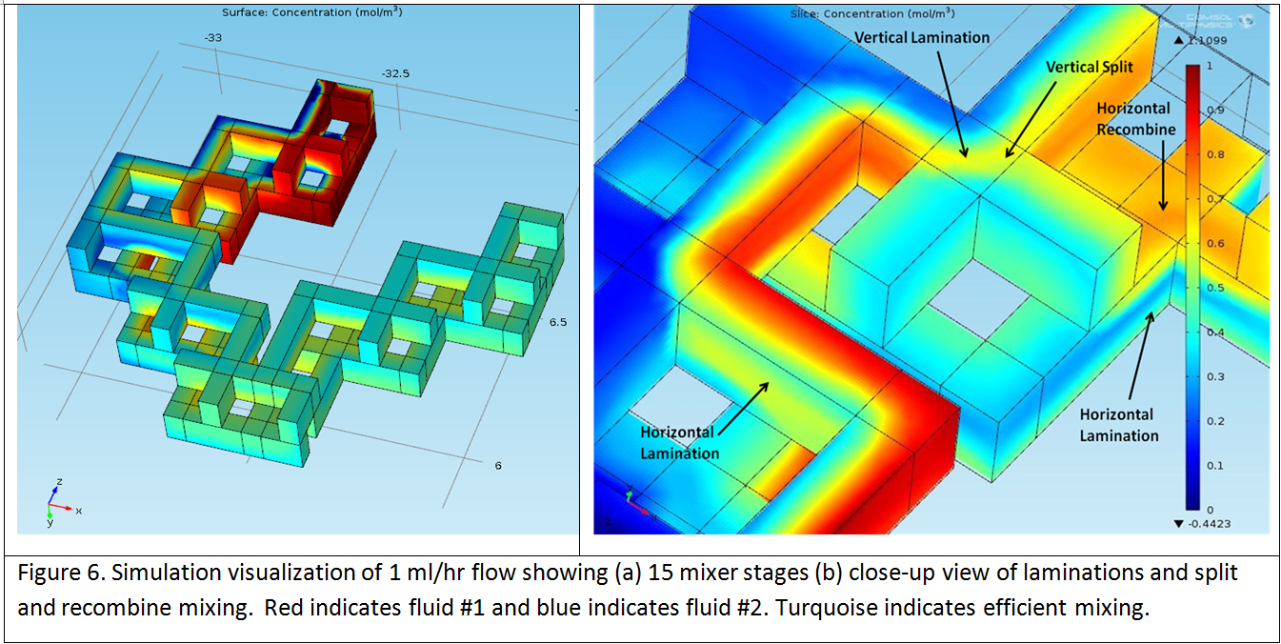
Example: Applicable Graphs, Data, or Figures

Slide 13
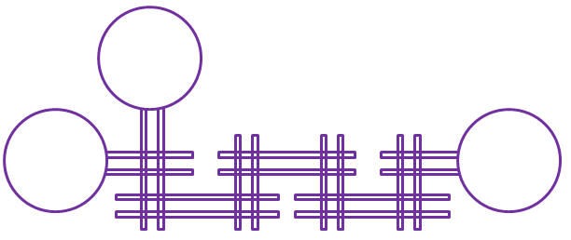
Example: Device Architecture Top View and Cross Section Process Flow
Spin coat SU8
UV Expose and Develop
Mix and pour PDMS over mold, partial cure
Remove PDMS halves
Poke inlet holes in PDMS
Align and bond PDMS halves, fully cure
SU8
Silicon
PDMS

Slide 14
Example: Proposed Materials and Fabrication Processes
Materials
Substrate
4” Silicon p-type wafer
Thin films/coatings
SU8 2050
Chemicals
Sylgard 184 PDMS
SU8 Developer
Processes
Deposition
Coatings
Sylgard 184 pour, vacuum degas and partial oven cure
Patterning
Photoresists
SU8 spin and develop
Align PDMS halves and fully cure
Packaging
Bore holes using coring tool
Press fit fluidic tubes into inlet and outlet ports
Test and Measurement
Optical
Microscope images of flows and mixing
Fluidic
Dual syringe pump with controlled flows and pressure gauge
Colored water for enhanced mixing imaging

Slide 15
Example: References
Squires, Todd M., and Stephen R. Quake. "Microfluidics: Fluid physics at the nanoliter scale." Reviews of modern physics 77.3 (2005): 977.
Nguyen, Nam-Trung, and Zhigang Wu. "Micromixers—a review." Journal of Micromechanics and Microengineering 15.2 (2005): R1.
Capretto, Lorenzo, et al. "Micromixing within microfluidic devices." Microfluidics. Springer Berlin Heidelberg, 2011. 27-68.
Chen, Hao, and Jens-Christian Meiners. "Topologic mixing on a microfluidic chip." Applied Physics Letters 84.12 (2004): 2193-2195.
SU8 Datasheet: http://microchem.com/pdf/SU-82000DataSheet2025thru2075Ver4.pdf, downloaded April 29, 2013.

