Slide 1

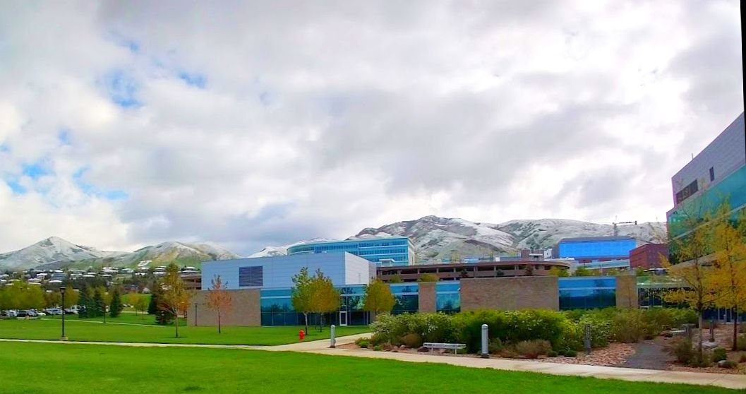
Town Meeting & Safety Training
August 24 & 25, 2023

Slide 2
Annual Safety Requirements
All active researchers for the Cleanroom must:
  Attend/review this presentation (make sure to print your name on the sign-in sheet)
  Review Safety and Protocol Videos https://www.nanofab.utah.edu/training/
  Retake the Safety Test by September 30, 2023
    Pass at 100%
    All members who have passed the test since June 1, 2023 are exempt until next year
    https://coral.nanofab.utah.edu/lab/safetytest

Slide 3
Agenda
Overview
Nanofab Staff
Billing
EMSAL Updates
Cleanroom Updates
General Information/Protocols
Safety Training

Slide 4

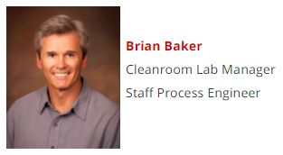
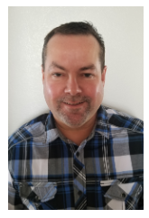
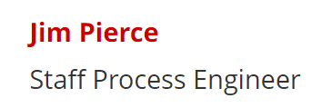
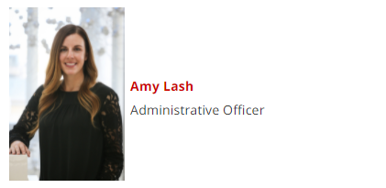
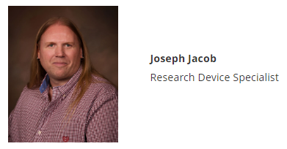
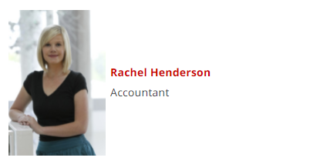
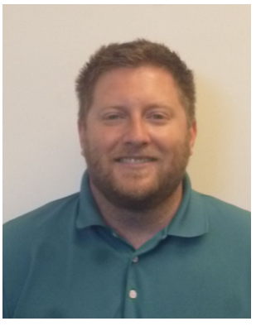
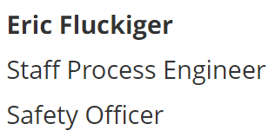
Nanofab Cleanroom Staff

Slide 5
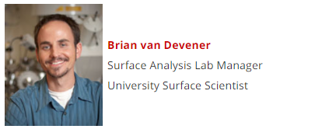
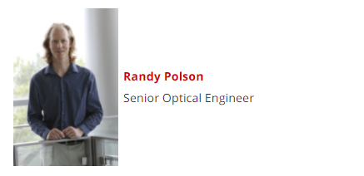
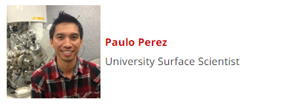

Nanofab Electron Microscopy and Surface Analysis Lab Staff
Bobby Duersch
Materials Characterization
Specialist

Slide 6
BILLING
(PAY ATTENTION TO THIS PART)

Slide 7
We have moved our billing
Billing now runs through HSC Cores https://cores.utah.edu
Invoices are automatically billed to your account on the 1st of the month
  Example: August invoices will be billed on September 1st
PI's and researchers need to be checking their lab activities regularly
  https://resource.cores.utah.edu/auth/login
  My Orders
Researchers must submit Cost Adjustment Requests prior to the last day of the month
  https://www.nanofab.utah.edu/cost-activity-adjustment-request/
PI's and Admins may inform HSC Cores of incorrect chartfields and account changes
  billing@cores.utah.edu
No changes can be made to an invoice once it has been billed

Slide 8
Cleanroom
Reservations
  Reservations can be modified or canceled at any time prior to the start of the reservation
  Reservations CANNOT be modified after the reservation has begun
Three tool categories
  Tools without interlocks (reservation required)
  Tools with interlocks (reservation required)
  Walk-up (reservation not required)

Slide 9
Cleanroom
Tools without interlocks
  Billing charges based on reservation only
Tools with interlocks
  Billing charge starts at the beginning of the reservation
Billing charge ends when the tool is locked
  If you fail to lock the tool, charges continue to accumulate
Other notes for tools with interlocks
  When the tool is locked, any remaining time on the reservation will be immediately deleted
  If the usage of Member A extends into the reservation of Member B, staff will be notified automatically and will make the necessary adjustments

Slide 10
Cleanroom
3. Walk-up tools (Spinners, Technics, Tencor Profiler)
  Billing starts when you press Start
Billing stops when you press End
  If you fail to press End, charges continue to accumulate

Slide 11
Cost Activity Adjustments
BOOKMARK THIS PAGE!
    https://www.nanofab.utah.edu/cost-activity-adjustment-request/
To be used in the case of special circumstances & tool problems
Researchers are responsible for requesting adjustments. Do not rely on technical/engineering staff to do it for you

Slide 12
PI’s and Admins
PI’s and admins should immediately notify HSC Cores billing@cores.utah.edu of any changes to their student’s payroll or if a lab member is no longer authorized to use the facility
The Nanofab billing chartfield must match the chartfield (project) they are paid from
Communicate with your students about their time in the lab and encourage them to act responsibly
    Unused reservations are completely avoidable
Ask questions and be involved in the billing process

Slide 13
Contact Us!
Do not hesitate to contact us if you have any questions.
Rachel Henderson rachel.henderson@utah.edu 801-581-6210
Amy Lash amy.lash@utah.edu 801-587-0676
HSC Cores Billing Team billing@cores.utah.edu

Slide 14
Electron Microscopy and Surface Analysis Lab Updates
New instruments! (Nano-CT, SEM, CL detector for Teneo SEM, Hi-res XRD)
New staff member! Dr. Bobby Duersch
Reminder of billing differences between EMSAL and cleanroom

Slide 15
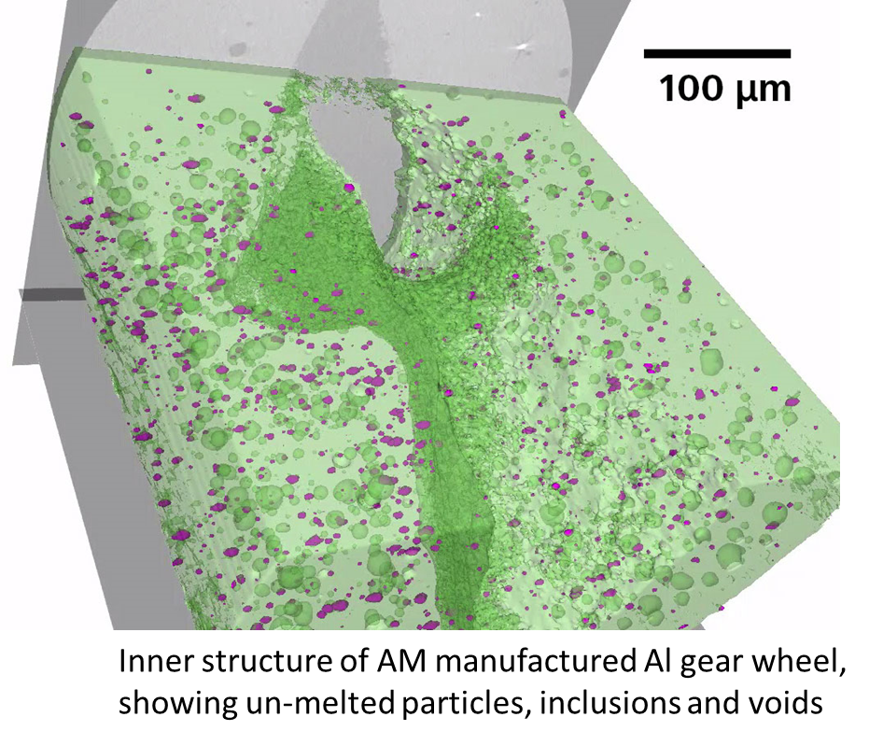
Nano-CT: Zeiss Xradia 620 Versa
High resolution, 3D Xray tomography
-NSF-MRI award (Jake Hochhalter)
-Non-destructive, in-situ, 4D imaging
-Study changes in materials while applying:
heat/cold, humidity, mechanical load
-600 nm imaging resolution (sample
dependent – most samples 1-10 µm)
-Lab DCT – 3D crystallographic orientation
imaging
Some Applications:
Electronics/Semiconductor: failure analysis,
non-destructive defect analysis, more
Materials Science: 3D structure of fibers, pores,
effects of heating/cooling, tension/compress., more
Life Science, Geo Materials, and more…

Slide 16
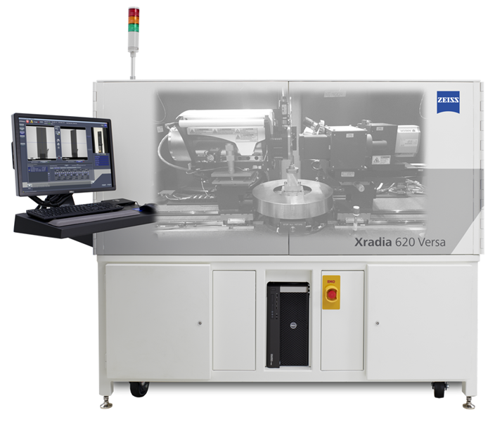
Nano-CT: Zeiss Xradia 620 Versa​
High resolution, 3D Xray tomography​
https://www.youtube.com/watch?v=bjkid8KFZOM

Slide 17
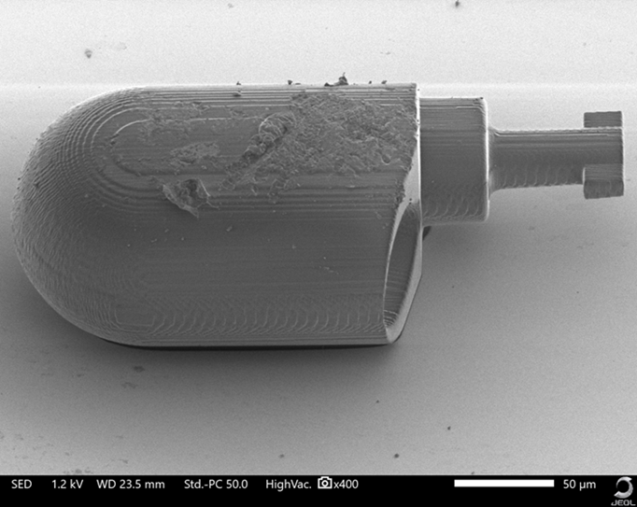
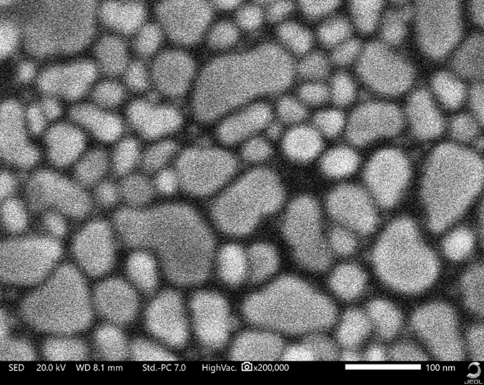
JEOL JSM IT-200LV SEM
3D printed part on glass
Located inside cleanroom metrology bay
Easy to use, and you can image your samples right in the cleanroom!
Low cost to use! $29/hr daytime, $14.50/hr nights and weekends (on-campus academic rates)
Quick imaging: ~15-30 min for most jobs
Resolution: High vacuum (SE): 3nm (30kV), 8 nm (3kV), 15 nm (1kV)
14x to 840,000X (display), 500 V to 30 kV
https://emsal.nanofab.utah.edu/jeol-jsm-it200-scanning-electron-microscope/
Au nanoparticles on carbon

Slide 18
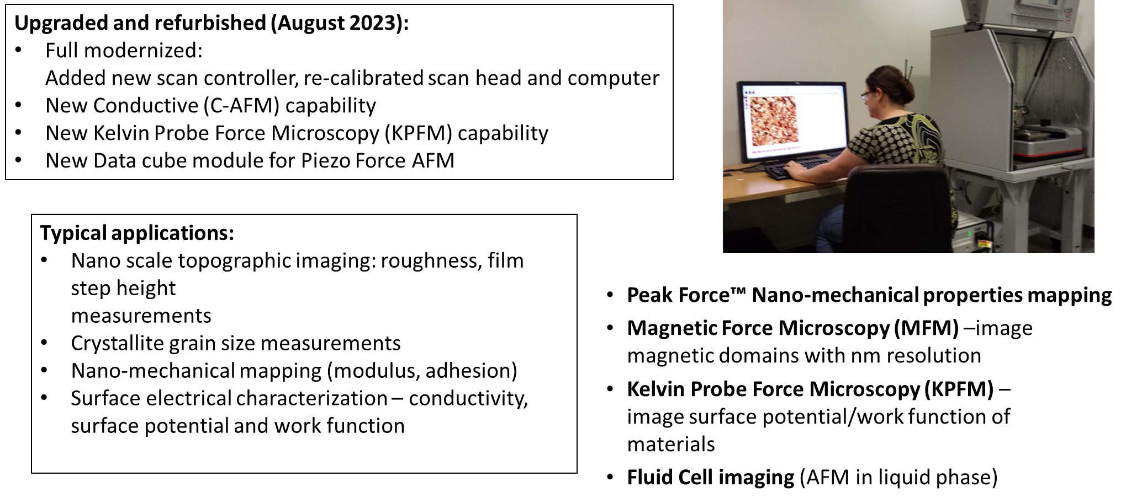
AFM upgrade (Bruker Dimension Icon PT)

Slide 19
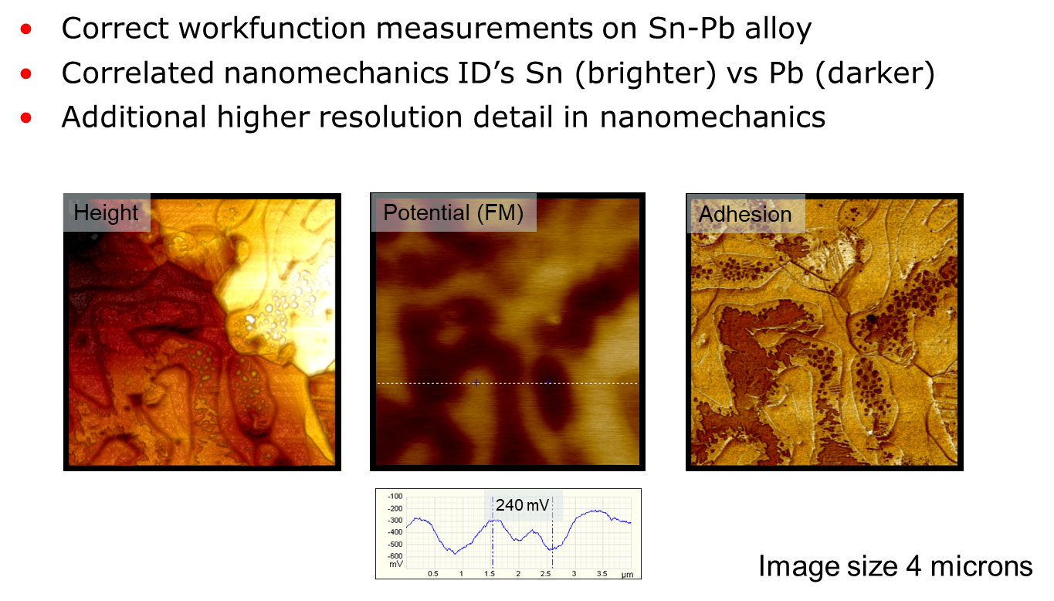
AFM upgrade (Bruker Dimension Icon PT)
KPFM data set: Sn-Pb alloy surface potential measurement.

Slide 20
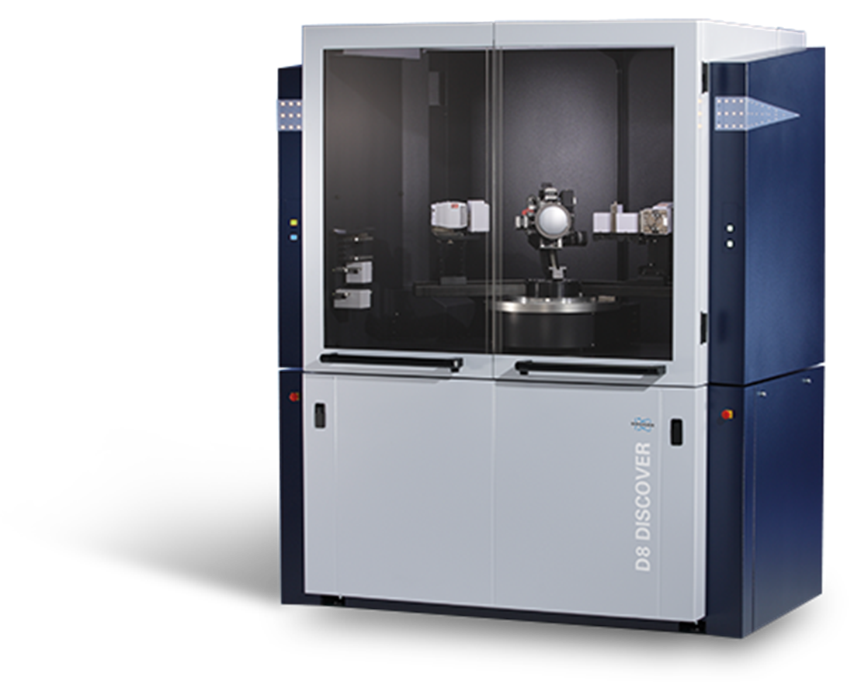
Hi-Res XRD
Bruker Discover D8
Hi resolution XRD system
Thin film, powder, polycrystalline materials
Faster analysis on powder samples
XRR, on/off axis Reciprocal Space Maps, theta/2-theta measurements
Heated stage (1100 C): analyze materials at temperature
Eiger 250k detector (0/1D/2D measurements)
Some applications:
Phase identification and quantification Micro-strain
Crystallite size analysis
Epitaxial film analysis
Residual stress analysis
Total scattering analysis: Pair-Distribution Function (PDF)

Slide 21
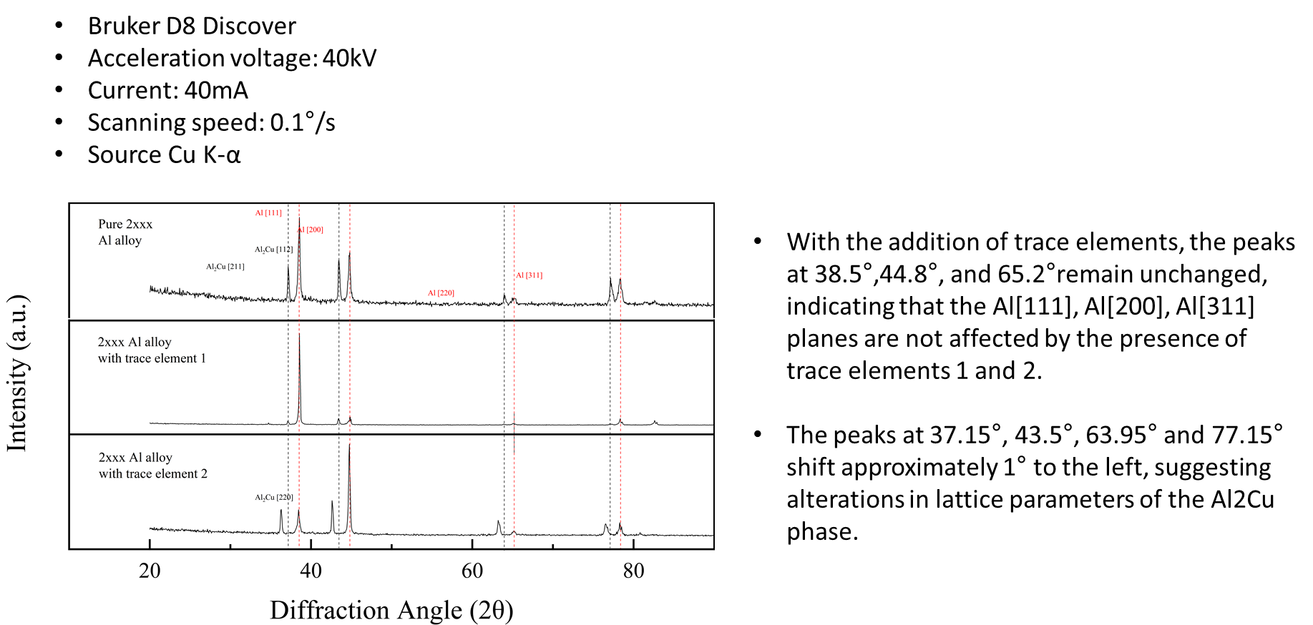
Hi-Res XRD
Bruker Discover D8
Example data collected on the XRD: Study of trace components in Al based alloy.
From the research of Prof. Shuihang Pan, Department of Mechanical Engineering

Slide 22
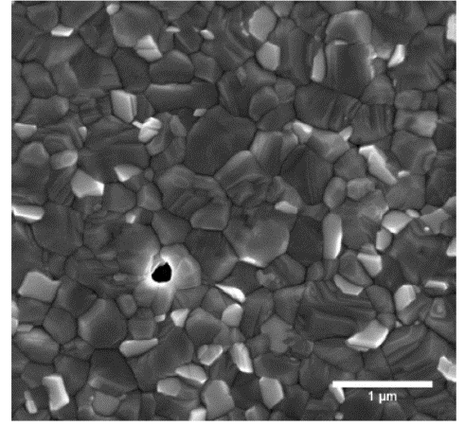
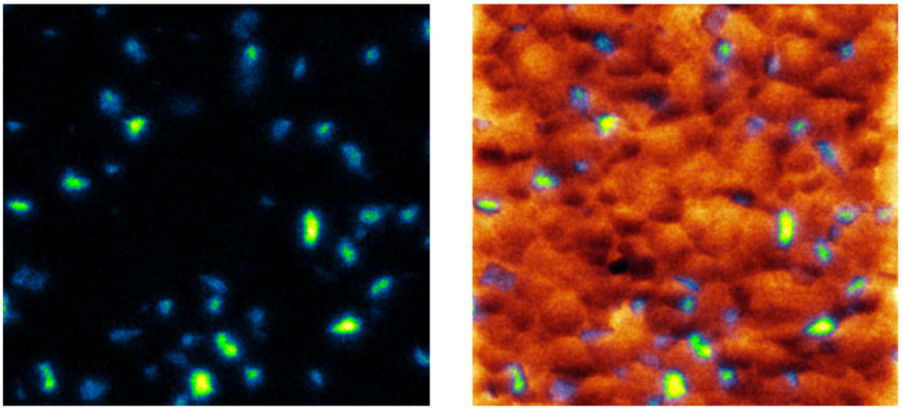
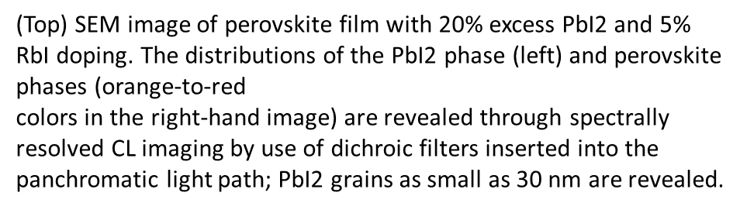
Cathodoluminescence (CL) Detector for Teneo SEM
Detector is being reconfigured for optimal performance
(higher port, shorter WD). Expected completion in late September
Hyperspectral imaging (mapping) CL detector
Measure light emission from materials being imaged in SEM
Size resolution: down to ~10 nm
Wavelength range: 185-2300 nm
Some applications: Nanophotonics, optoelectronics, geo-sciences

Slide 23
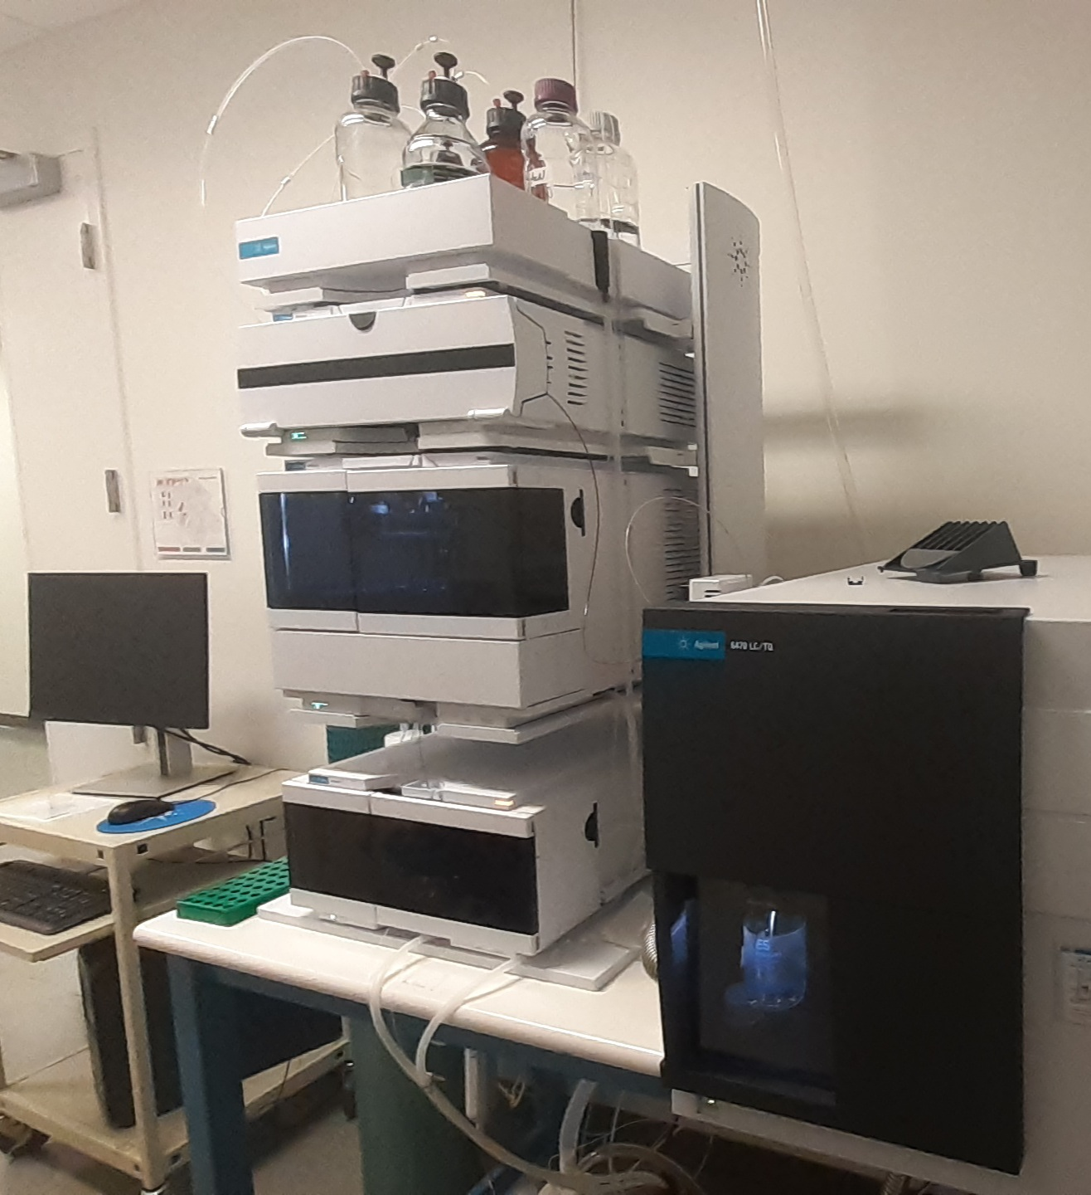
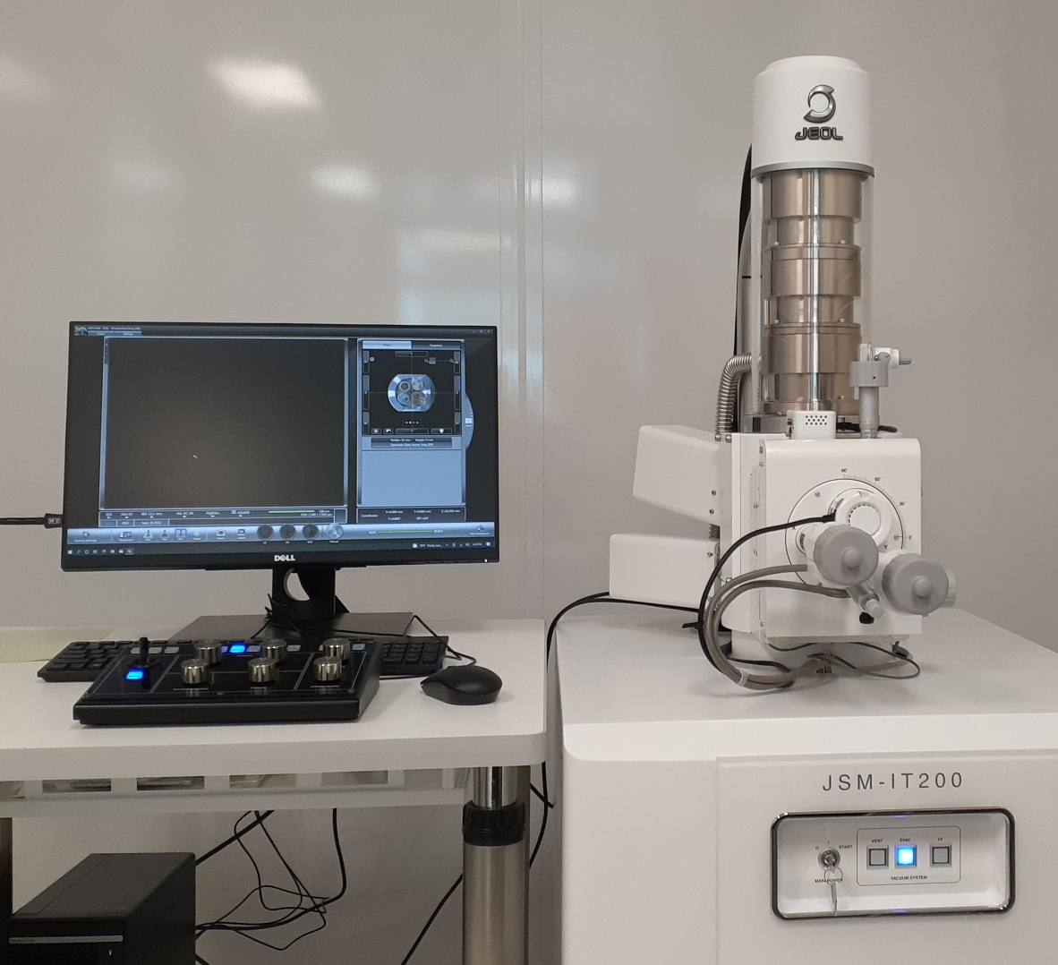
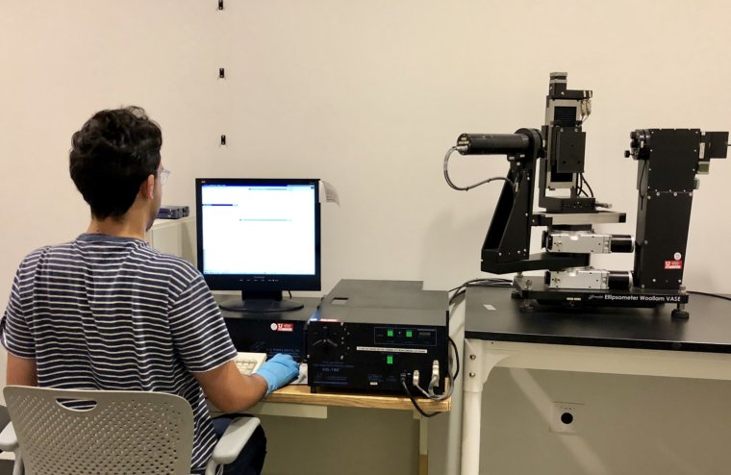
New Technical Staff Member
Dr. Bobby Duersch
Bobby Duersch
Materials Characterization
Specialist
Primary responsibilities: XRD, JEOL SEM, ellipsometer, LC MS
Secondary responsibilities:
Back-up support on: other SEMs, FIB, sample prep, AFM, TEM

Slide 24
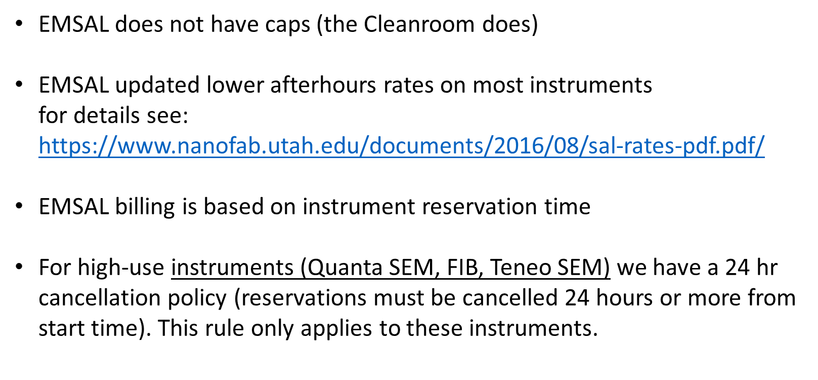
EMSAL Differences in Billing

Slide 25
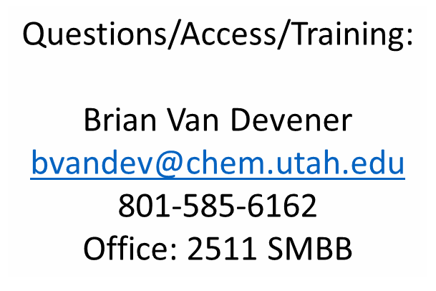
EMSAL Questions

Slide 26
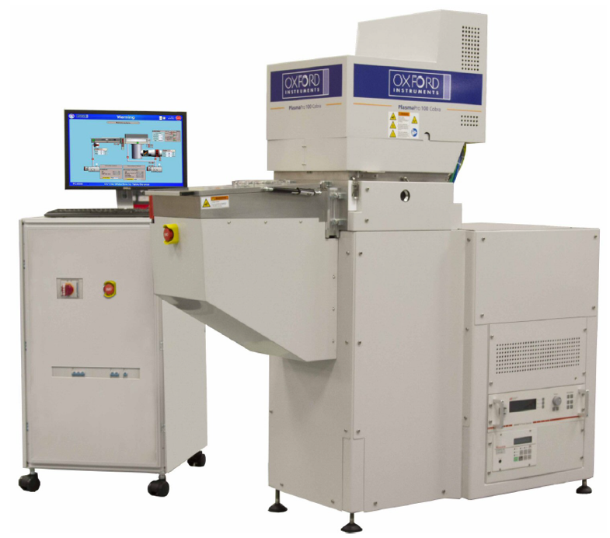
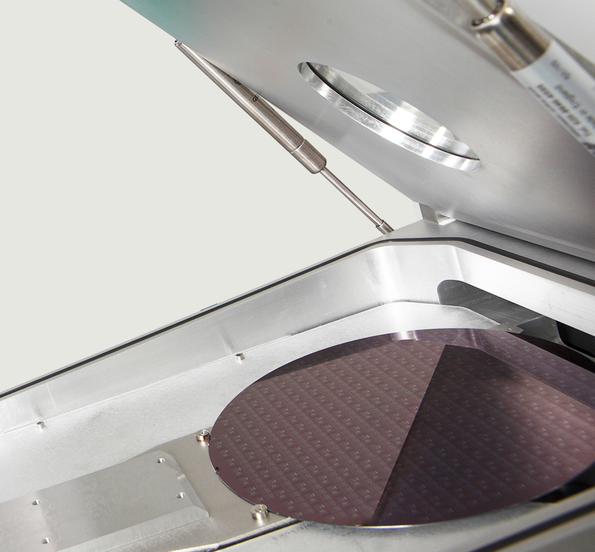
Cleanroom Updates
New Nanolithography Bay wet bench installation Q3 2023
Oxford 80+ PECVD/RIE replacement: PlasmaPro 100 Cobra 300
  44 week lead time + 3 month installation = ~1 year
  200mm capable DRIE
  ICP PECVD

Slide 27
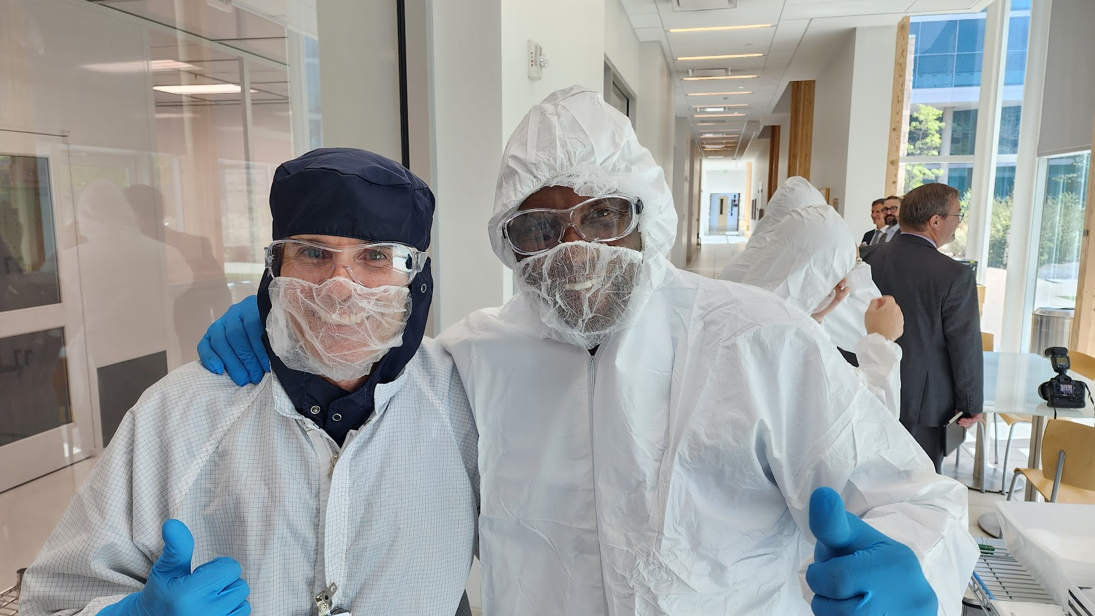
Visit From Burgess Owens
Member of U.S. House of Representatives

Slide 28
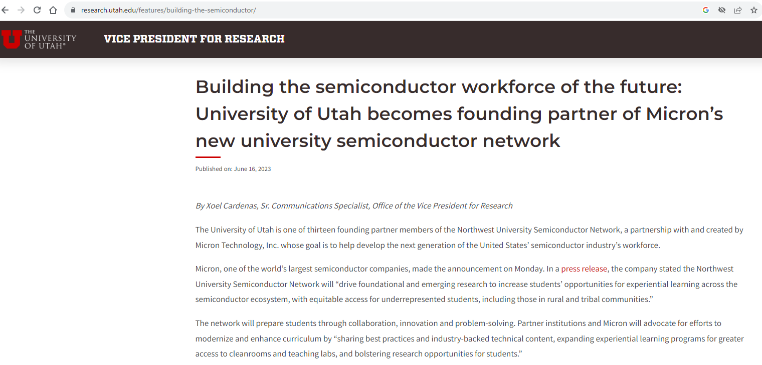

Slide 29
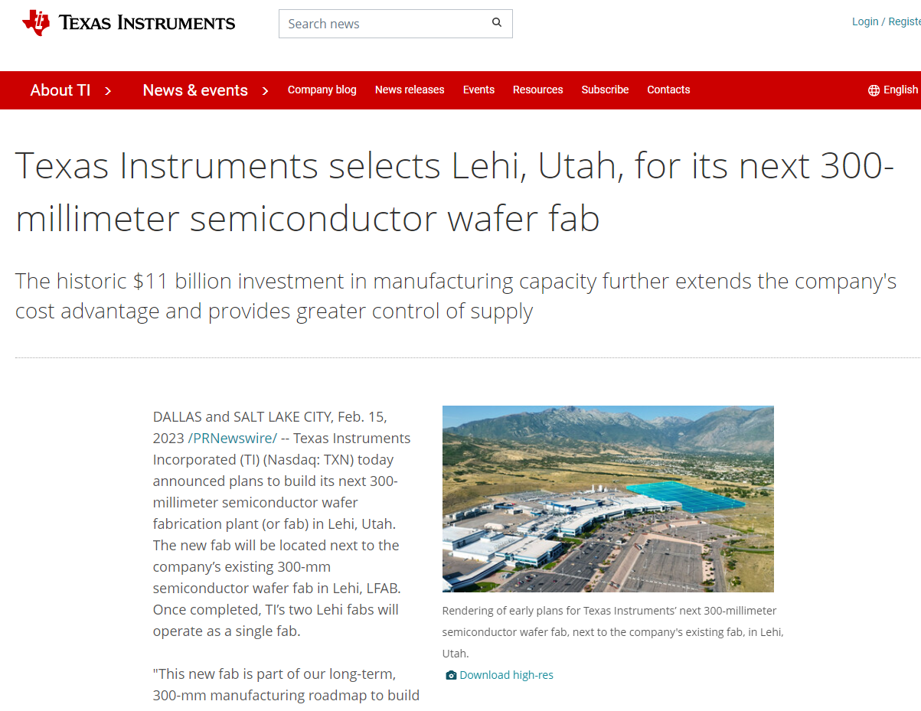

Slide 30
General Information/Protocols
Staff Hours
  Staff Support: Monday – Friday, 8am – 5pm
    Excluding Campus Holidays and Closures
  Hours/Days of Specific Staff Members varies
    Response to telephone and emails may be delayed
Loose items
  Unclaimed items left on tables and workstations may be discarded
    Not limited to overnight
    Check lost & found
  Identified items that remain undisturbed for an extended time may be discarded
Stocking of consumables (wipes, gloves, etc.)
  On occasion we do not restock appropriately
    Open access supplies are available under tables and in the Gowning Room Cabinets
Notes:
Tony

Slide 31
Process Review Meeting
Joint review of process flow between researcher and staff
Assist researcher in selecting tools and processes that will enable successful device fabrication
Suggested for new or modified projects of existing members
Every Tuesday, 3:30 PM
    Please schedule with staff by email
Notes:
Tony

Slide 32
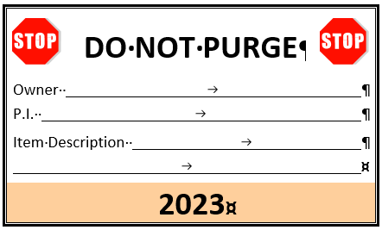
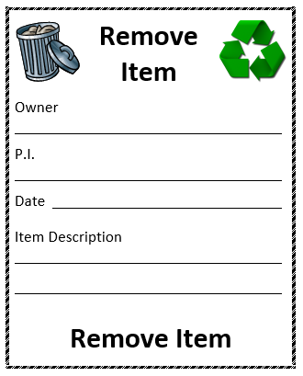
Nanofab Purge/Cleanliness
Thank you for your diligence in the Annual Nanofab Purge
  Helps ensure adequate storage for all and reduces clutter
  Scheduled for October 13, 2023
  Identification tags throughout the facility (does not include Surface Lab)
    Do Not Purge
    Remove Item
General storage recommendations
  Only storage totes, wafer cassette boxes, and mask cassette boxes should be placed directly on storage shelves
    ALL other items should be in a tote (including single wafer trays and mask holders)
    Totes should not be stacked
  Only store photosensitive items in the NanoLith Bay
  Label it!
    All totes or other loose items should be labeled with owner’s name
    Unidentified items are likely to be discarded.
Purge (including chemicals)
  If you want to keep it, attach Do Not Purge tag
  If it can be discarded, toss it appropriately or attach Remove Item tag
Ongoing Facility Hygiene
  If you no longer need it in the facility, remove it!
  Members who are leaving should try to transfer totes and other items to their replacements
  Please remember User Chemicals
    Many were unclaimed during purge
    Many more are expired (request and/or shelf life)
      If the request has expired, please coordinate removal with Staff
Notes:
Tony
*

Slide 33
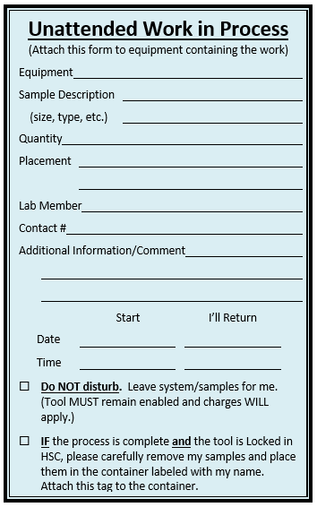
Unattended Work in Process
Provide information to Staff and other members when you leave work in a tool
Member leaving work should complete this form
  Authorize or deny removal of samples from tool
  If authorized, member removing samples MUST ensure process is complete AND tool is Locked in HSC
For example:
  Ovens – no lock box
  Long process
  Overnight vacuum pumpdown
We recommend frequent/regular use of this form to avoid risk to your work.
Please remember to remove form
Notes:
Tony

Slide 34
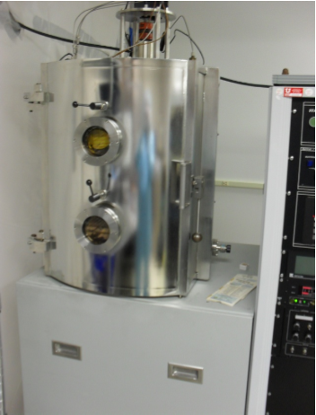
Equipment
  Lab members may only use the equipment for which they are trained and authorized by lab staff
    When requesting training, provide details
      Substrate type, size, quantity
      Material(s)
      Thickness
      Desired characteristics
      Etc.
  Use only approved materials in all systems
  Report equipment problems to Staff
    DO NOT attempt to repair equipment yourself!
  Use correct project and account
    NEVER reserve or unlock a tool for your use through another member’s account

Slide 35
Safety Training
Annual Requirement
  Today’s attendance
  Review Videos
  Take Safety Test (annual requirement)
    New Questions
    Answers in Lab User Guide, Videos, and website
Safety Issues
  Campus Safety Initiatives
  Dress Code
  New Materials
  Chemical Labeling – ALWAYS!
  PPE
    Wet bench – ALWAYS!
    Removal of white gloves, apron
  Buddy System
  Emergency Access to Labs (Student, Microfluidics, MOCVD)
  Report a Safety Concern or Issue
    Near misses
  Incident Reporting
Notes:
Tony

Slide 36
Mar. 18, 2022 Wetbench Near-miss
Piranha solution, also known as piranha etch, is a mixture of sulfuric acid (H2SO4) and hydrogen peroxide (H2O2), used to clean organic residues off substrates. Because the mixture is a strong oxidizing agent, it will decompose most organic matter. This means the solution can also easily dissolve fabric and skin, potentially causing severe damage and chemical burns in case of inadvertent contact.
An after-hours user was using the wetbench on a weekend when a near-miss occurred. The user was aspirating piranha solution out of a container when the container unexpectedly tipped over
Let’s analyze footage of the near-miss and talk about it. What went wrong? What went right? What can we learn from this? How can we all do better next time? What actions were taken to minimize the chance of something similar happening in the future.
https://uofu.app.box.com/file/935145227197?s=ndzfpgd9yxba8vs4clpeeirbbv72xfzz

Slide 37
EHS FACT SHEET - General Laboratory Safety Rules
To ensure that help is available if needed, do not work alone if using hazardous materials or performing hazardous procedures.
To ensure that help is available in case of emergencies, laboratory personnel should not deviate from the assigned work schedule without prior authorization from the laboratory supervisor.
Do not perform unauthorized experiments.
Plan appropriate protective procedures and the positioning of all equipment before beginning any operation. Follow the appropriate standard operating procedures at all times in the laboratory.
Always read the SDS and the label before using a chemical in the laboratory.
Wear appropriate PPE, including a laboratory apron or coat, at all times in the laboratory. Everyone, including visitors, must wear appropriate eye protection in areas where laboratory chemicals are used or stored.
Wear appropriate gloves when handling hazardous materials. Inspect all gloves for holes and defects before using.
Use appropriate ventilation such as laboratory chemical hoods when working with hazardous chemicals.
Contact your supervisor or the EHS office if you have questions about the adequacy of the safety equipment available or chemical handling procedures.
Notes:
Nanofab Policies take precedence.
Lab Members may NOT escort visitors. Staff must escort ALL visitors. (This includes family members and all rooms, e.g. 2223, 2227)
Any PPE exceptions will require ADDITIONAL PPE. There are no exceptions for less.

Slide 38
EHS FACT SHEET - General Laboratory Safety Rules
Know the location and proper use of the safety equipment (i.e., eyewash unit, safety shower, fire extinguisher, first-aid kit, fire blanket, emergency telephone, and fire alarm pulls).
Maintain situational awareness. Be aware of the hazards posed by the work of others in the laboratory and any additional hazards that may result from contact between materials and chemicals from different work areas.
Make others in the laboratory aware of any special hazards associated with your work.
Report all injuries, accidents, incidents, and near misses to you supervisor and complete the Employers First Report of Injury form through Human Resources.
For liability, safety, and security reasons, do not allow unauthorized persons in the laboratory.
Report any unsafe conditions to the laboratory supervisor.
Properly dispose of all chemical wastes. Follow University policies for drain and trash disposal of chemicals.
Notes:
Nanofab Policies take precedence.
Lab Members may NOT escort visitors. Staff must escort ALL visitors. (This includes family members and all rooms, e.g. 2223, 2227)
Any PPE exceptions will require ADDITIONAL PPE. There are no exceptions for less.

Slide 39
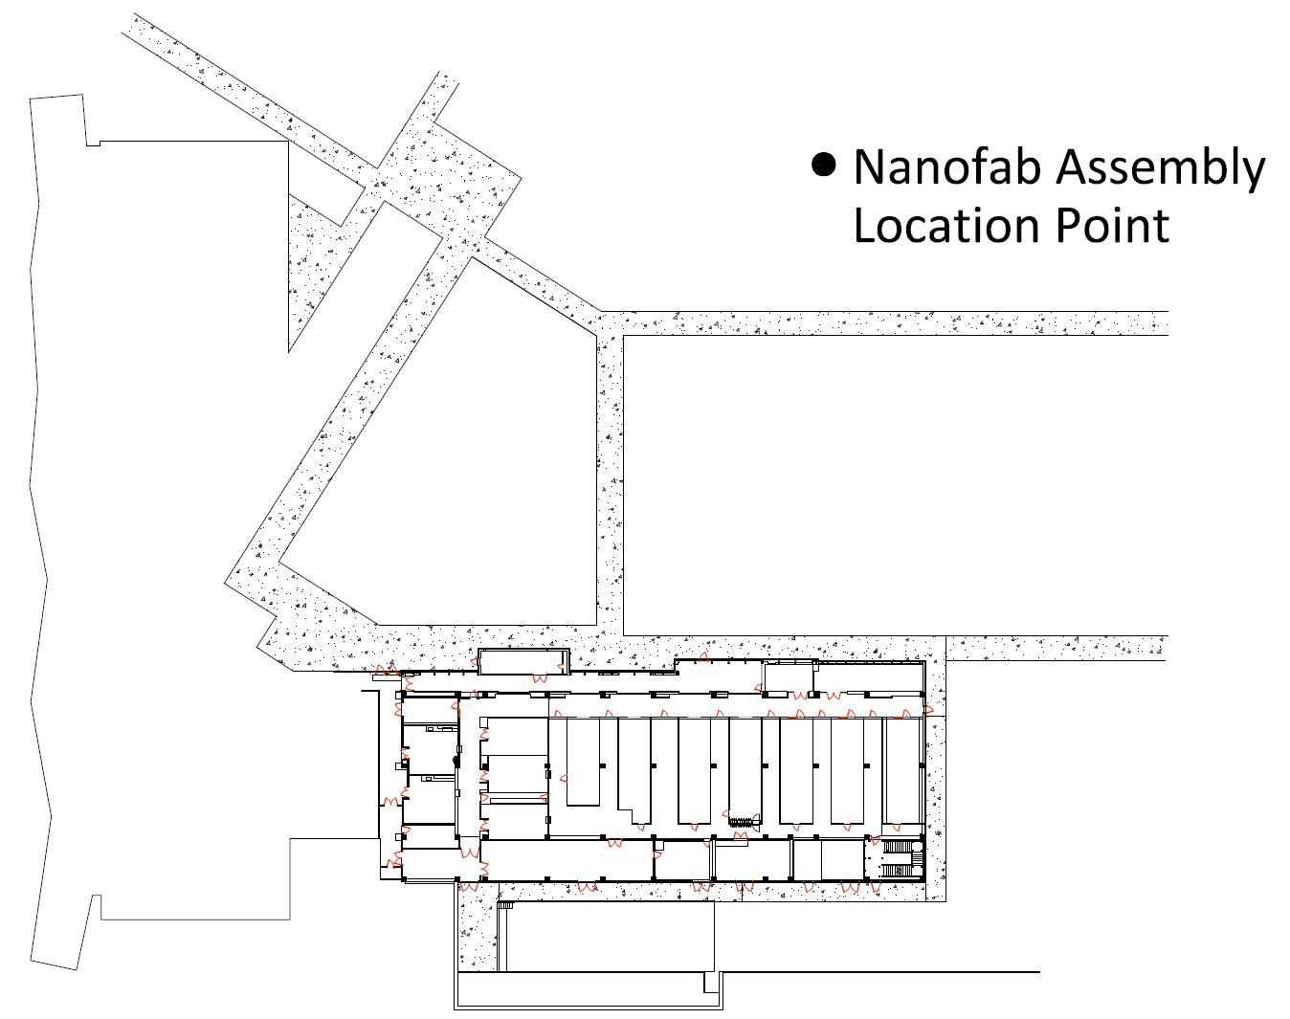
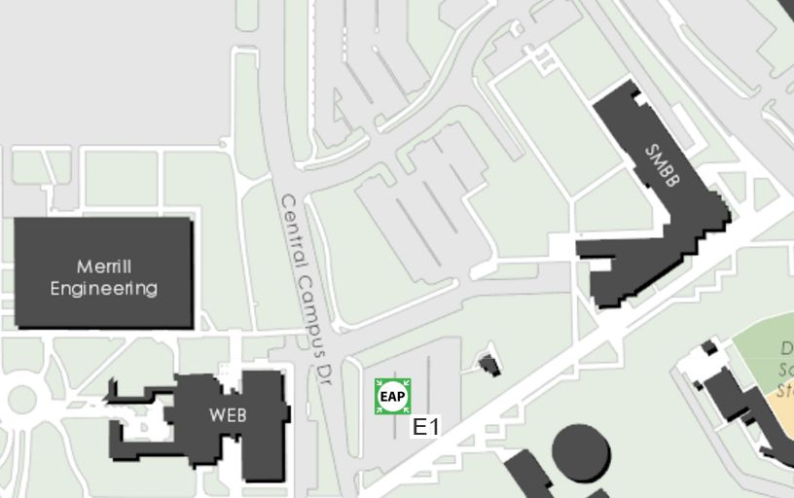
Emergency Evacuation
Stop what you are doing
Abort processing, as needed
Promptly exit facility and building
Report to Nanofab Assembly Point
Report status and observations to Staff
Remove Cleanroom clothing
Proceed to Emergency Access Point (EAP)

Slide 40








Dress Code
Dress Code meets COE and Campus Requirements
  Applies to ALL rooms in Facility – including Backend and Prototyping Labs (2223, 2227)
4.8.1 Legwear
Legwear (pants) must completely cover all skin on the legs from the bottom of the shirt to the ankles.
Shorts, short pants, capris, skirts, dresses, ripped jeans, etc. are not allowed. However, they may be covered with hospital scrub-style pants, sweat pants, or similar legwear that fully covers each leg.
4.8.2 Shirts
Shirts/blouses must completely cover all skin from the top of the shoulders to the pants (short sleeves are acceptable).
Bare midriffs, tank tops, halter tops, or spaghetti strap tops are not allowed.
4.8.3 Shoes
Shoes must be closed-toe and closed-heel that fully enclose and cover the heel, toes, and top
of the foot. Sandals, open-weave shoes, or shoes that expose the top of the foot are not allowed.
Notes:
Add images of acceptable/unacceptable

Slide 41
New Materials
What is considered a New Material?
Anything not provided or sold by Staff that will be placed in or on any equipment or tool (including measurement tools)
  Liquids, targets, pellets, substrates, membranes, etc.
    Includes samples/devices that have been obtained outside the facility and require additional processes inside the facility
    Request now asks for additional details to describe ALL layers and materials on the sample/device
  New Material Request requires a list of ALL processing and equipment to be used with the material/sample/device
    Every process step in the facility after material is placed on device
      Need to protect downstream equipment
  Each approval is specific to that request and described usage ONLY!
  The following is a short list of materials that are NOT allowed:
    Gadolinium, Lead, Gallium, PZT, Cadmium, Vanadium Oxide
  All approved liquids are delivered to Eric, who will label and place in cleanroom
    Lab Members NOT allowed to move liquids in or out of cleanroom
    Please coordinate schedule – give me sufficient time
Notes:
Tony

Slide 42
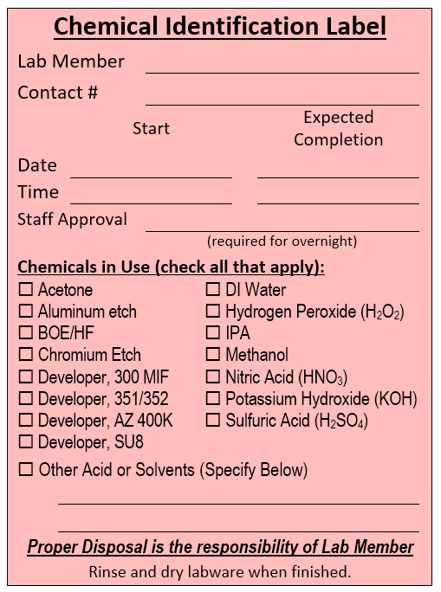
Chemical Labeling
In-Use Chemicals
  Chemical Identification Label
    Use for chemicals no longer in stock bottle
    All Chemicals MUST be labeled ALWAYS
      Even water!!!!
    Complete label BEFORE pouring chemical
    Tape label to container
      Exception: hot plate control pad
    Overnight Use: Staff Approval Required

Slide 43
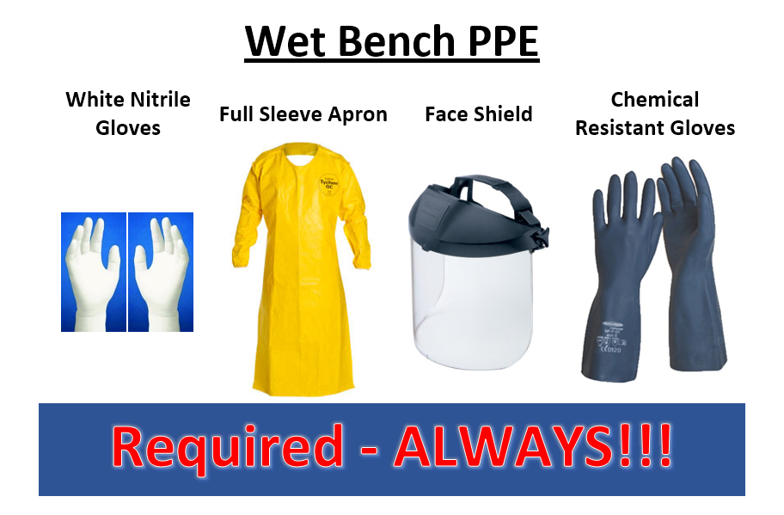
Wet Bench Safety
  Full PPE must be used ALWAYS at ALL wet benches
    White nitrile gloves, full-sleeve apron, face shield, chemical-resistant gloves
Notes:
*
We continue to look for other options for Chemical Resistant Gloves.

Slide 44
Wet Bench/Fume Hood Safety
Always wear required PPE
Remove White Nitrile gloves before touching other items
Don’t wander or sit on chairs while wearing aprons
Label all chemicals: in advance
Only place chemicals in authorized locations
  Wet Bench/Fume Hood Deck
  Storage locations (per chemical code labels)
  Transport Cart
Open chemical caps only when bottle is completely inside the wet bench and sitting on a flat surface. Screw cap back on completely and snugly before removing bottle from wet bench.
Always ensure the manual valve on the gooseneck faucet is fully closed before pressing the Start switch https://uofu.box.com/s/li2vr4garumkmcvi62mgkmc3fu1sj1u1
Place hot plates in recessed areas or away from edge
  Do NOT block access to other components
Wipe drips from work surfaces
  DO NOT attempt to clean up spills – Contact Staff
Rinse and label empty bottles and caps
  Write “Empty/Rinsed” on bottle before placing in trash
DON’T drink the water from wet benches or fume hoods!!
  Use dispenser in Clean Conference Room
Never placed opened chemical containers in the pass-through cabinets
Lower fume hood sash when not in use
Notes:
*
Tony

Slide 45
Buddy System
This policy required by EH&S and College of Engineering to ensure lab members have available assistance for ANY incident.
Trained and authorized lab users can work in the Cleanroom outside of Staff Coverage hours (8am - 5pm M-F) ONLY with an authorized buddy present at ALL times in the Cleanroom
  No exceptions for duration or activity
No buddy necessary for Backend or Prototyping Labs (2223, 2227)
Buddy must be swiped into Cleanroom and remain present
Buddies must communicate frequently (at least every 15 min.)
Each lab member is responsible to schedule their own buddy
Users violating the buddy system rules are subject to disciplinary action!
Notes:
No excuse – even for being stranded.
Remember, the rule is ALL times – not even for a couple minutes.
If Buddy leaves, you must leave, too. (“Short” breaks often take much longer than expected.)
*

Slide 46
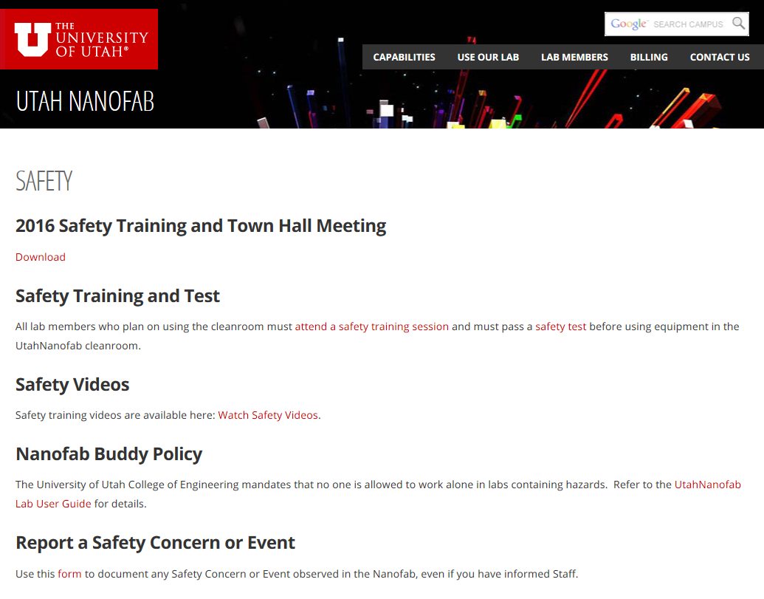
Report a Safety Concern or Event
On-line form
  Reports to Nanofab Staff
  Use for any concern
  Use for near misses
  **Please contact us directly and immediately for chemical spills, fires, smoke, burning smells, injuries, chemical exposures, toxic gas or material exposure, etc.
  Use this report even when verbally reported to Staff

Slide 47
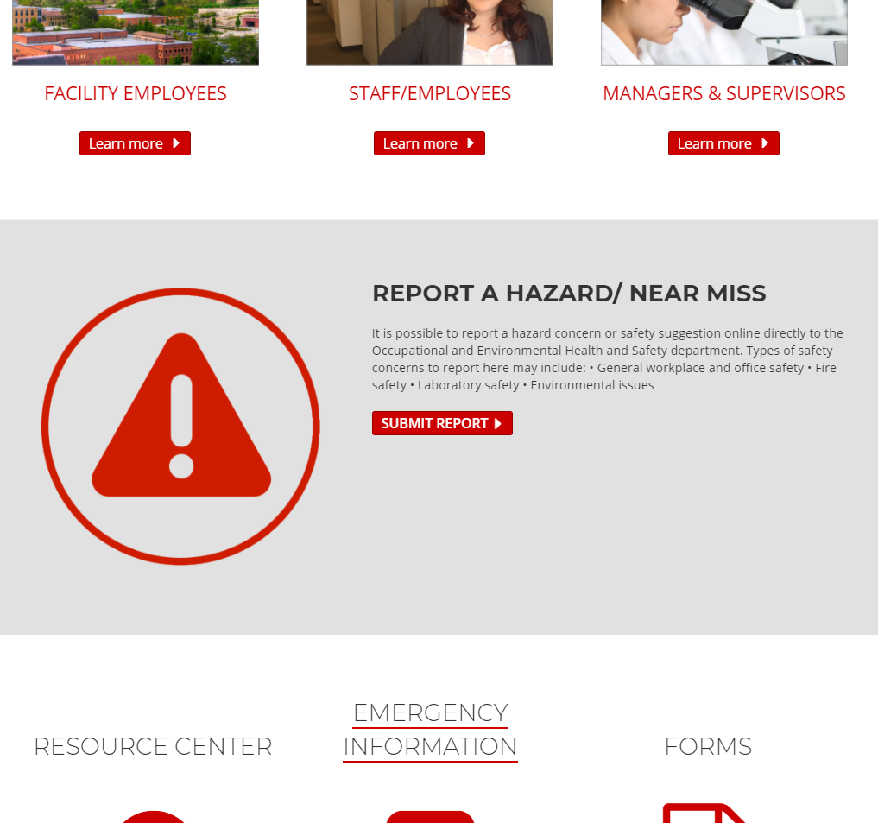
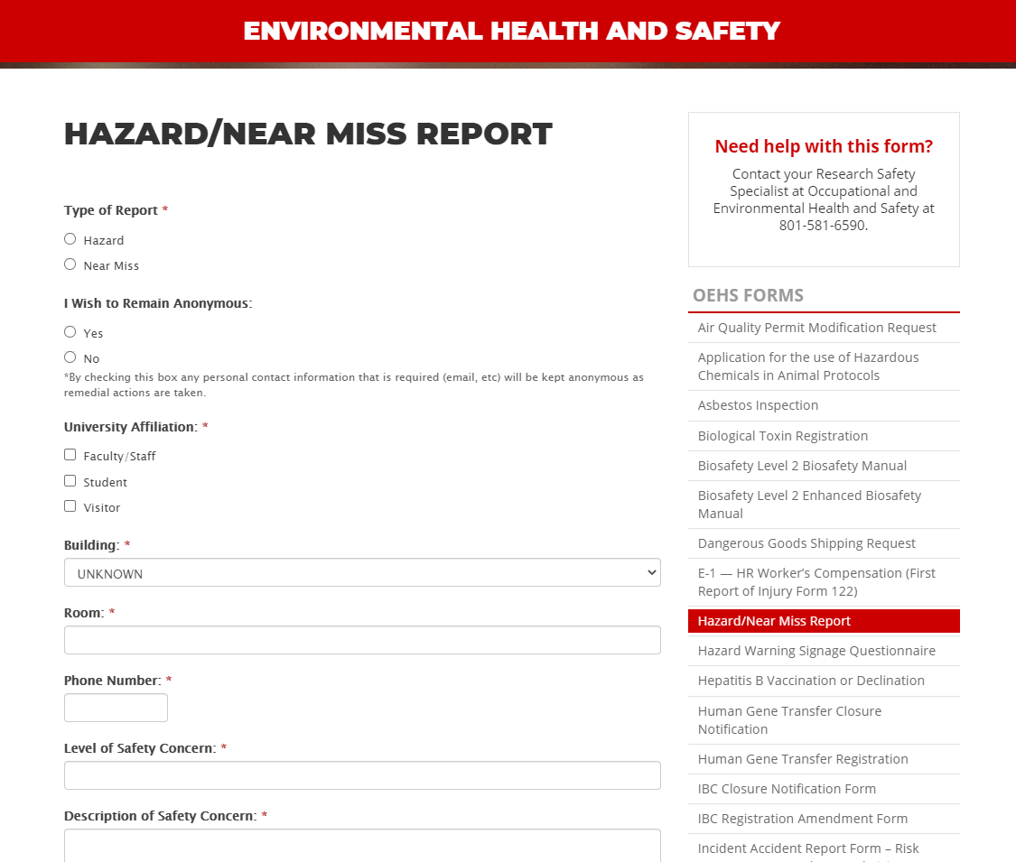
EHS Hazard/Near Miss Report
On-line form
  Reports to Campus EHS
  Use for any concern
  Use for near misses
  Use even when verbally reported to Staff
https://oehs.utah.edu/
https://oehs.utah.edu/resource-center/forms/hazard-report

Slide 48
Think Laboratory Safety
Use common sense when thinking about safety
  Personal safety is ALWAYS more important than research activities
Read, understand, and abide by the rules and policies
  Lab User Guide
  Safety Videos
If you do not know – ASK Staff!!
There is no valid excuse for ignoring the rules
If you are in the lab your name must show on the “Users in Lab” page
Entry authorized only by card access
  Notify Eric if UCard has been replaced
Notes:
Tony
*

Slide 49
Safety Violations
Nanofab staff makes PI aware of situation
Staff, PI, and student meet to understand student's perspective, understanding, decide on restrictions and make a plan to correct any misunderstandings
Restrictions include but are not limited to
  Removal of after-hours access (temporary or permanent)
  Removal of lab access (temporary or permanent)
  Temporary tool disqualifications
  Retraining of safety or equipment protocols
Student performs corrective actions as outlined by staff
Staff lifts any imposed temporary restrictions
Student does groundbreaking research, graduates, and becomes rich and famous

Slide 50
This is your lab!
  Your Safety - people who place themselves and others at risk will lose lab access privileges.
  Your Community - Is this a better place for everyone because you are here?
  Your Responsibility - if you see a problem, please talk to the individual or report it to the laboratory staff.
  Your Accountability - If you create a problem, it is far better to “own-up” to it immediately
Ownership, pride and discipline results from your respectful use of the lab.

Slide 51
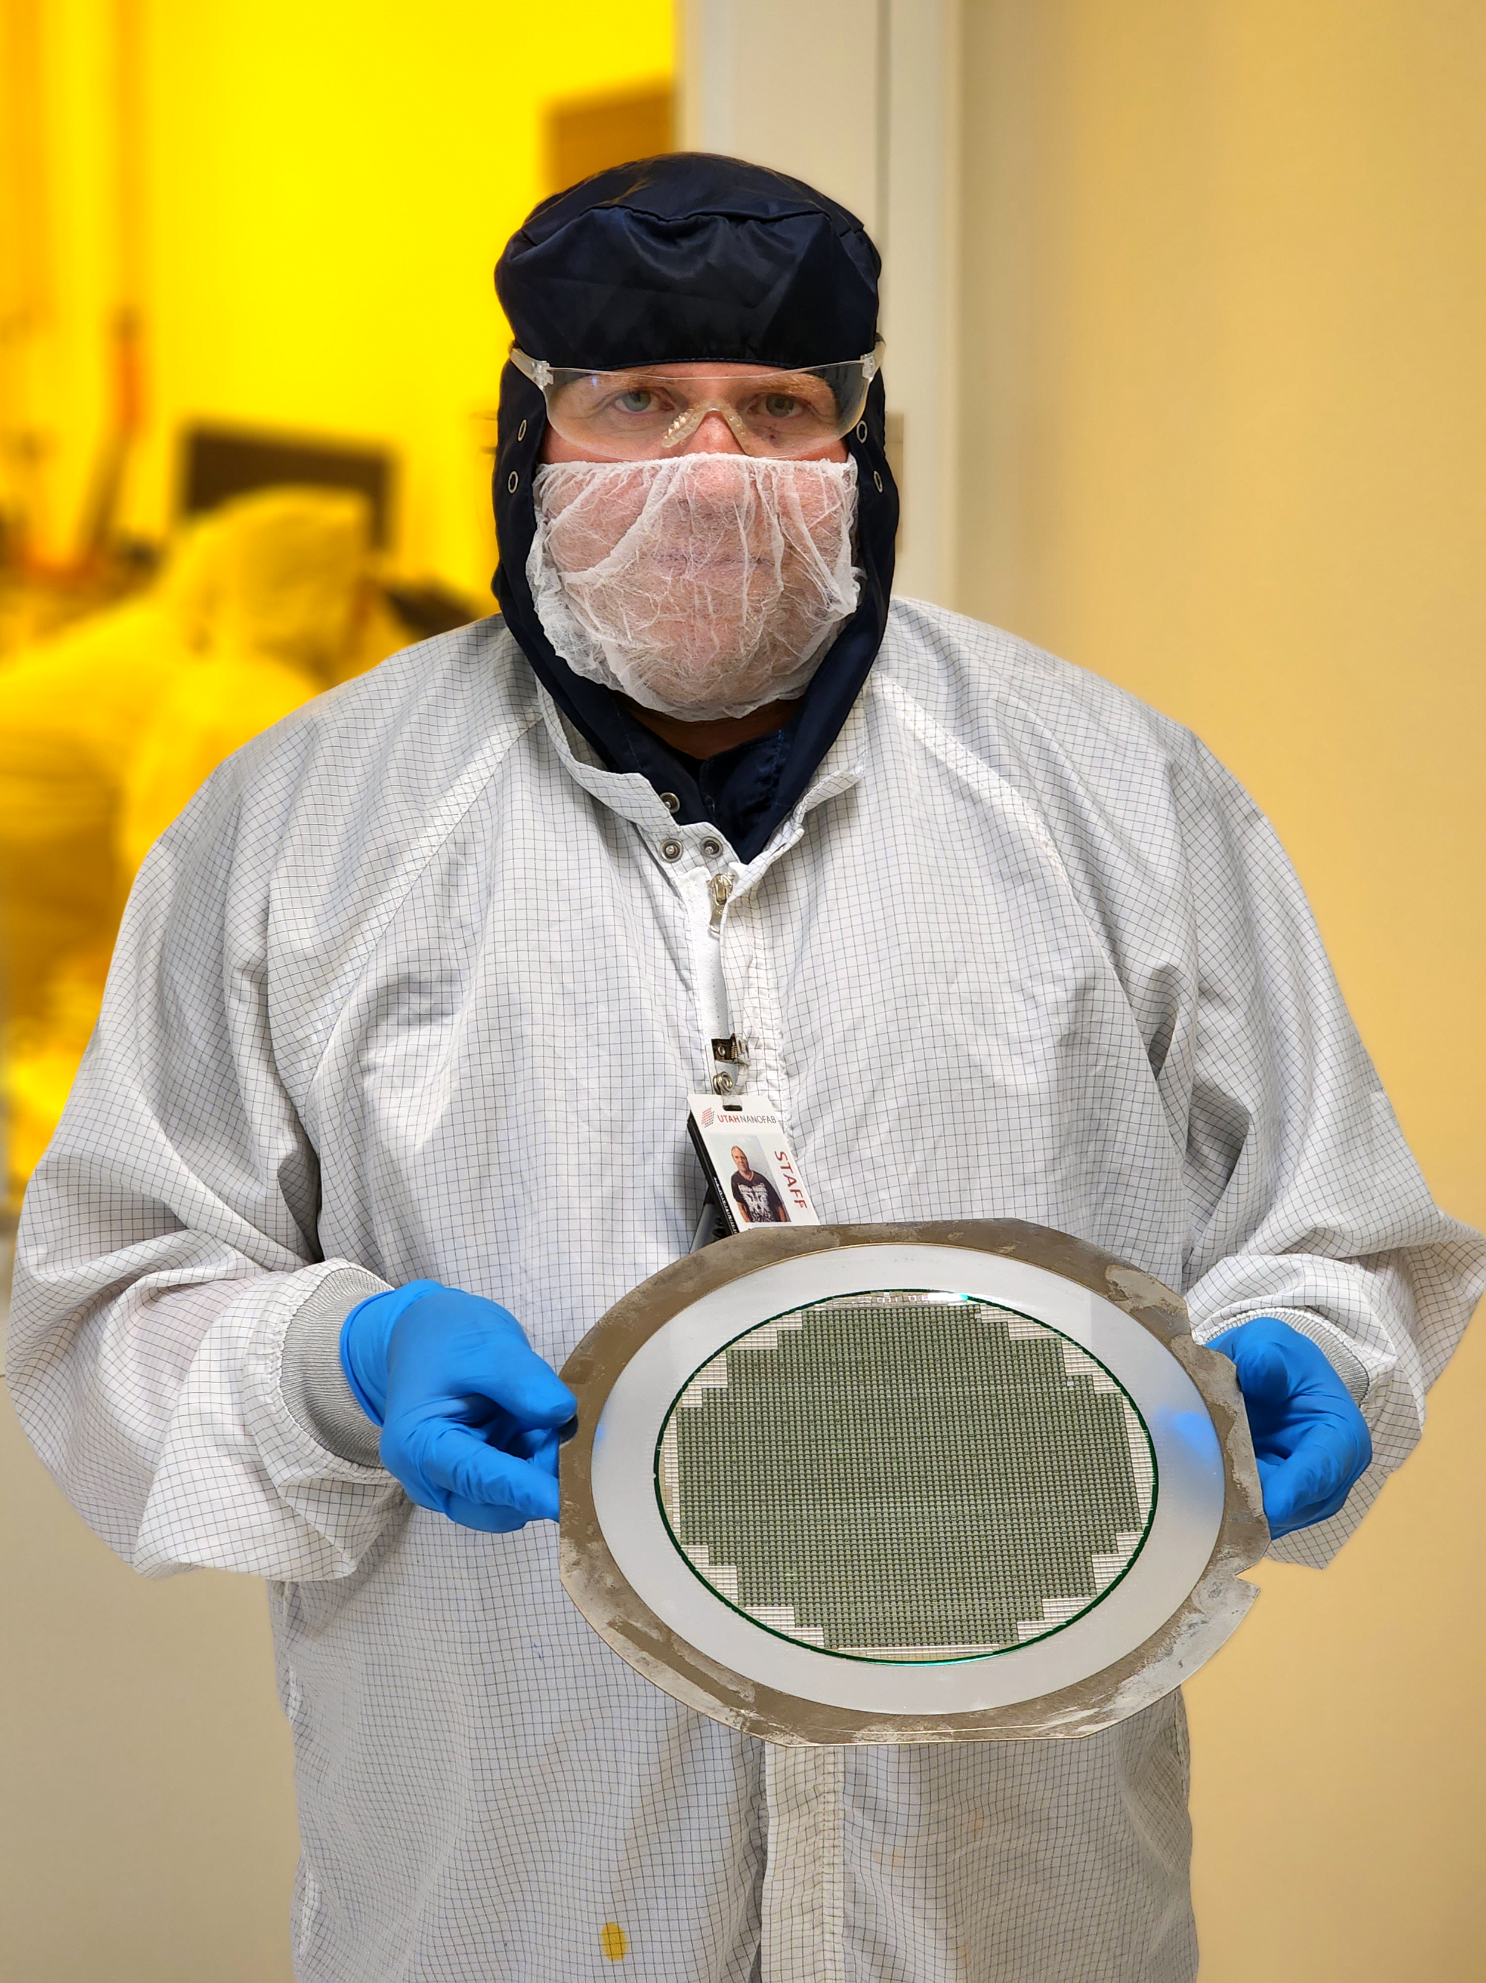
Questions?

