Slide 1
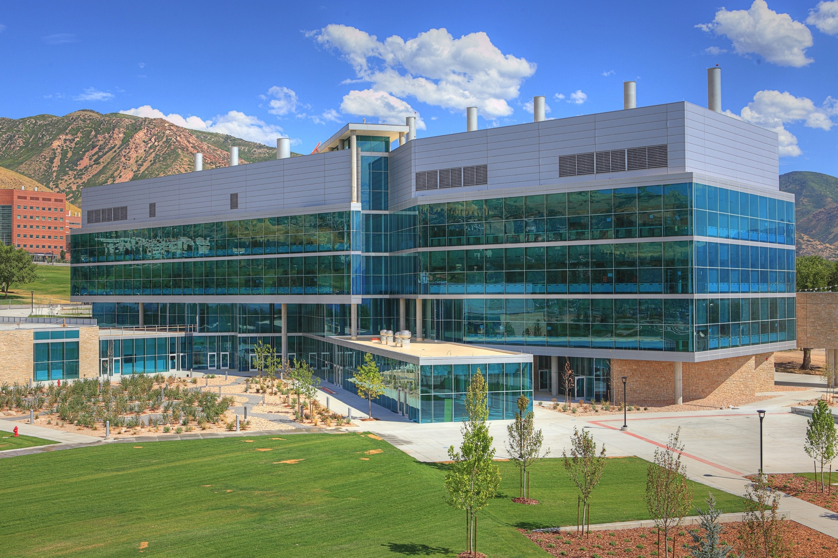
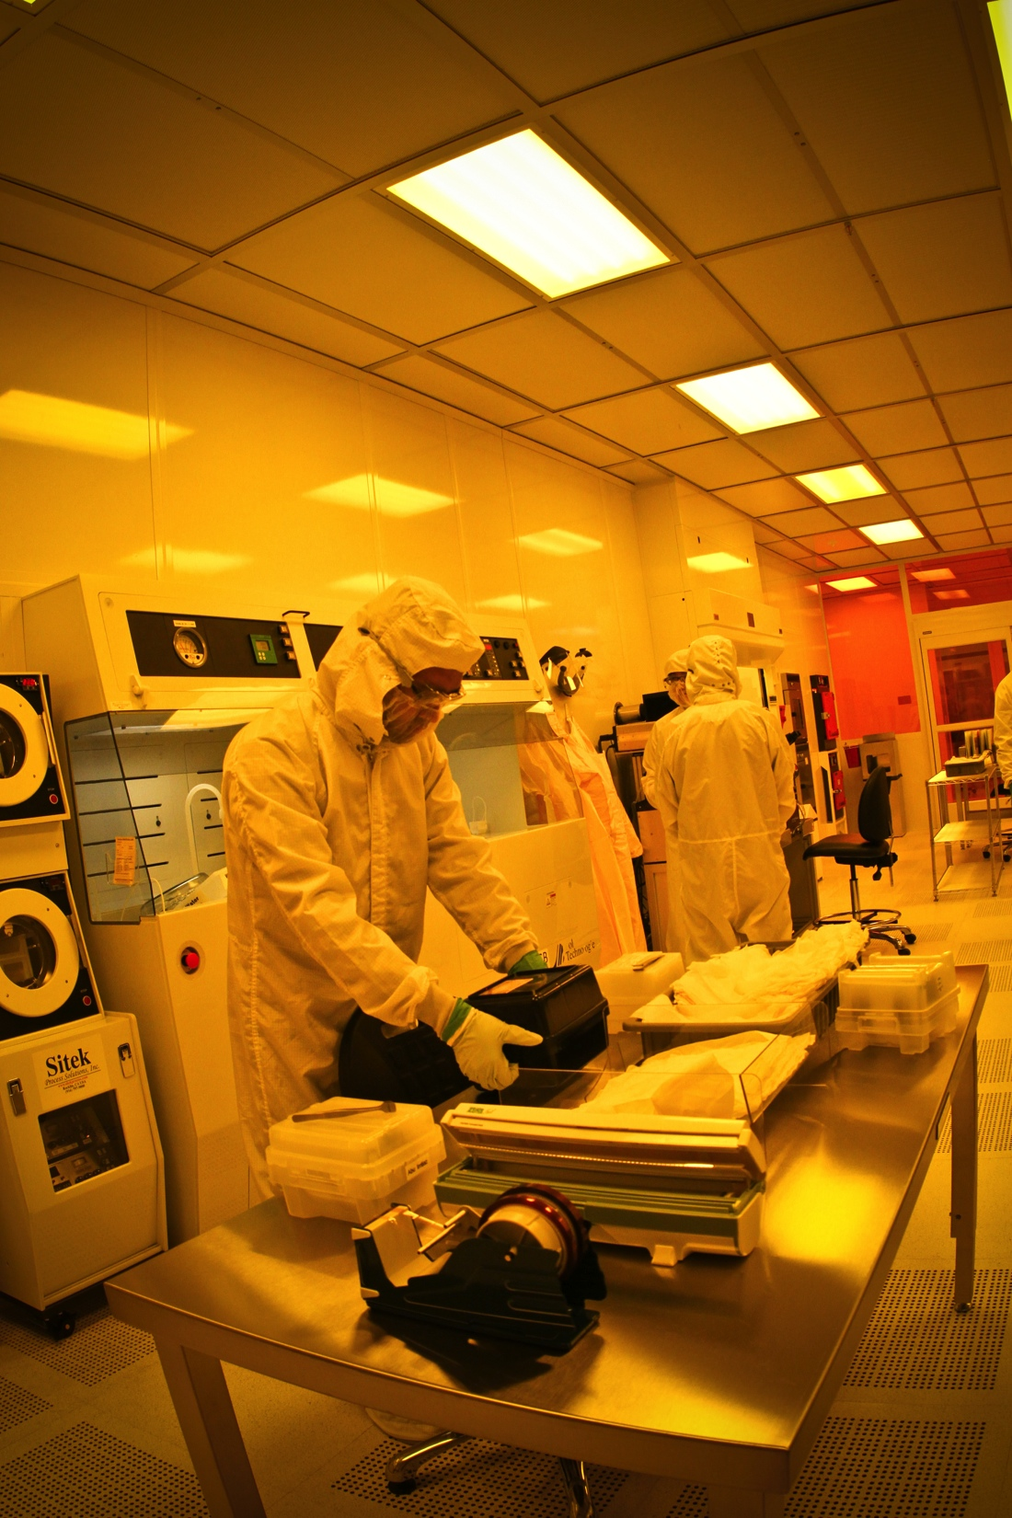
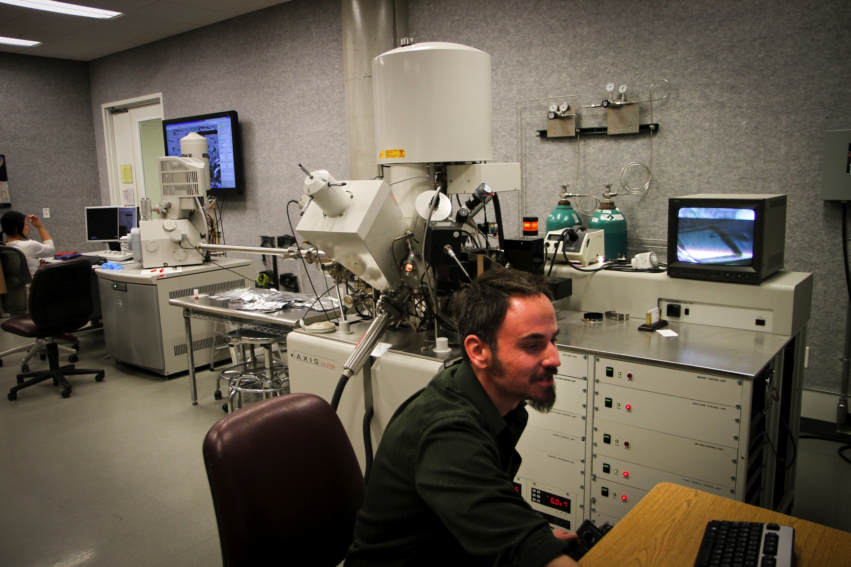
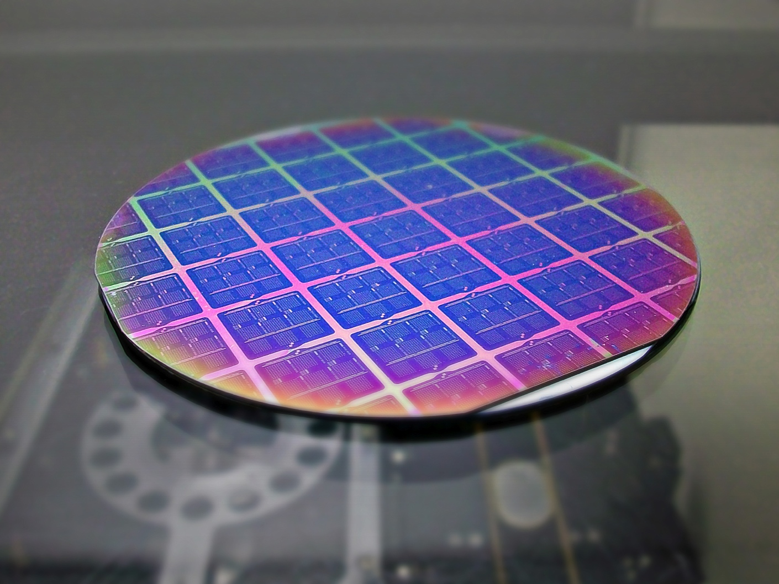
Center for Engineering Innovation
www.nanofab.utah.edu
USTAR Cleanroom
Surface Analysis & nanoImaging
• Thin film patterning
• Microfluidics
• Laser & wire EDM
• μmachining
• Microsystems packaging
• Electrical characterization
• Sensors
• Actuators
• System prototypes
• Correlative multi-scale analytical microscopy
• fast, hi-res analytical electron microscopy
• surface chemistry and topogrphy
Build it.
Commercialize it.
Look at it.

Slide 2
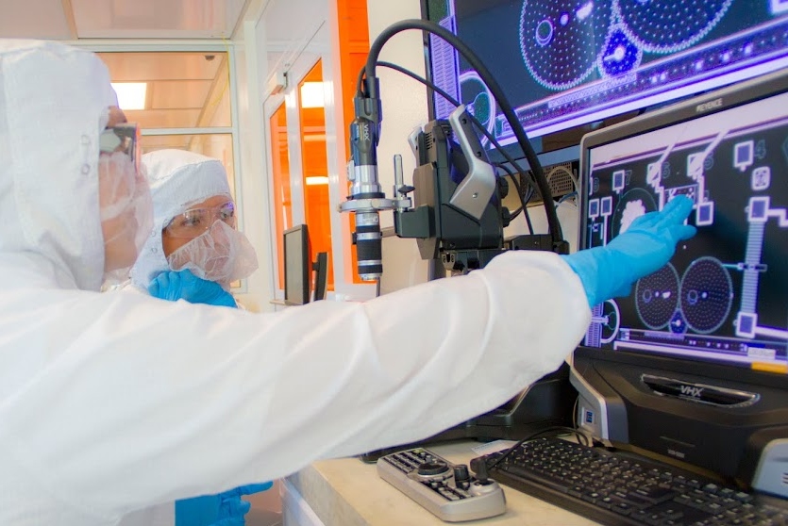
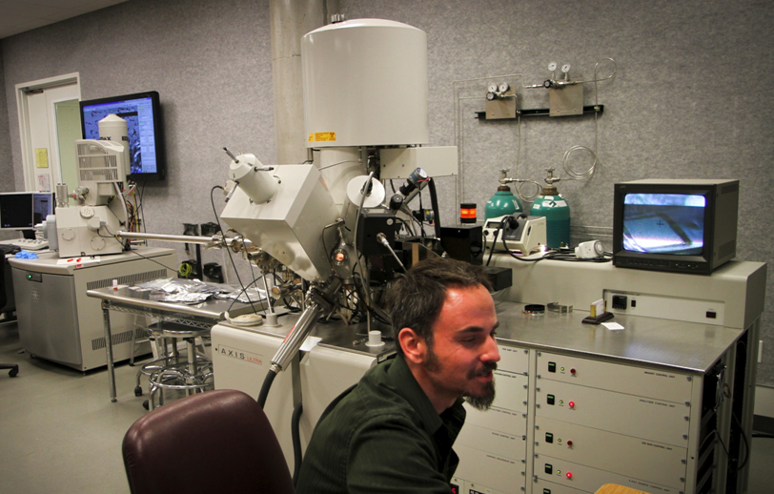
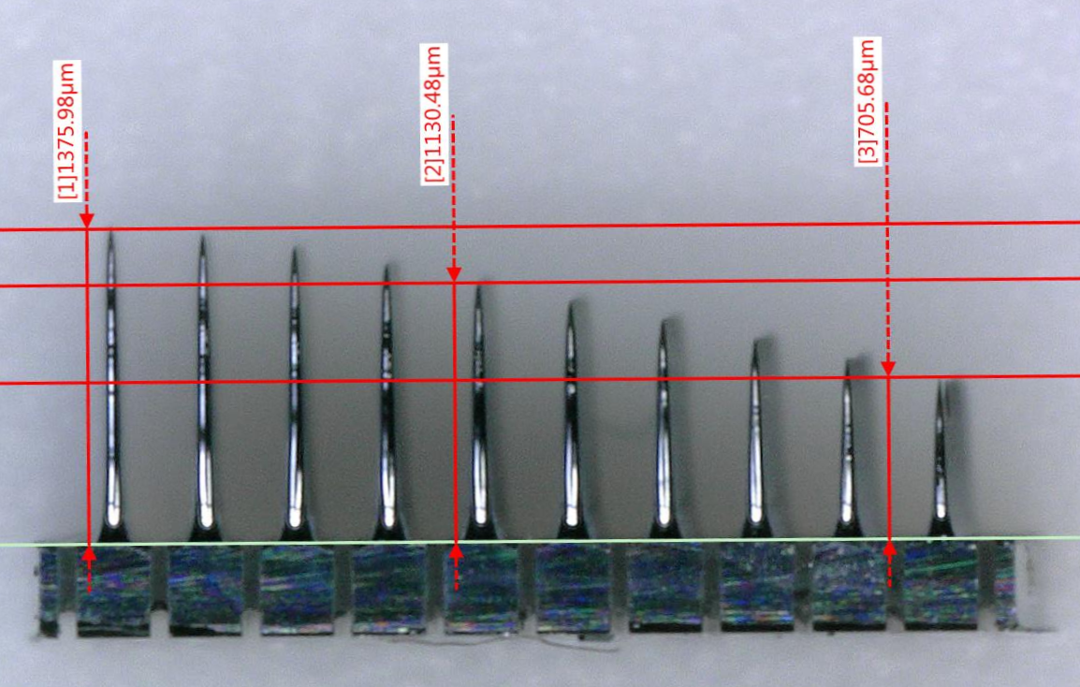
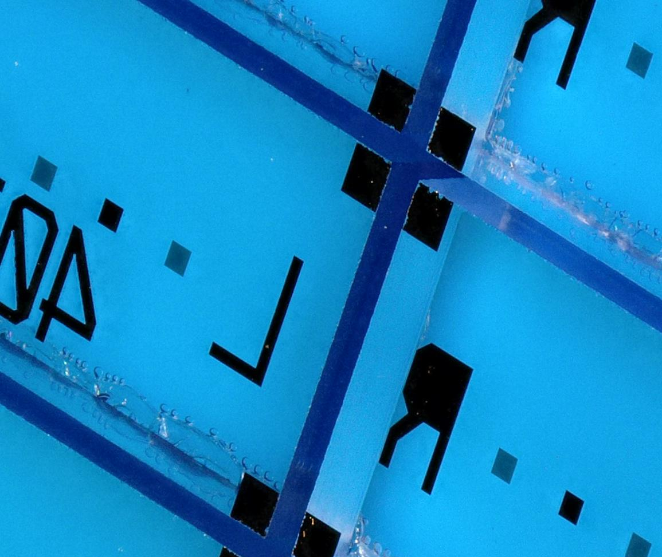
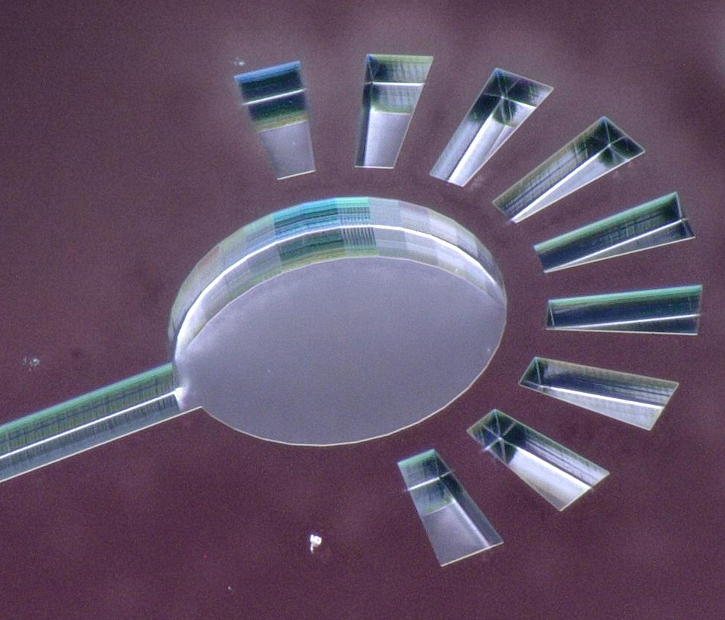
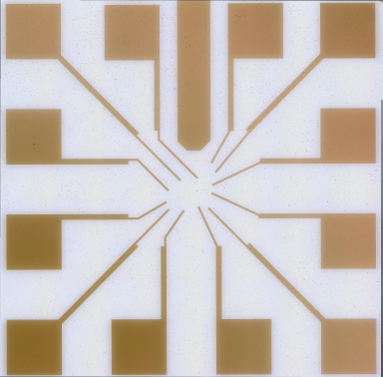
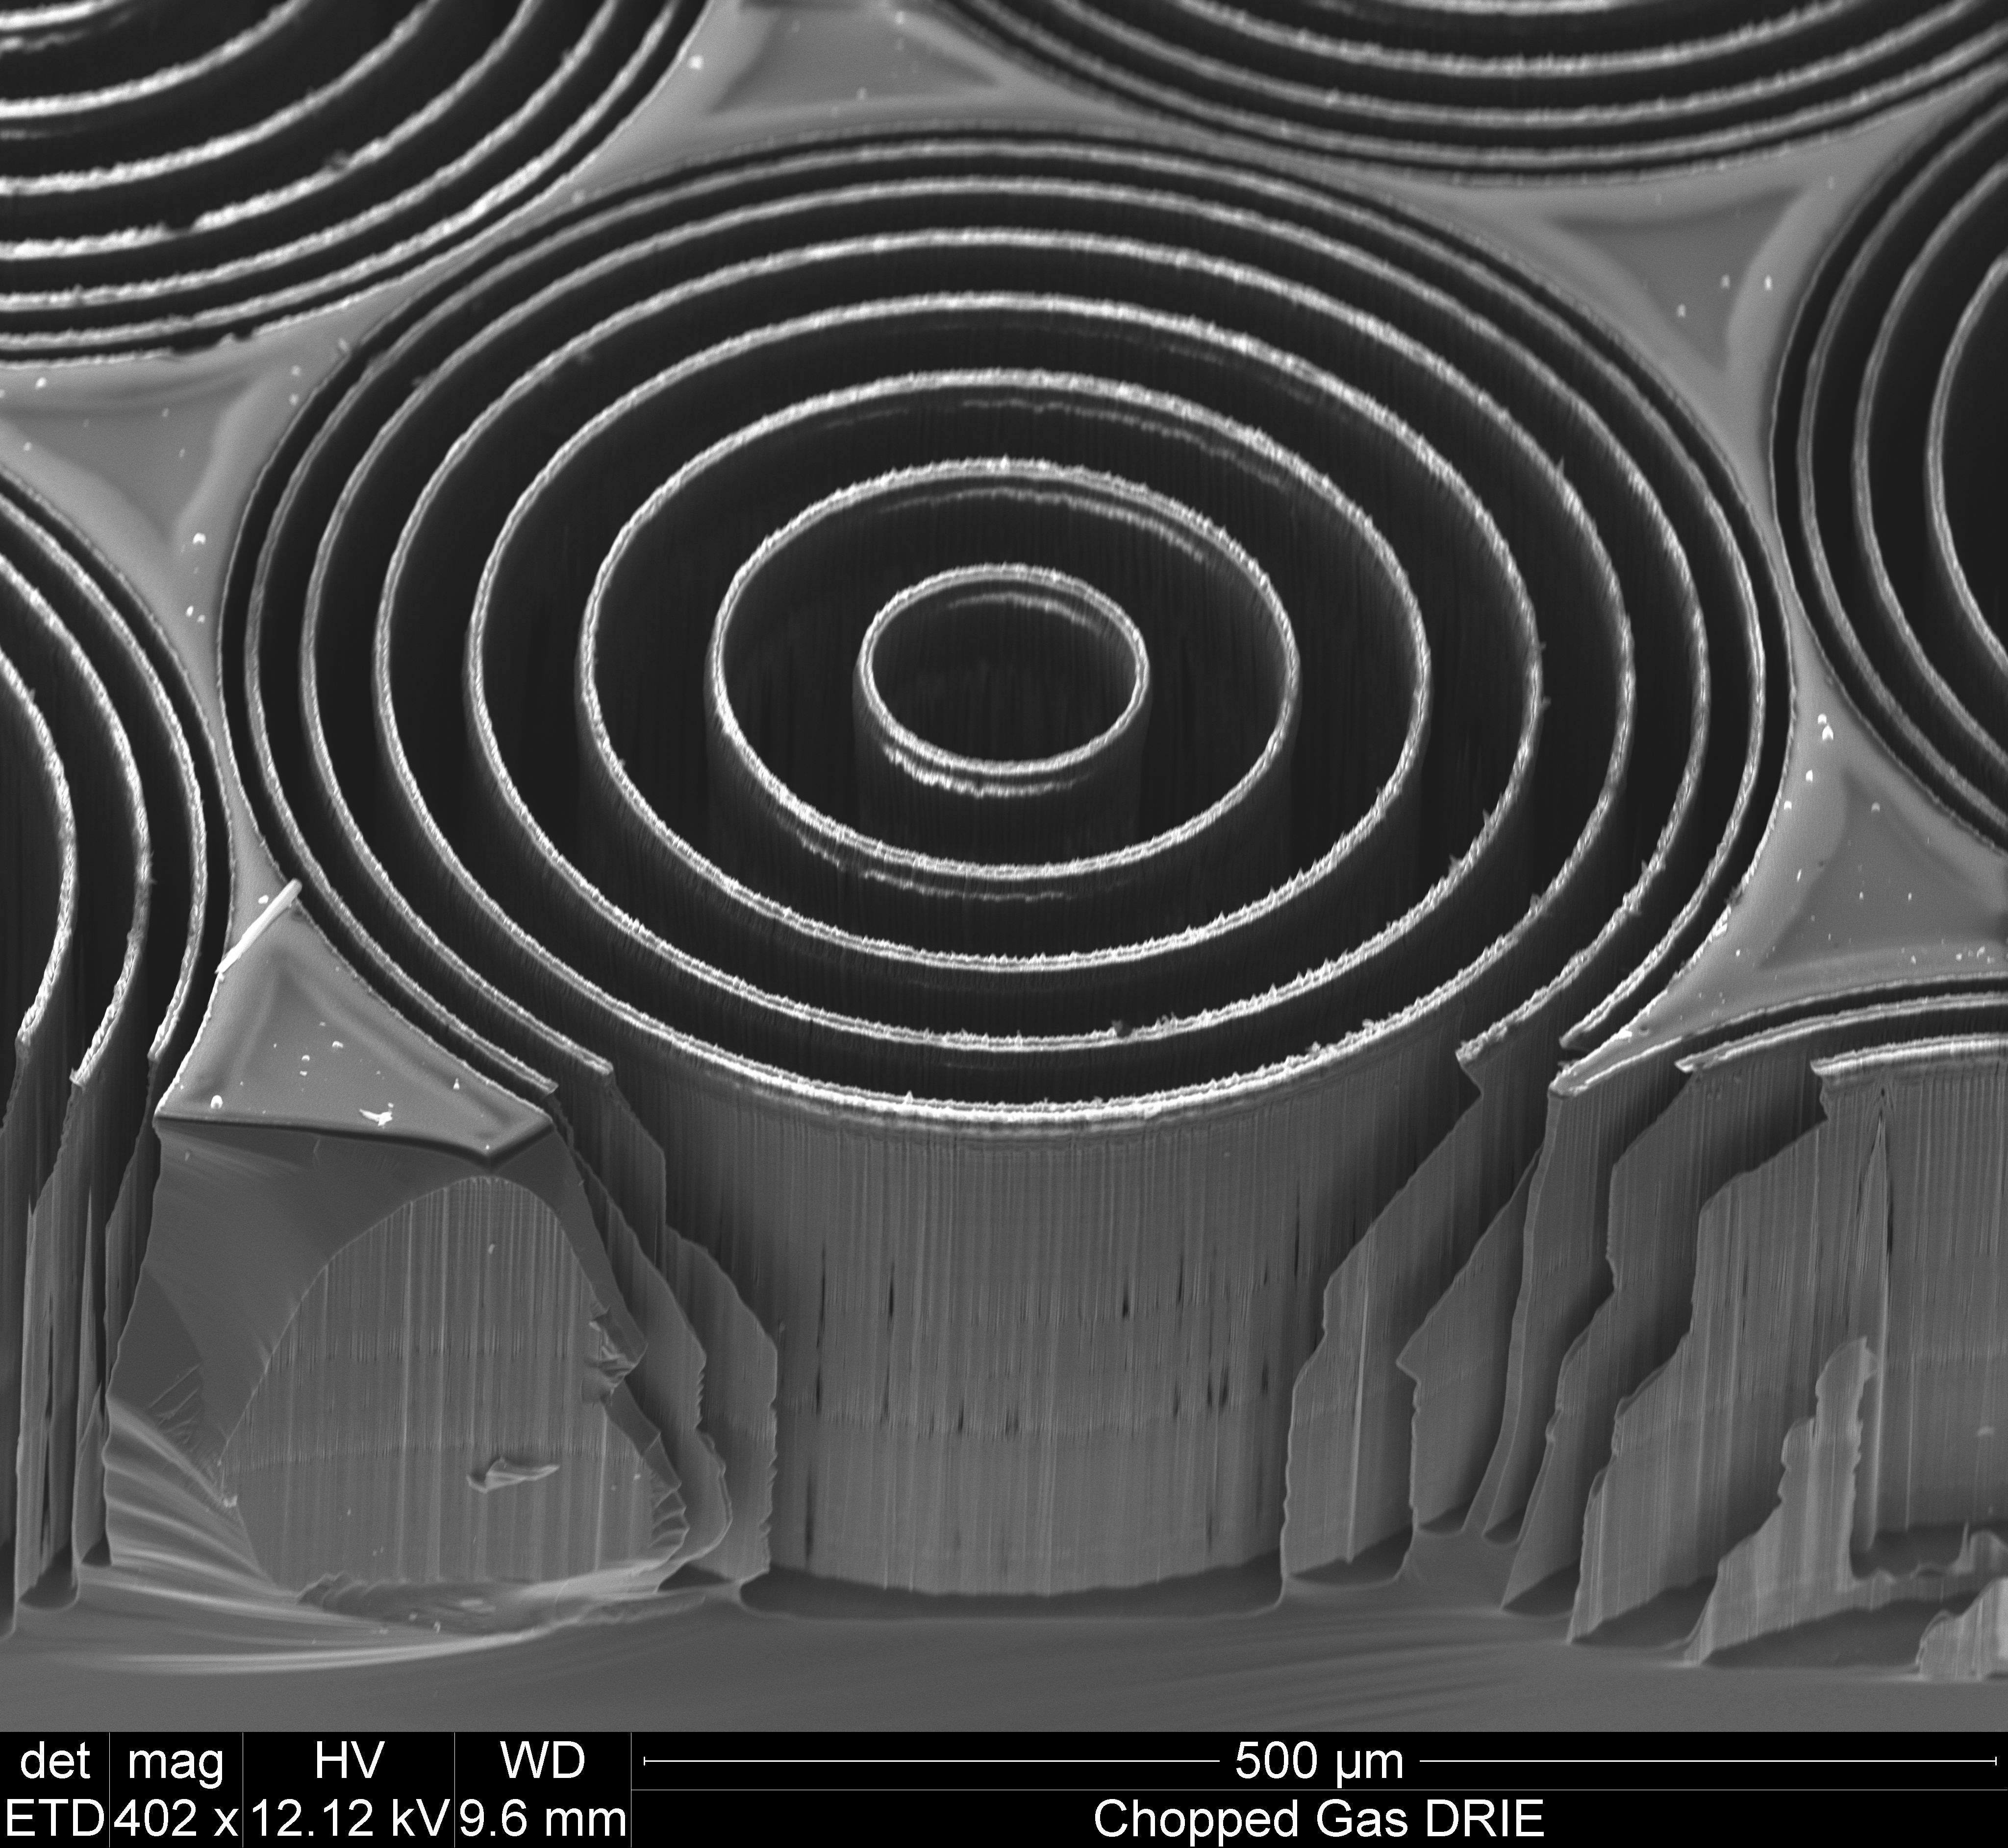
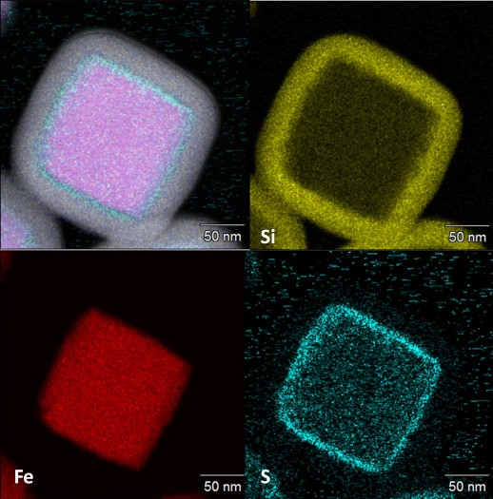
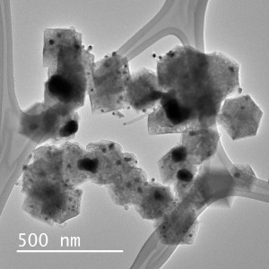
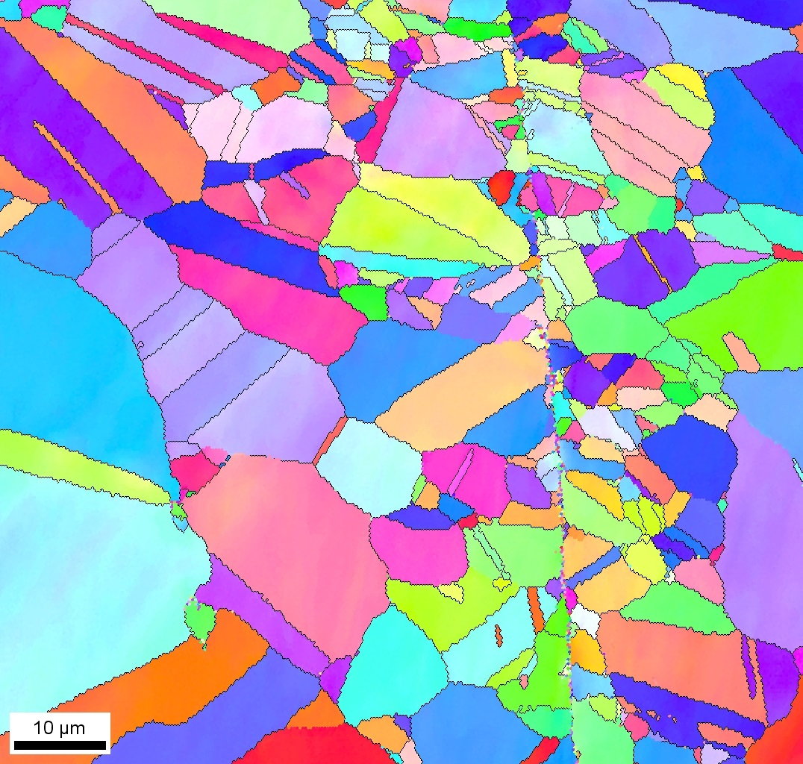
Center for Engineering Innovation
www.nanofab.utah.edu
Surface Analysis & nanoImaging
USTAR Cleanroom
• Thin film deposition and patterning
• Microfluidics
• Biomedical microsystems
• DRIE micromachining
• Microsystems packaging
• Electrical characterization
• Correlative multi-scale analytical microscopy
• Fast, hi-res analytical electron imaging
• AFM, SEM, dbFIB, S/TEM
• Surface analysis
• Microsensors and actuators
• System prototypes
Build it.
Look at it.
Commercialize it.

