Slide 1
AZ 9260 Characterization
By: Timothy Kowalchik and Keeton Hodgson

Slide 2
Recipe Details
Cycles: 200
Chuck Temperature: 15°C
Helium Back Pressure: 10 Torr
Set Pressure: 0mTorr
Actual Pressure: 17/14 SF6/C4F8 mTorr
ICP Forward Power: 500 W
RF Forward Power: 25/10 W SF6/C4F8
RF Bias: 97/55 SF6/C4F8 V
Flow Rates: 80:80 SF6/C4F8
Etch:Deposition Time: 9:5, 10:5, 11:5, 12:5, 13:5, SF6:C4F8
Questions? Contact Tim Kowalchik at u0494768@utah.edu

Slide 3
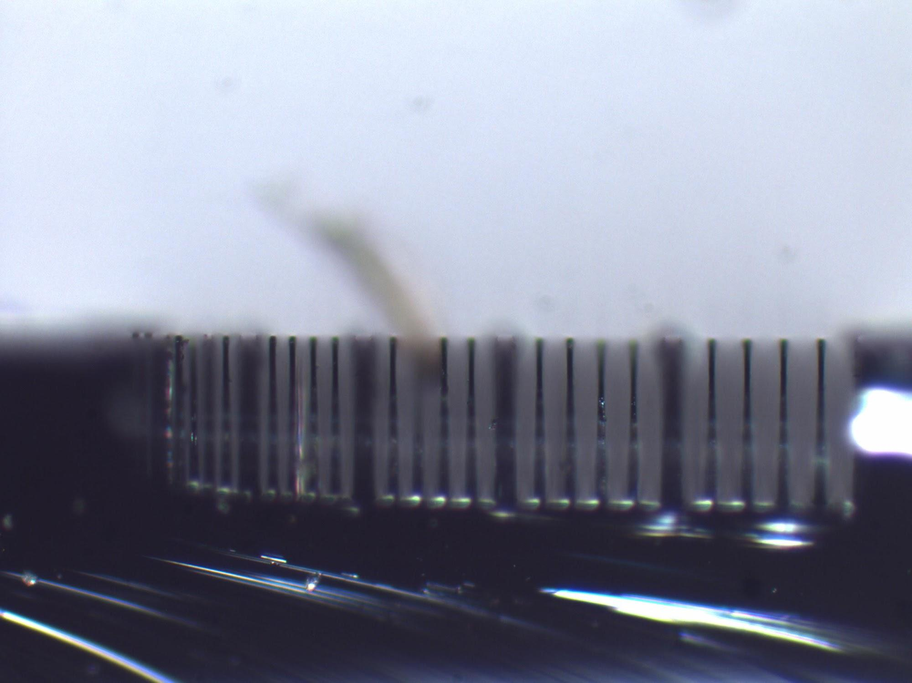
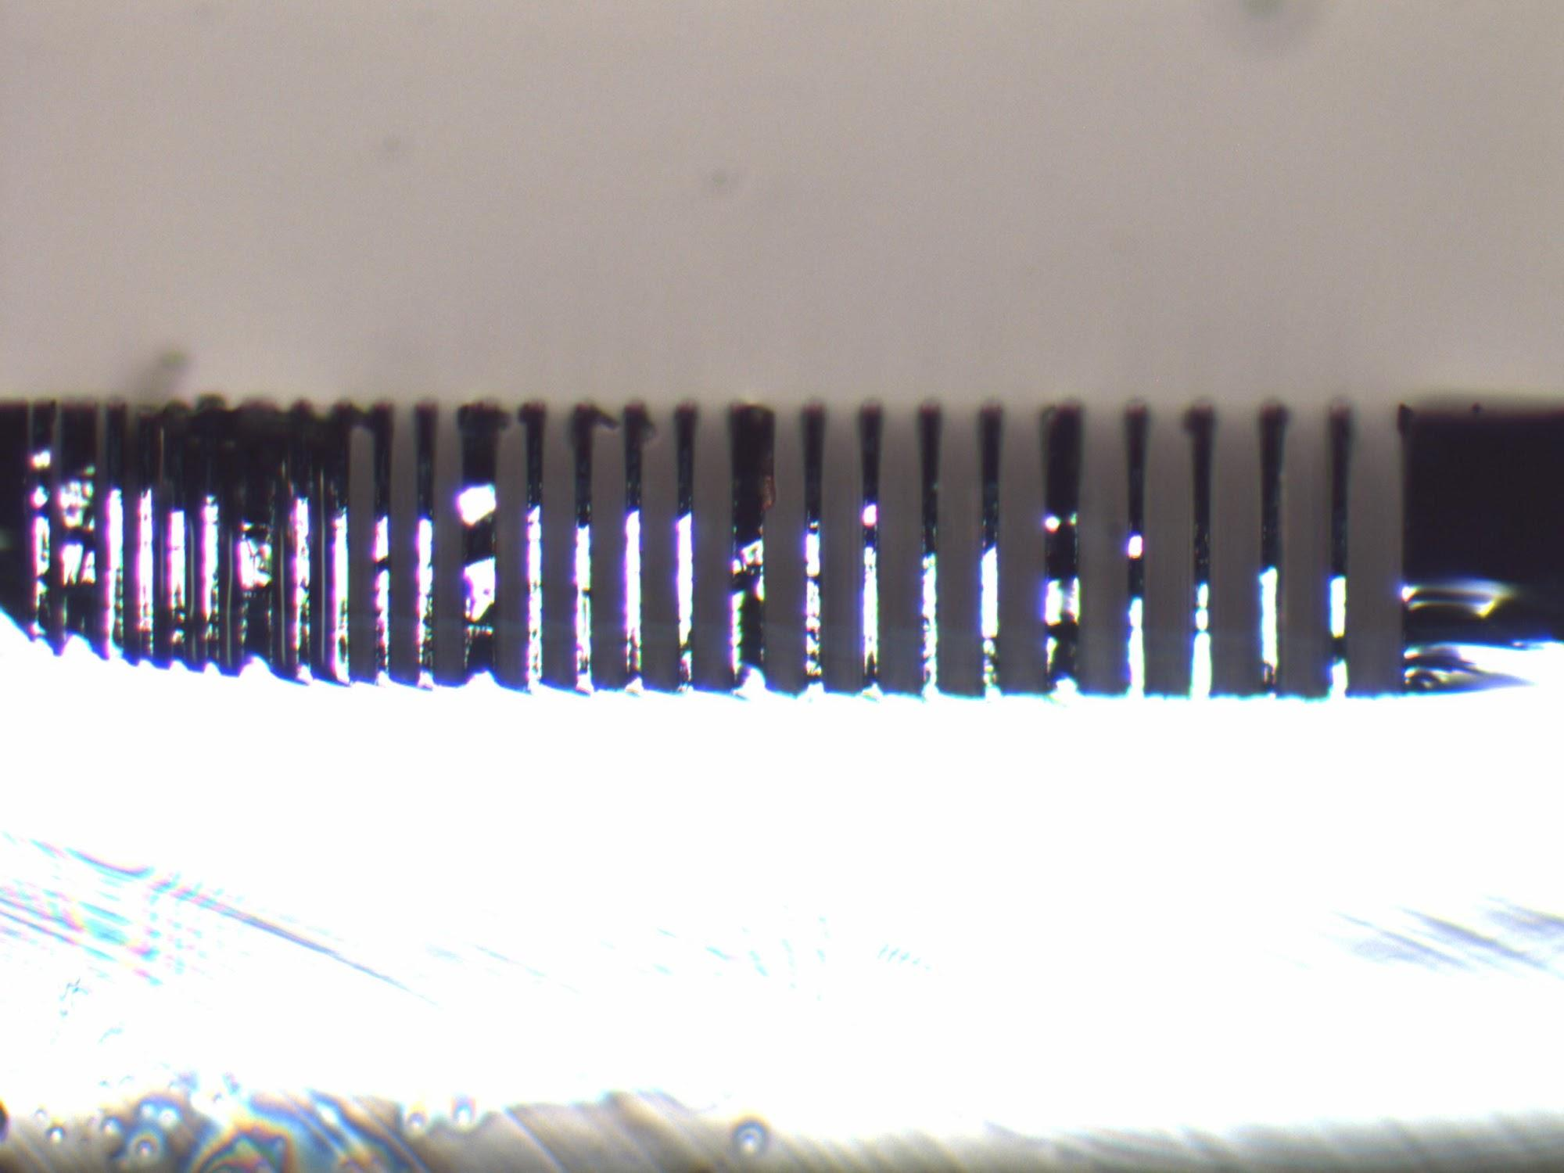
9:5 and 10:5 Trenches
Etch:Dep Time: 9:5
Si Etch Rate: 0.79 um per cycle
Pr Etch Rate: 4.65 nm per cycle
Trench Etch Depth: 158 um
Trench Sidewall Angle: 88.881°
Date: 1/18/2013
Etch:Dep Time: 10:5
Si Etch Rate: 0.79 um per cycle
Pr Etch Rate: 7 nm per cycle
Trench Etch Depth: 158 um
Trench Sidewall Angle: 90.621 °
Date: 1/24/2013

Slide 4
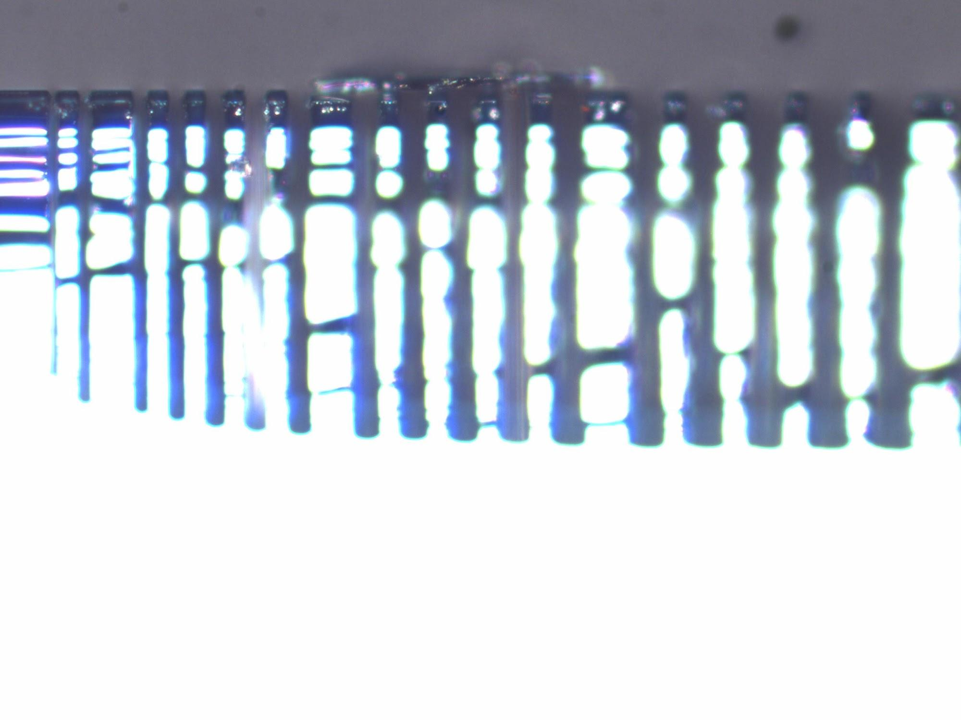
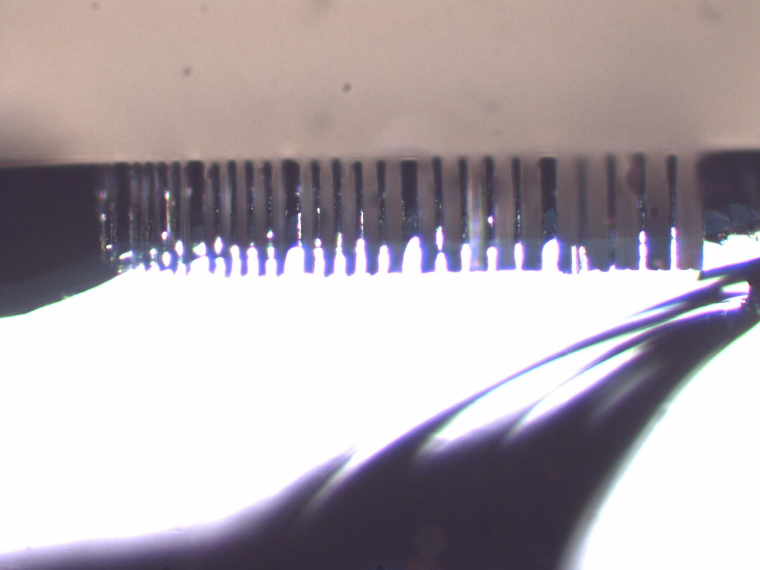
11:5 and 12:5 Trenches
Etch:Dep Time: 11:5
Si Etch Rate: 0.805 um per cycle
Pr Etch Rate: 9 nm per cycle
Trench Etch Depth: 161 um
Trench Sidewall Angle: 90.907°
Date: 2/4/2013
Etch:Dep Time: 12:5
Si Etch Rate: 0.69 um per cycle
Pr Etch Rate: 9 nm per cycle
Trench Etch Depth: 138 um*
Trench Sidewall Angle: 91.121°
Date: 2/1/2013

Slide 5
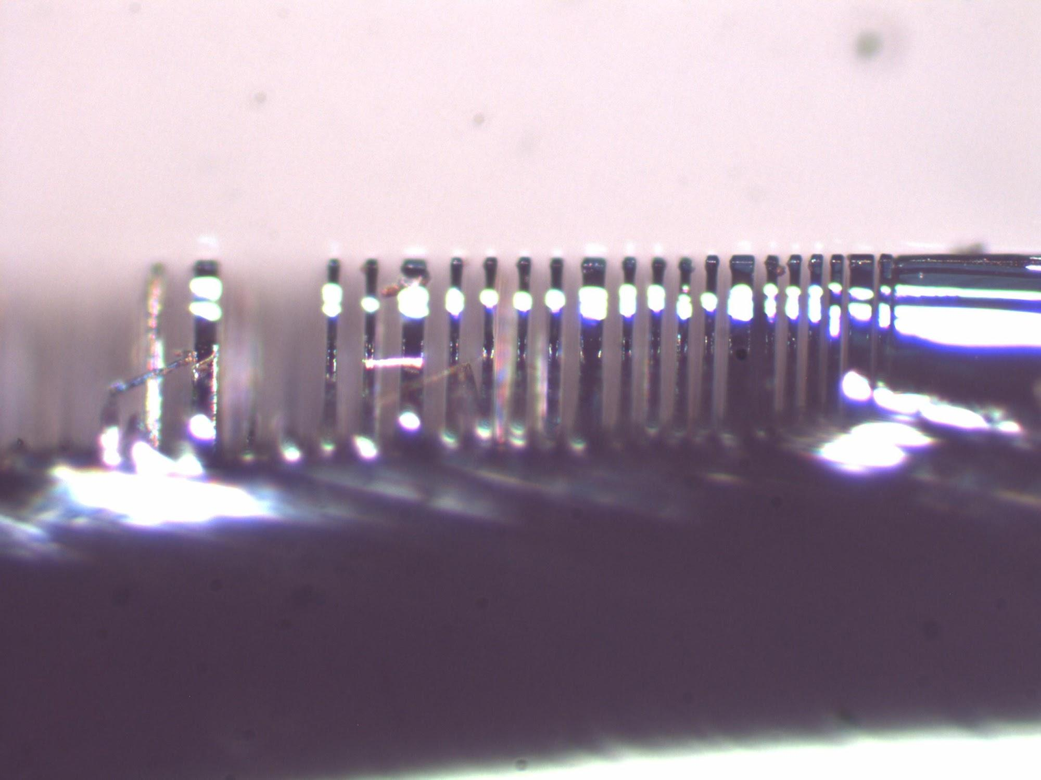
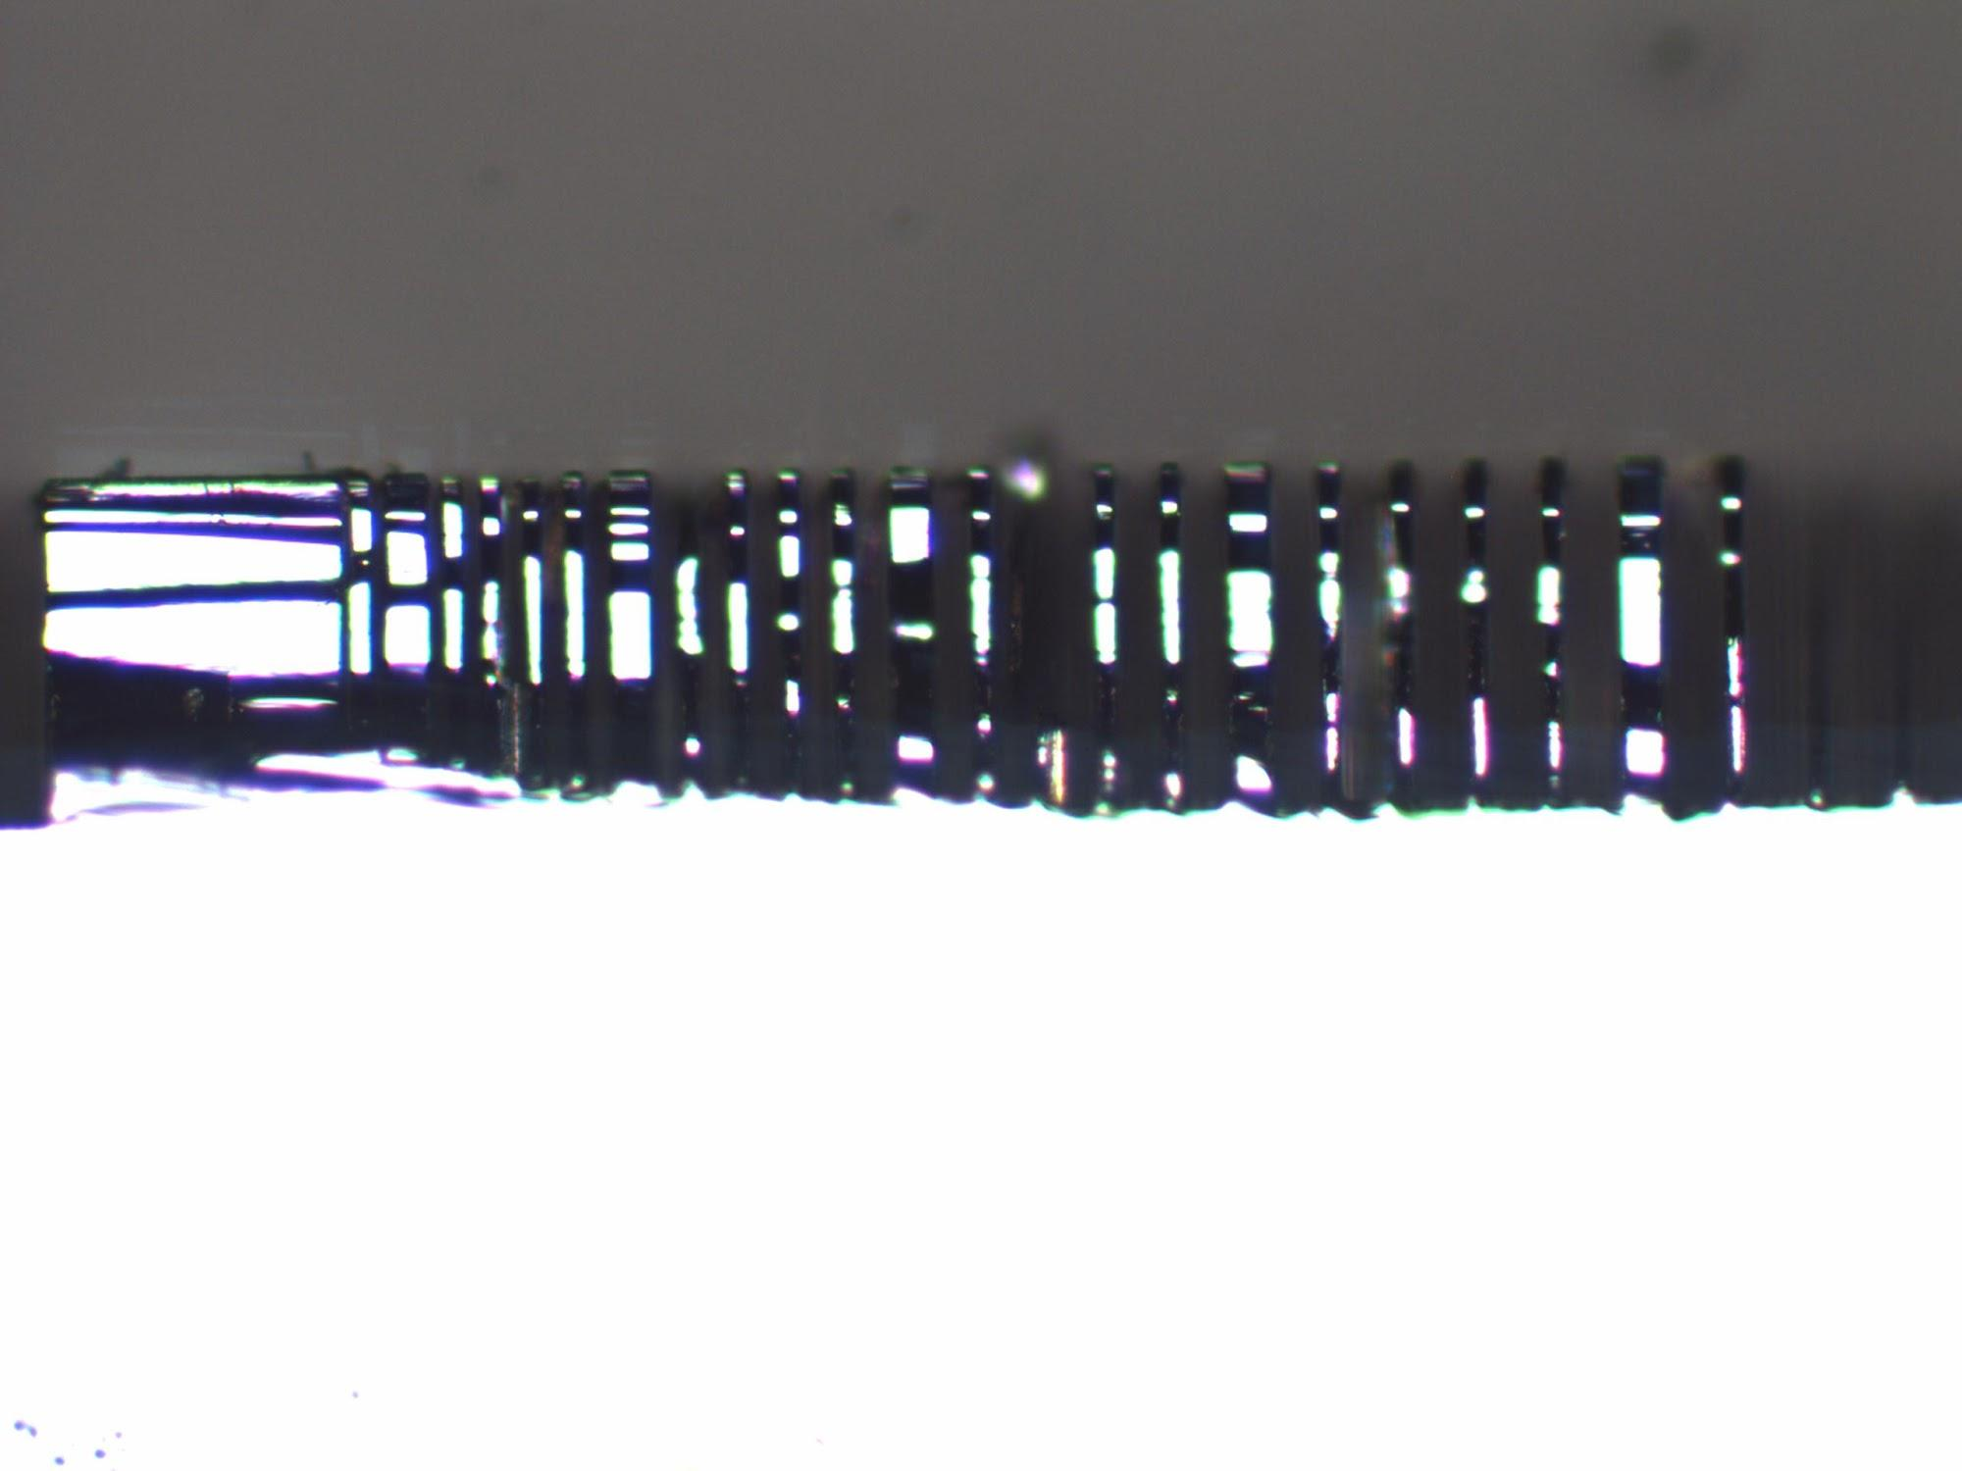
13:5 and 14:5 Trenches
Etch:Dep Time: 13:5
Si Etch Rate: 0.8 um per cycle
Pr Etch Rate: 12.5 nm per cycle
Trench Etch Depth: 160 um
Trench Sidewall Angle: 91.11°
Date: 2/4/2013
Etch:Dep Time: 14:5
Si Etch Rate: 0.8 um per cycle
Pr Etch Rate: 13 nm per cycle
Trench Etch Depth: 160 um
Trench Sidewall Angle: 91.137°
Date: 2/8/2013

Slide 6
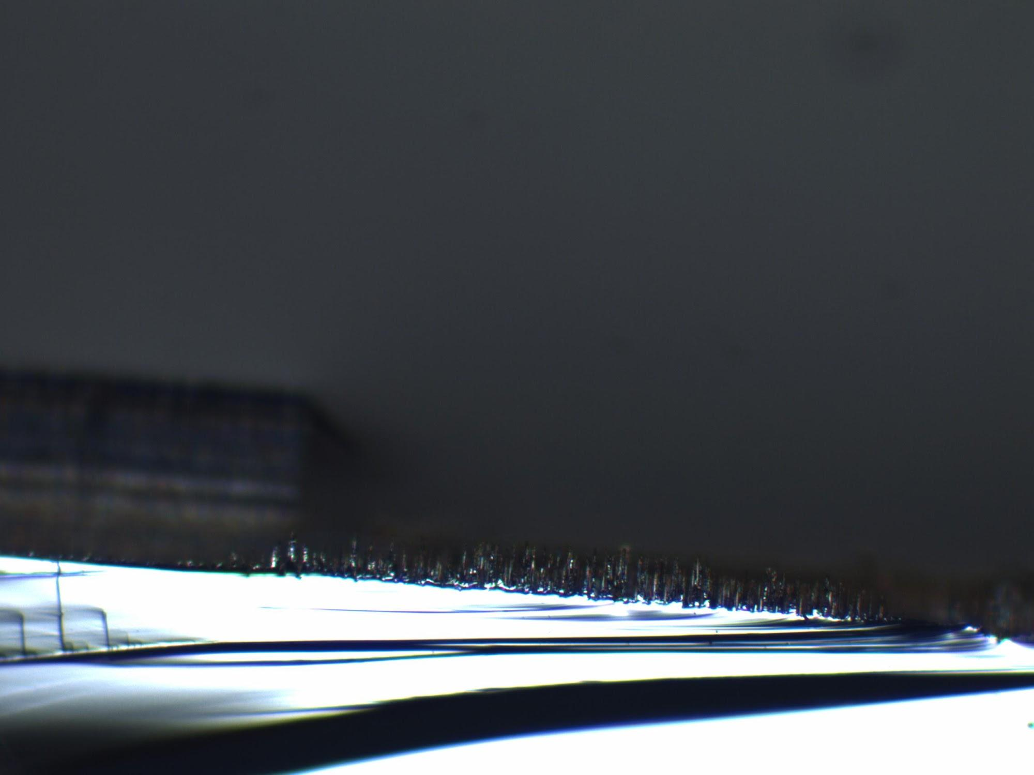
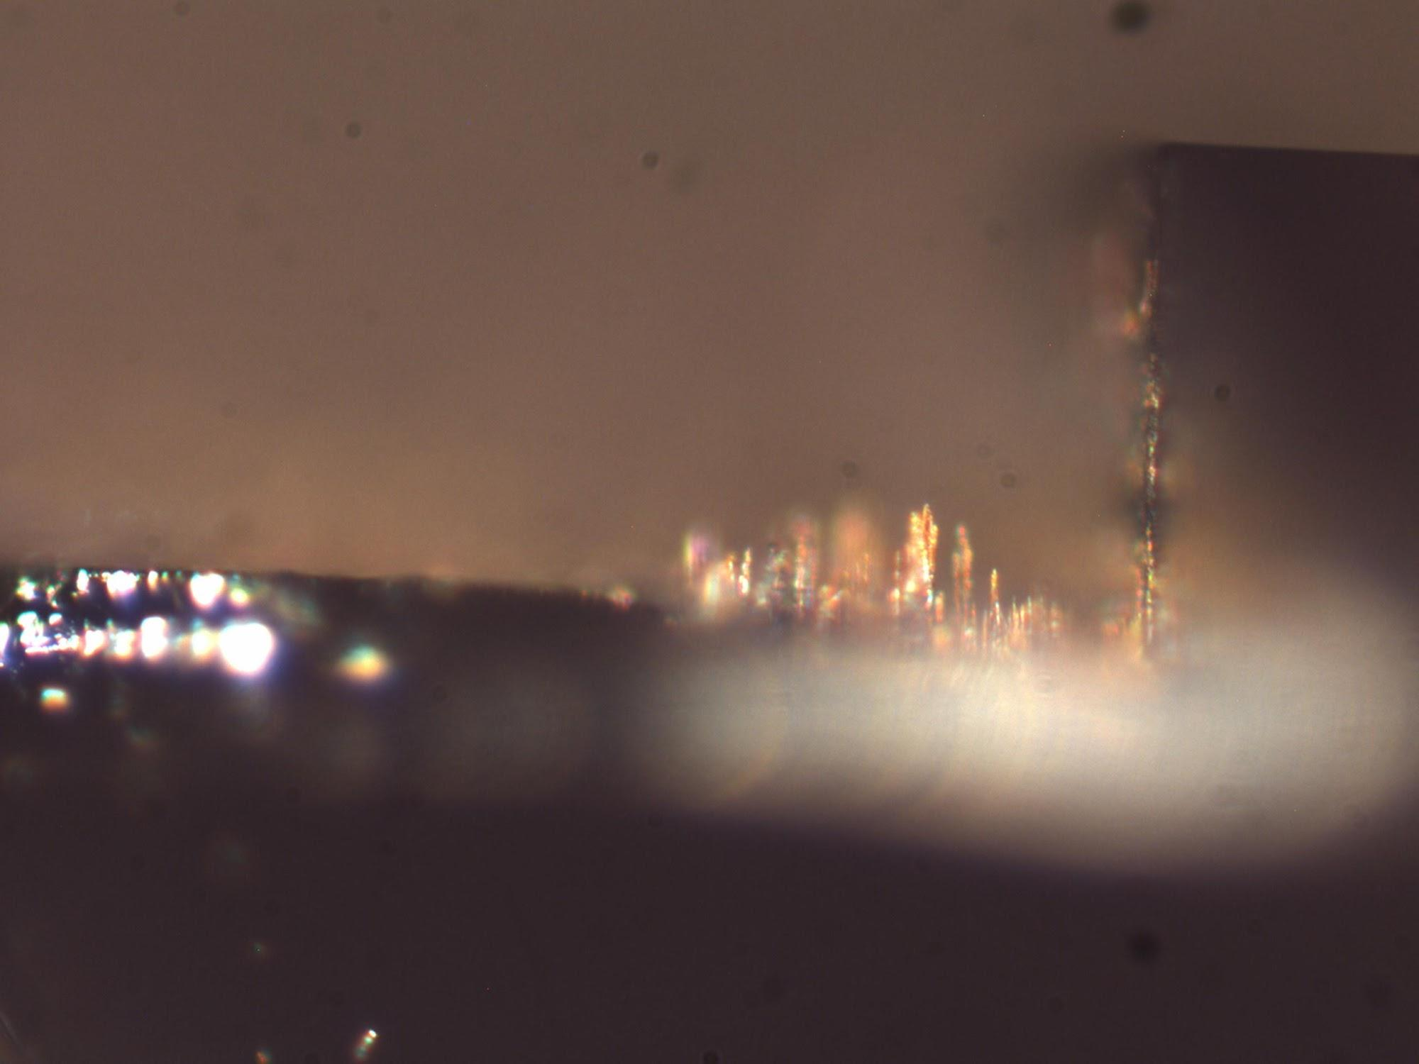
9:5 and 10:5 Large Areas
Etch:Dep Time: 9:5
Top to Grass: 122 um
Sidewall Height: 158 um
Etch:Dep Time: 10:5
Top to Grass: 120.9 um
Sidewall Height: 158 um

Slide 7
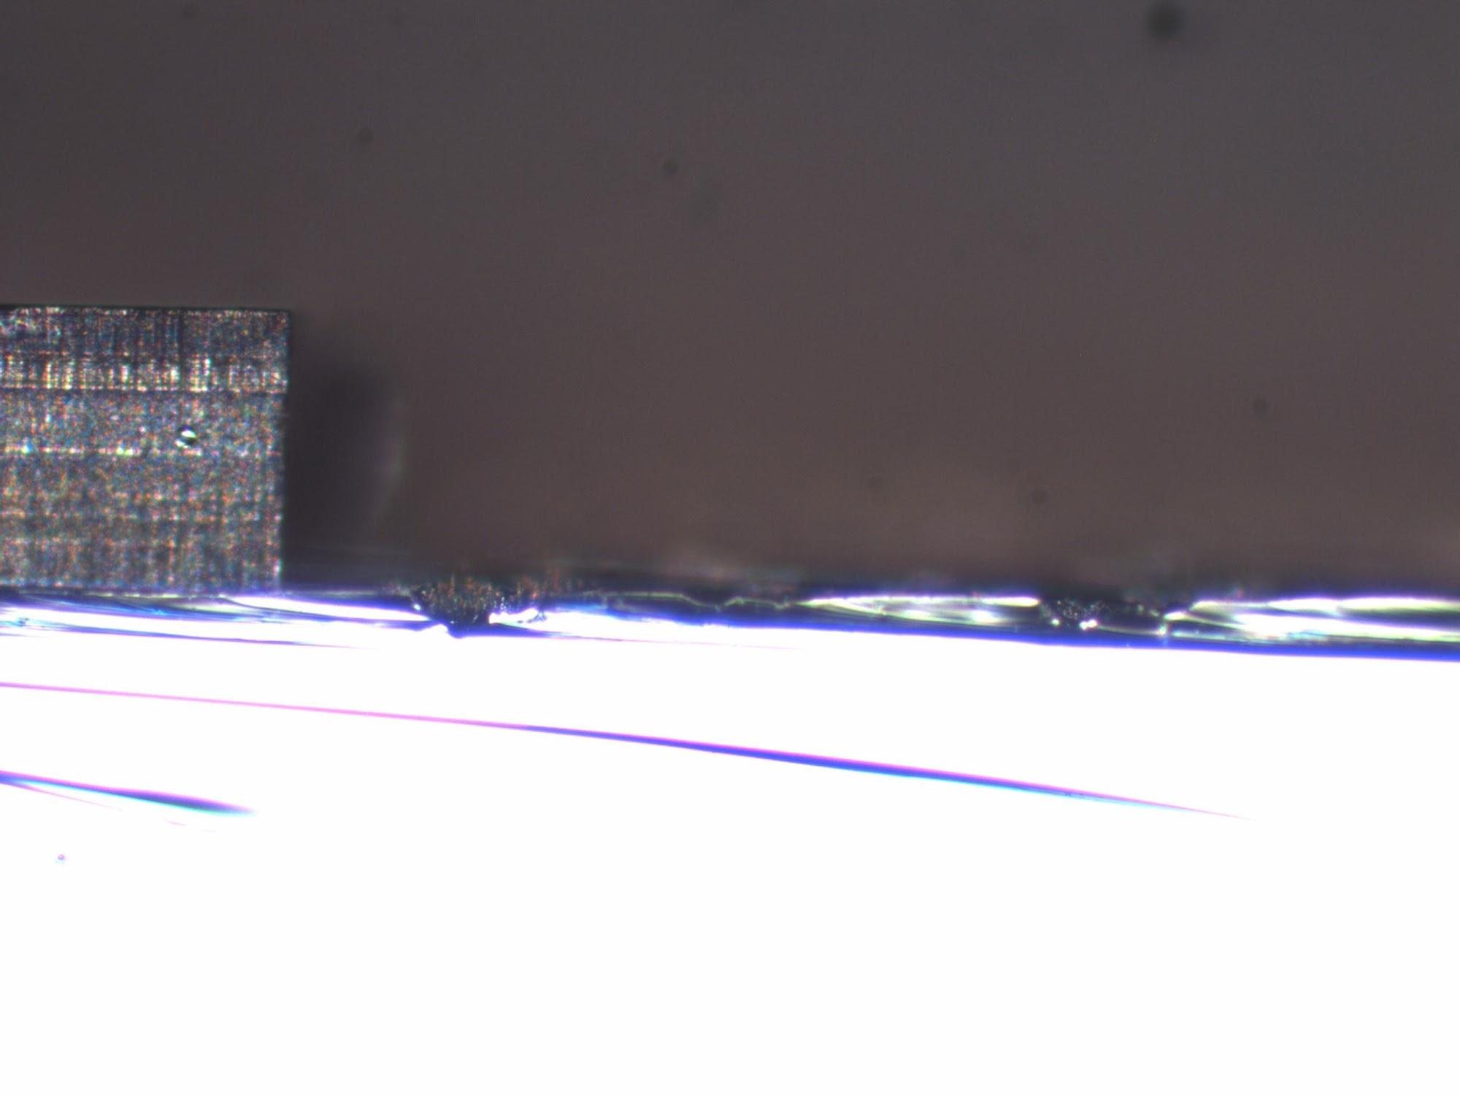
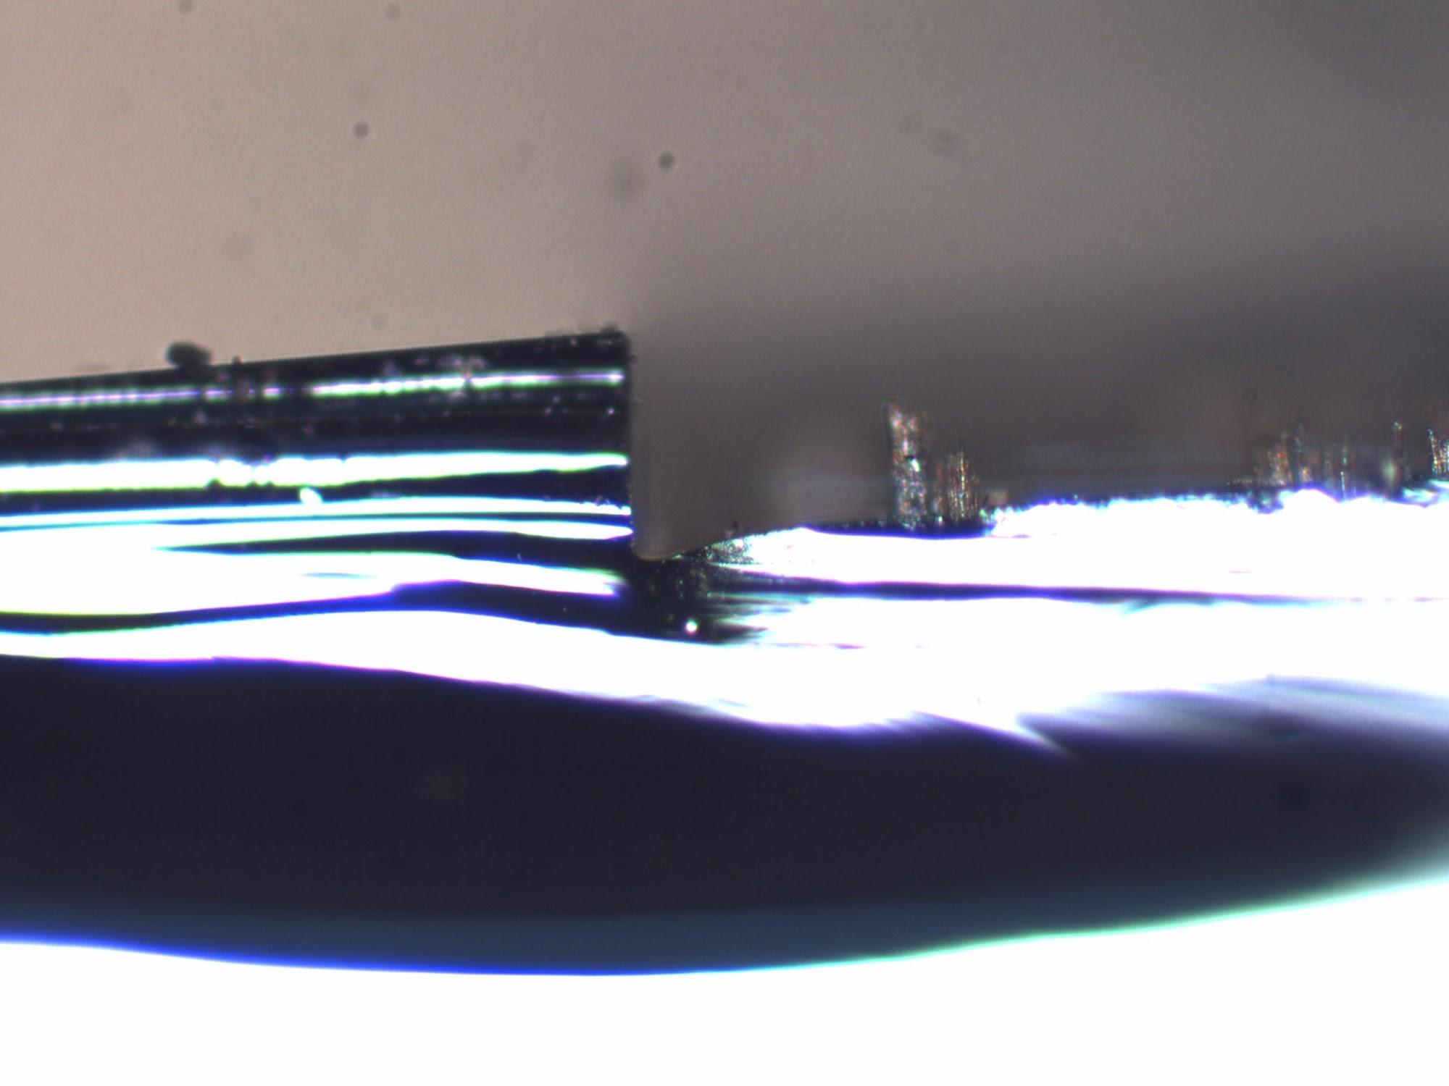
11:5 and 12:5 Large Areas
Etch:Dep Time: 11:5
Top to Grass: 153.4 um
Sidewall Height: 172 um
Etch:Dep Time: 12:5
Top to Grass: 58* um
Sidewall Height: 139 um

Slide 8
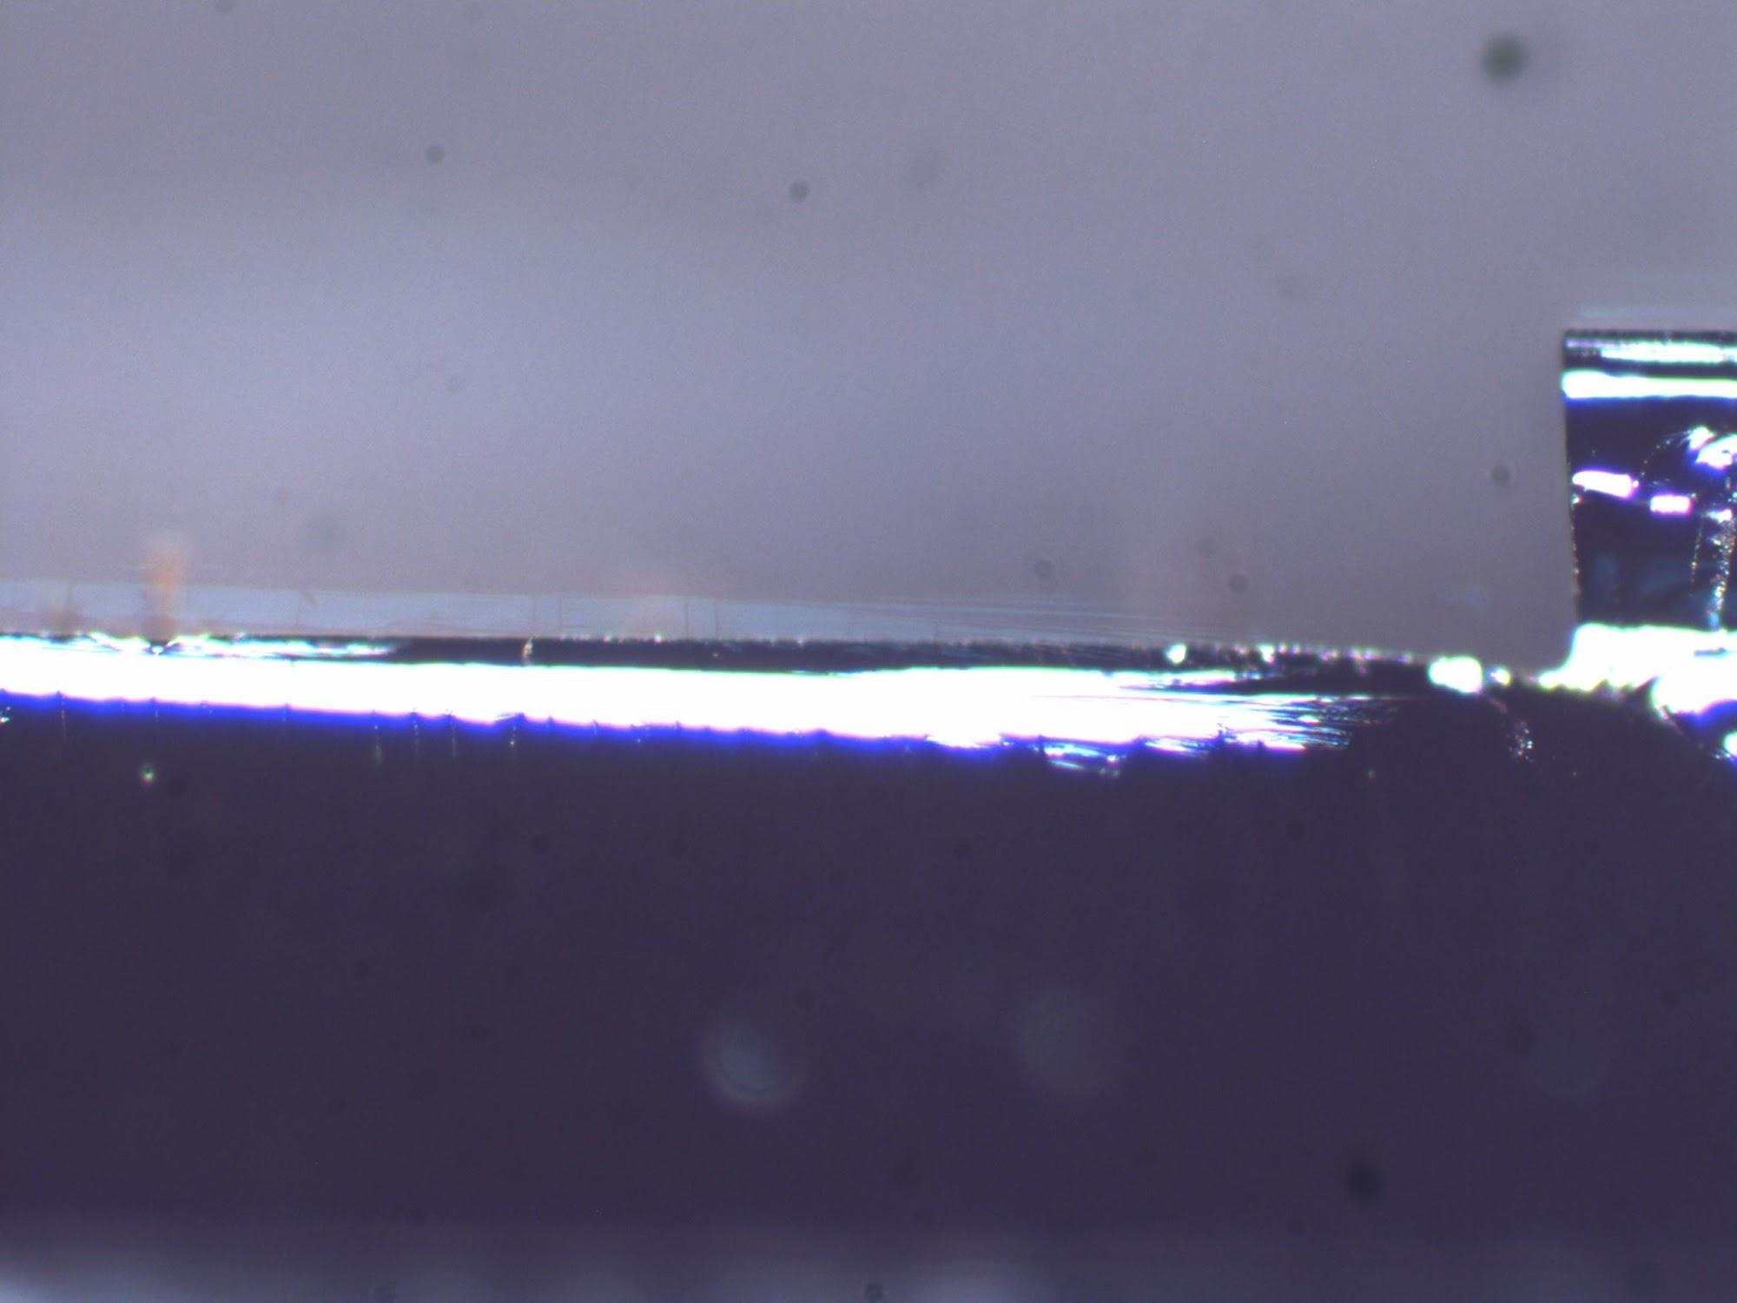
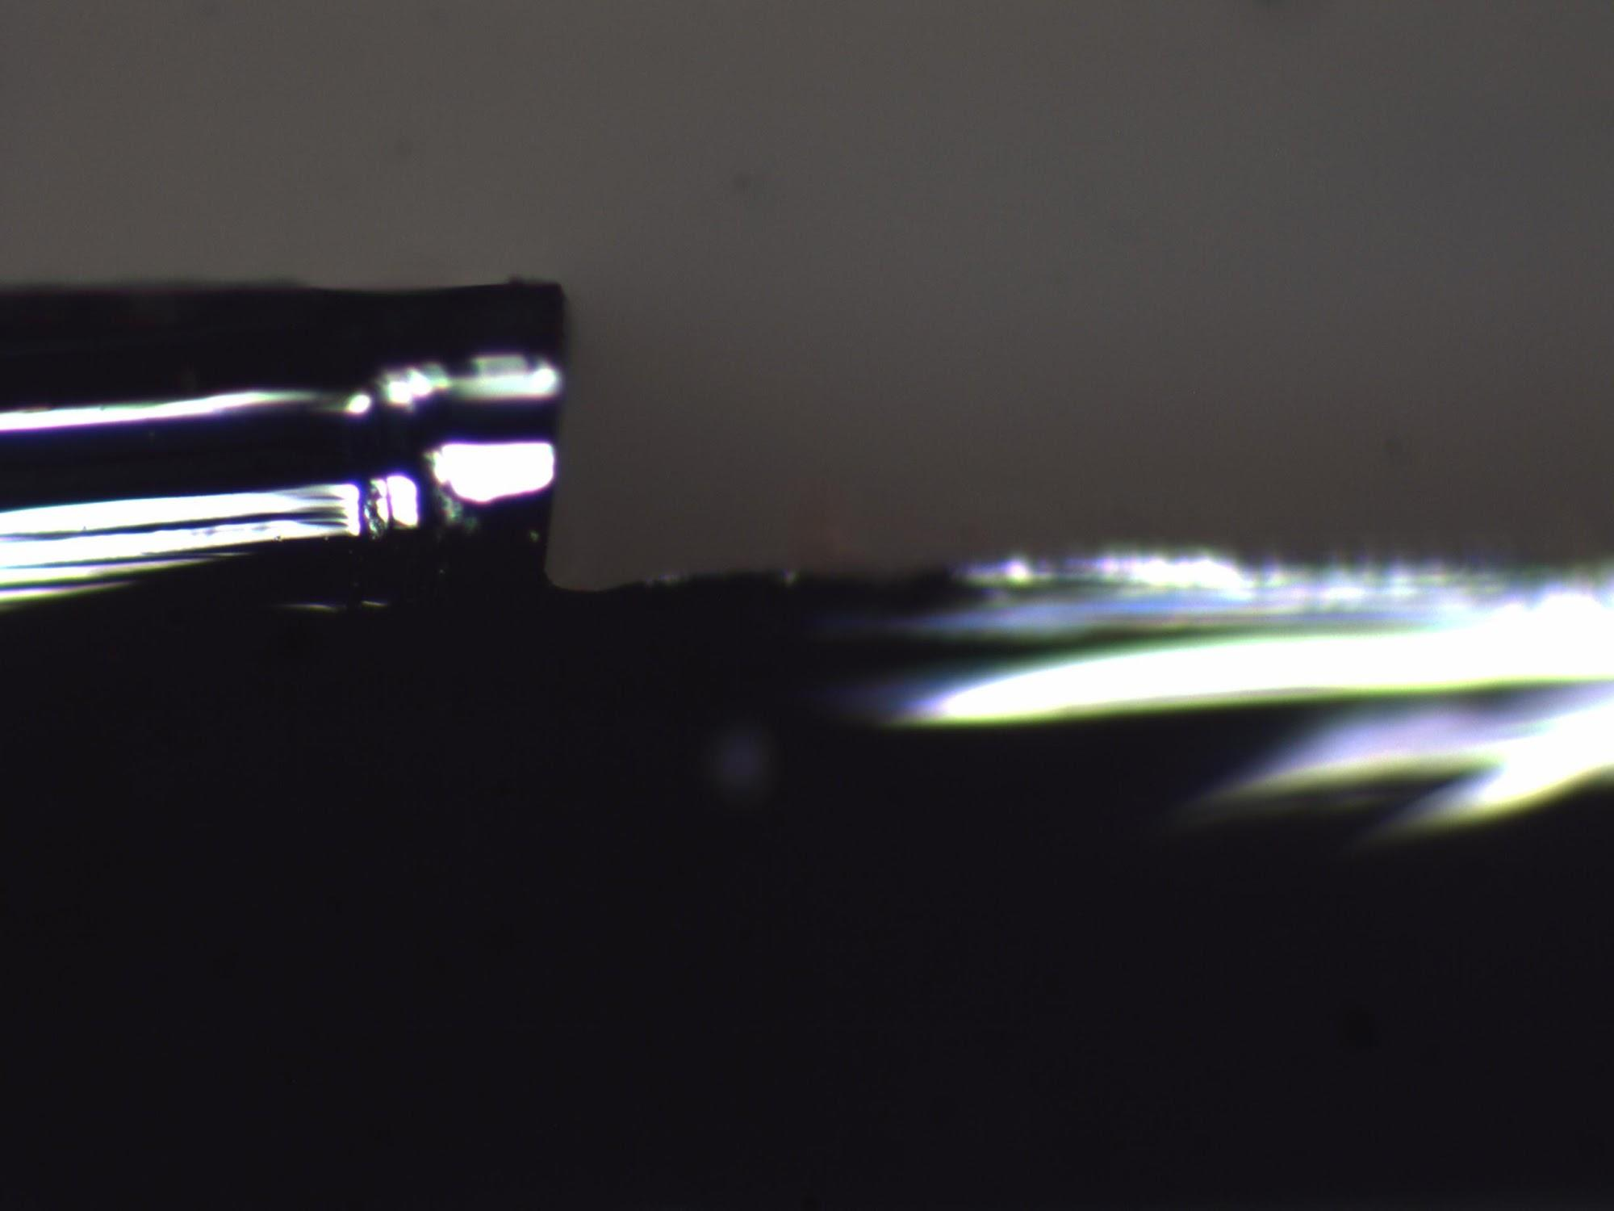
13:5 and 14:5 Large Areas
Etch:Dep Time: 13:5
Top to Grass: 116.4 um
Sidewall Height: 159 um
Etch:Dep Time: 14:5
Top to Grass: 116.4 um
Sidewall Height: 158 um

Slide 9
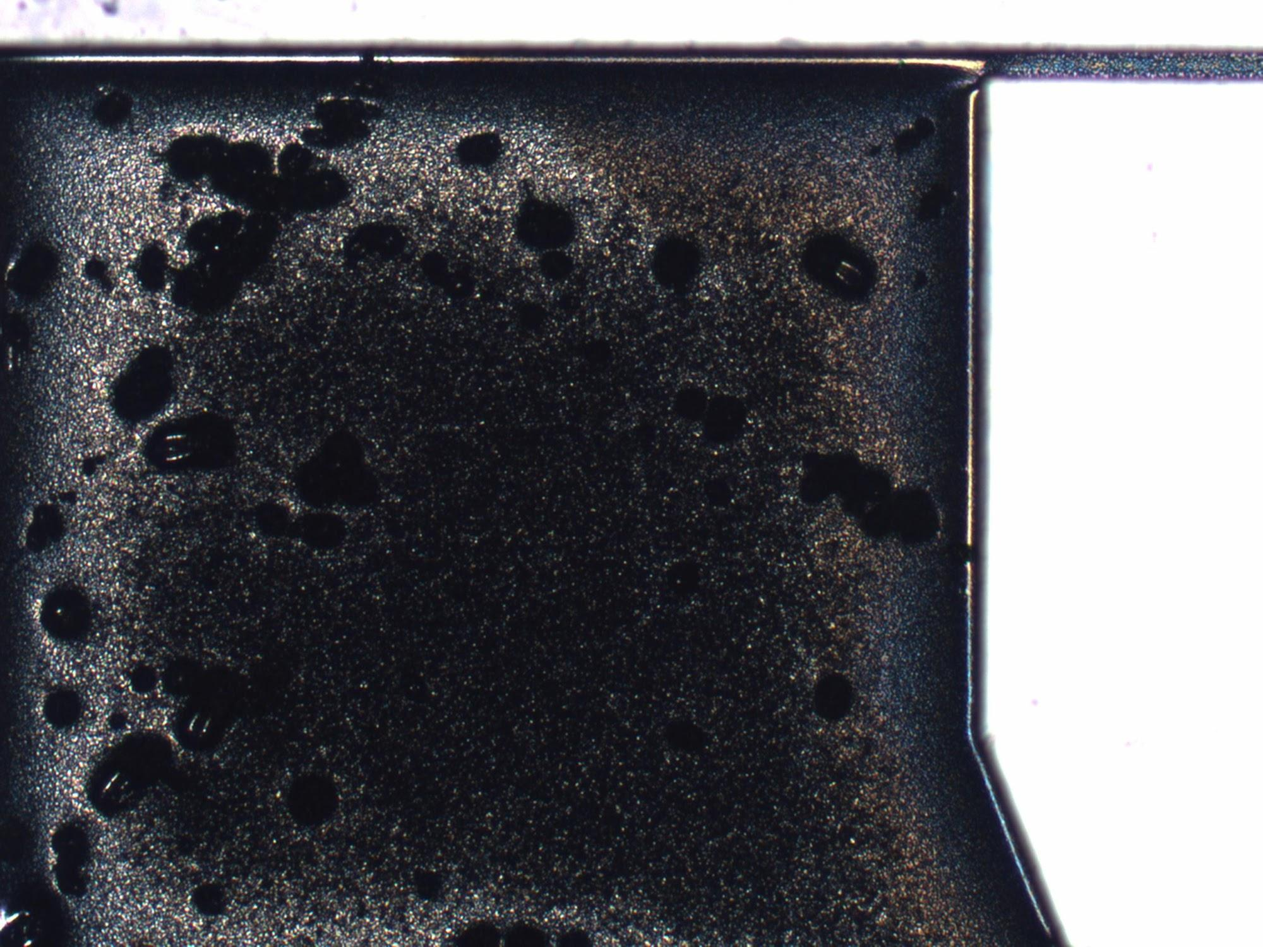
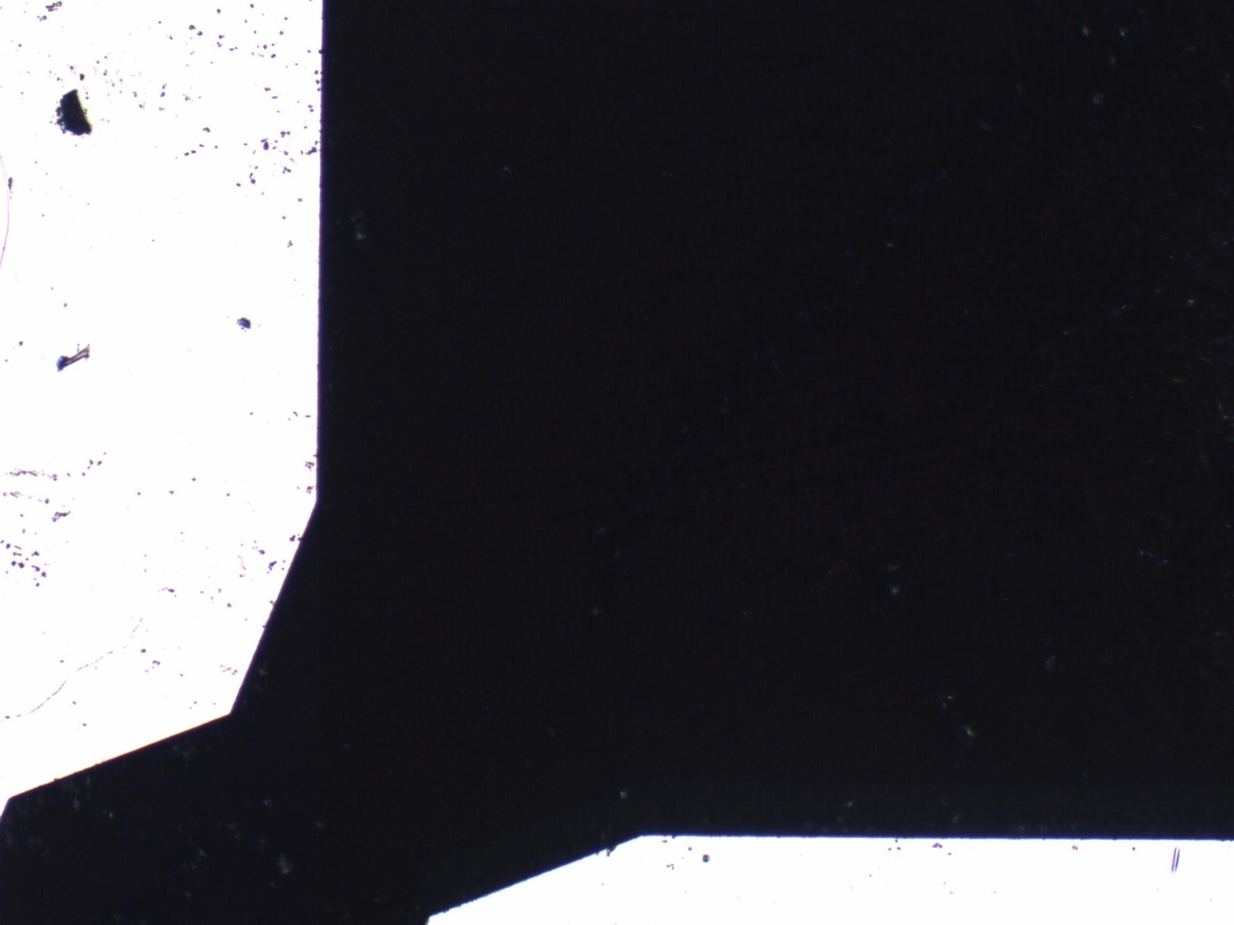
9:5 and 10:5 Top View

Slide 10
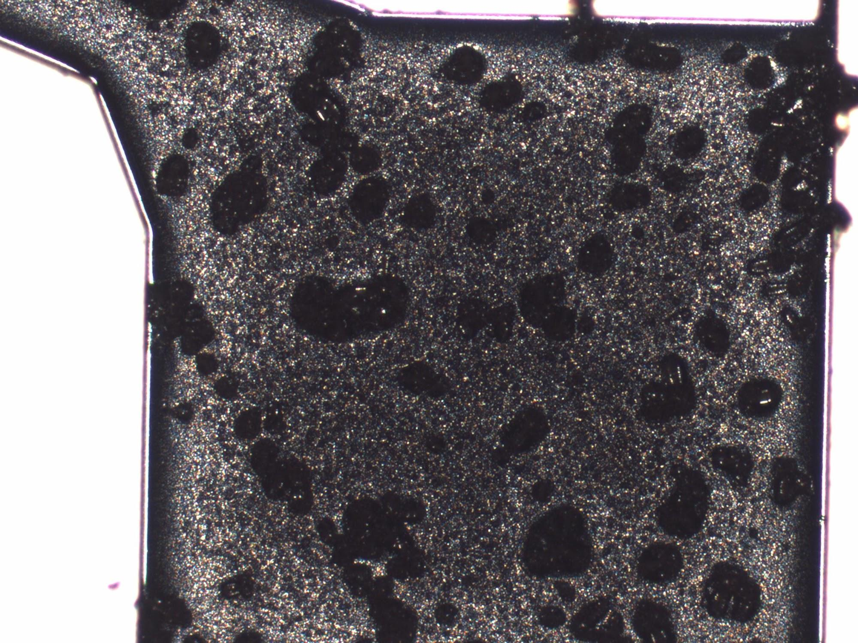
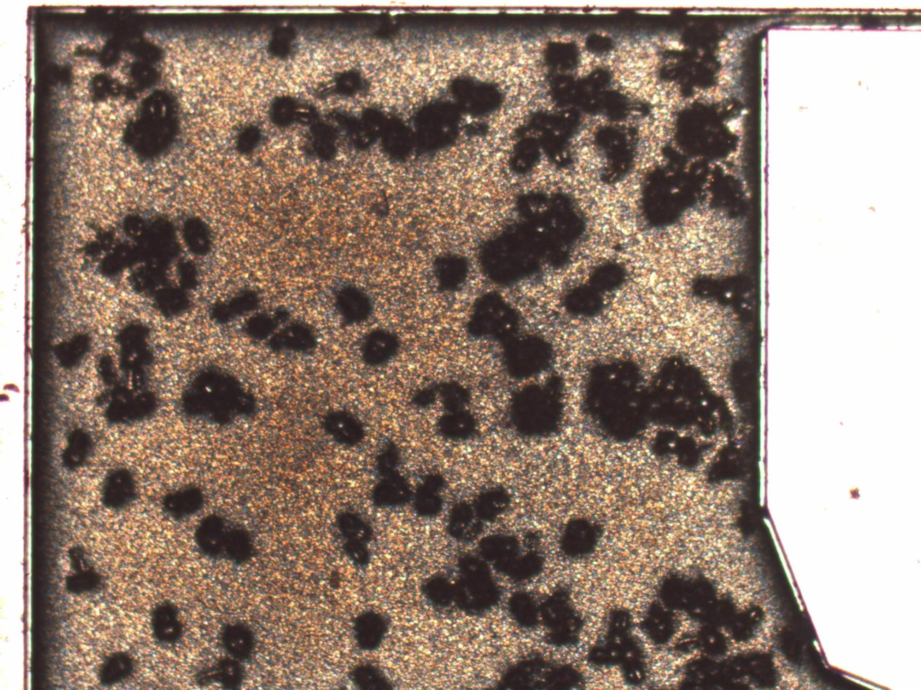
11:5 and 12:5 Top View

Slide 11
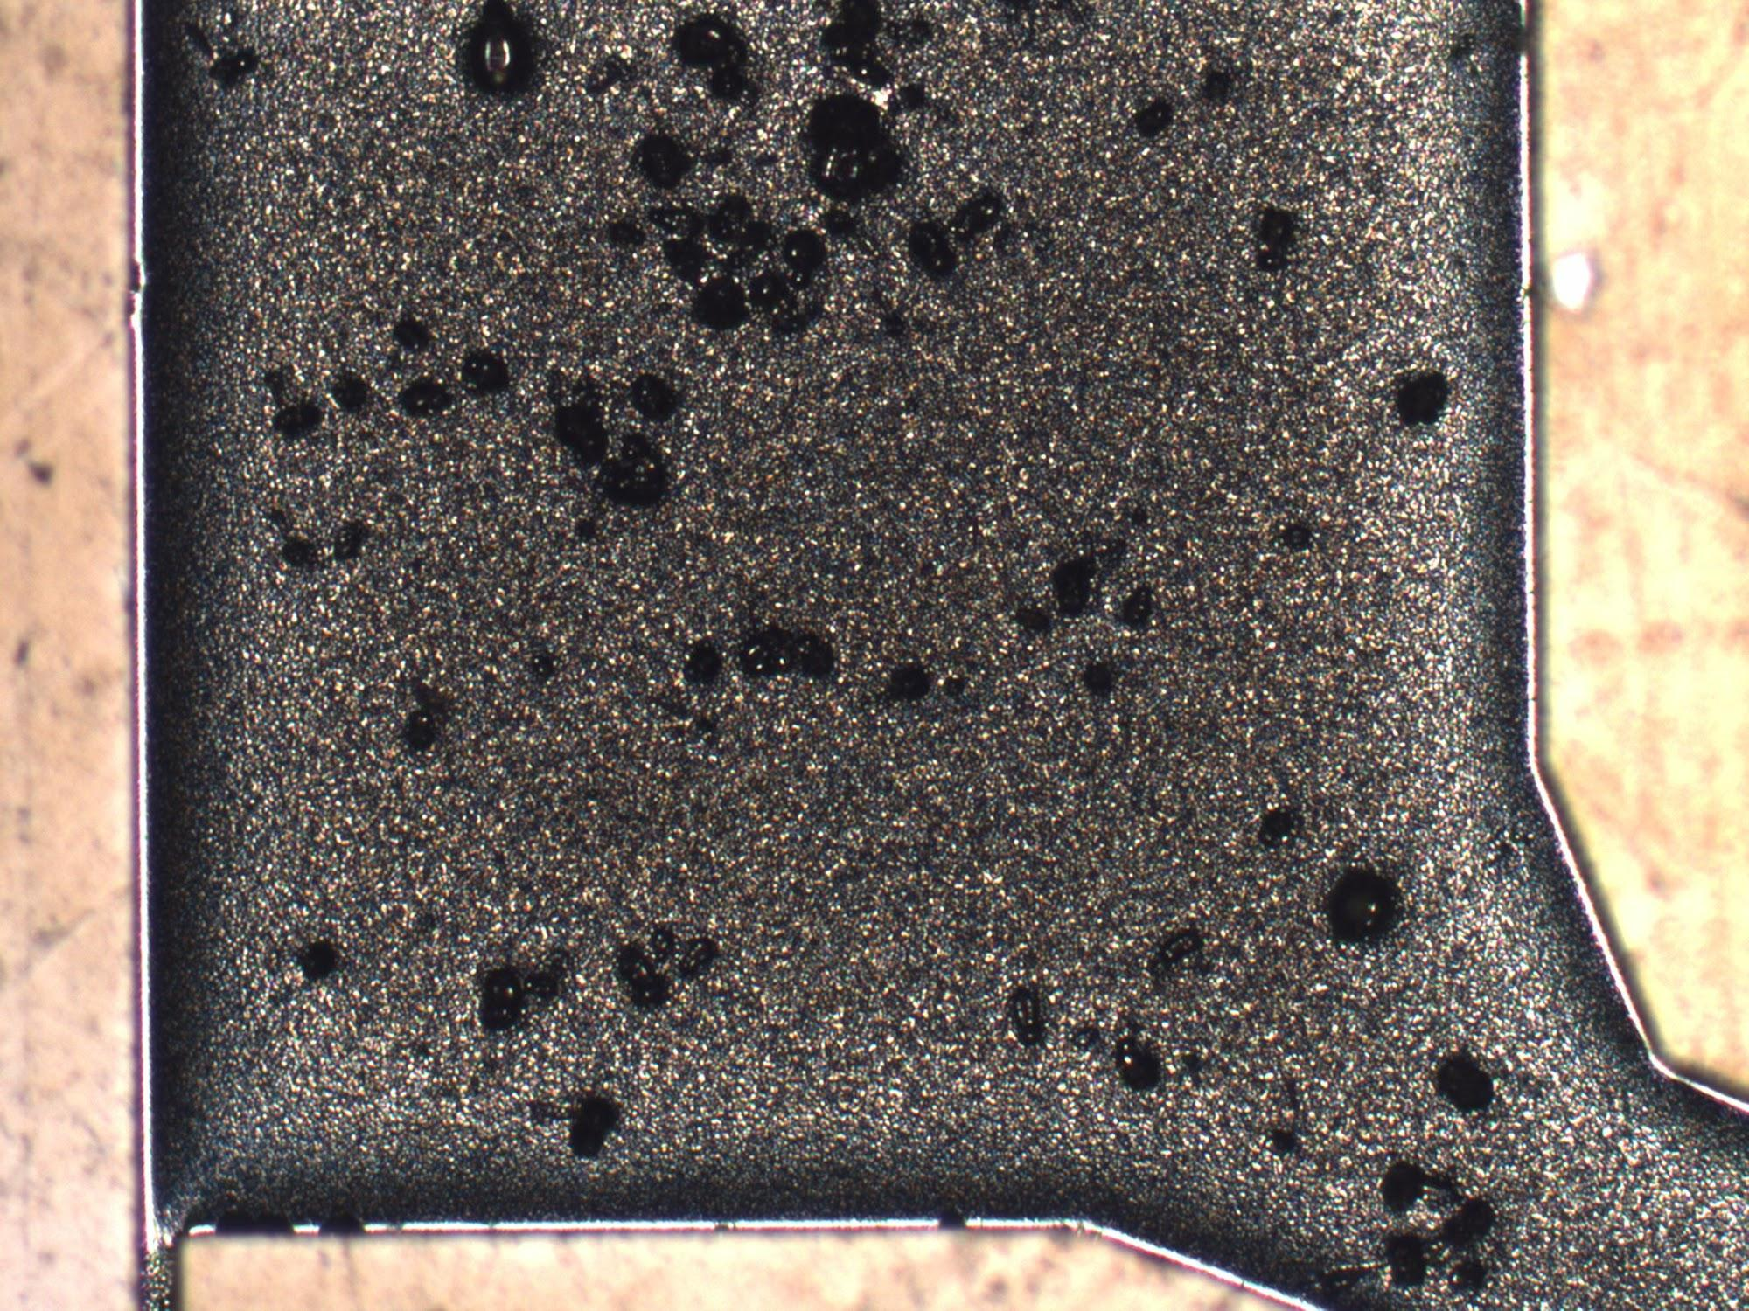
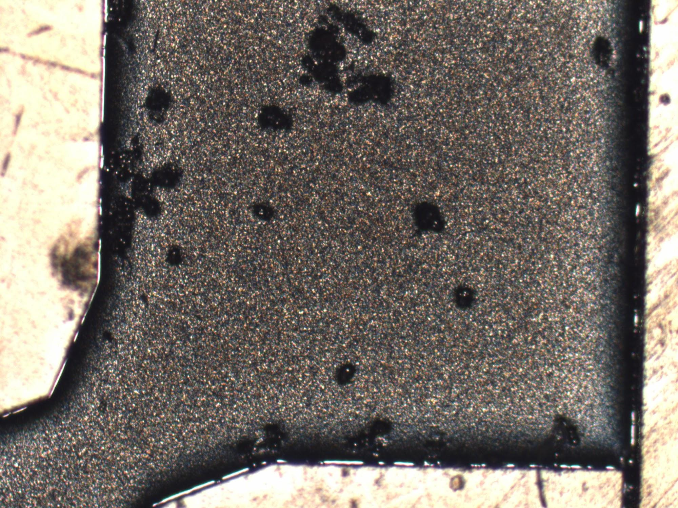
13:5 and 14:5 Top View

Slide 12
Trenches*
Large Views

Slide 13
9:5
Notes:
If only I could crop this picture!

Slide 14
10:5

Slide 15
11:5

Slide 16
12:5

Slide 17
13:5

Slide 18
14:5

Slide 19
Pillars
Recipe Details
Cycles: 120
Chuck Temperature: 15°C
Helium Back Pressure: 10 Torr
Set Pressure: 0 mTorr
Actual Pressure: 17/14 SF6/C4F8 mTorr
ICP Forward Power: 500 W
RF Forward Power: 25/10 W SF6/C4F8
RF Bias: 97/55 SF6/C4F8 V
Flow Rates: 80:80 SF6:C4F8
Etch:Deposition Time: 9:5, 10:5, 11:5, 12:5 SF6:C4F8

Slide 20
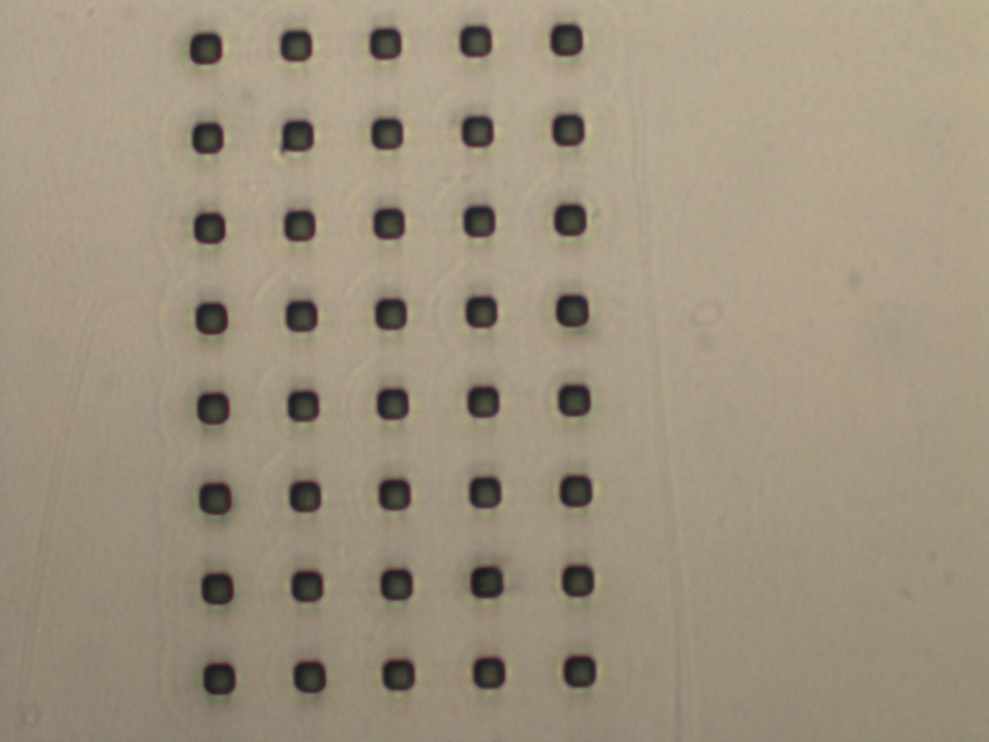
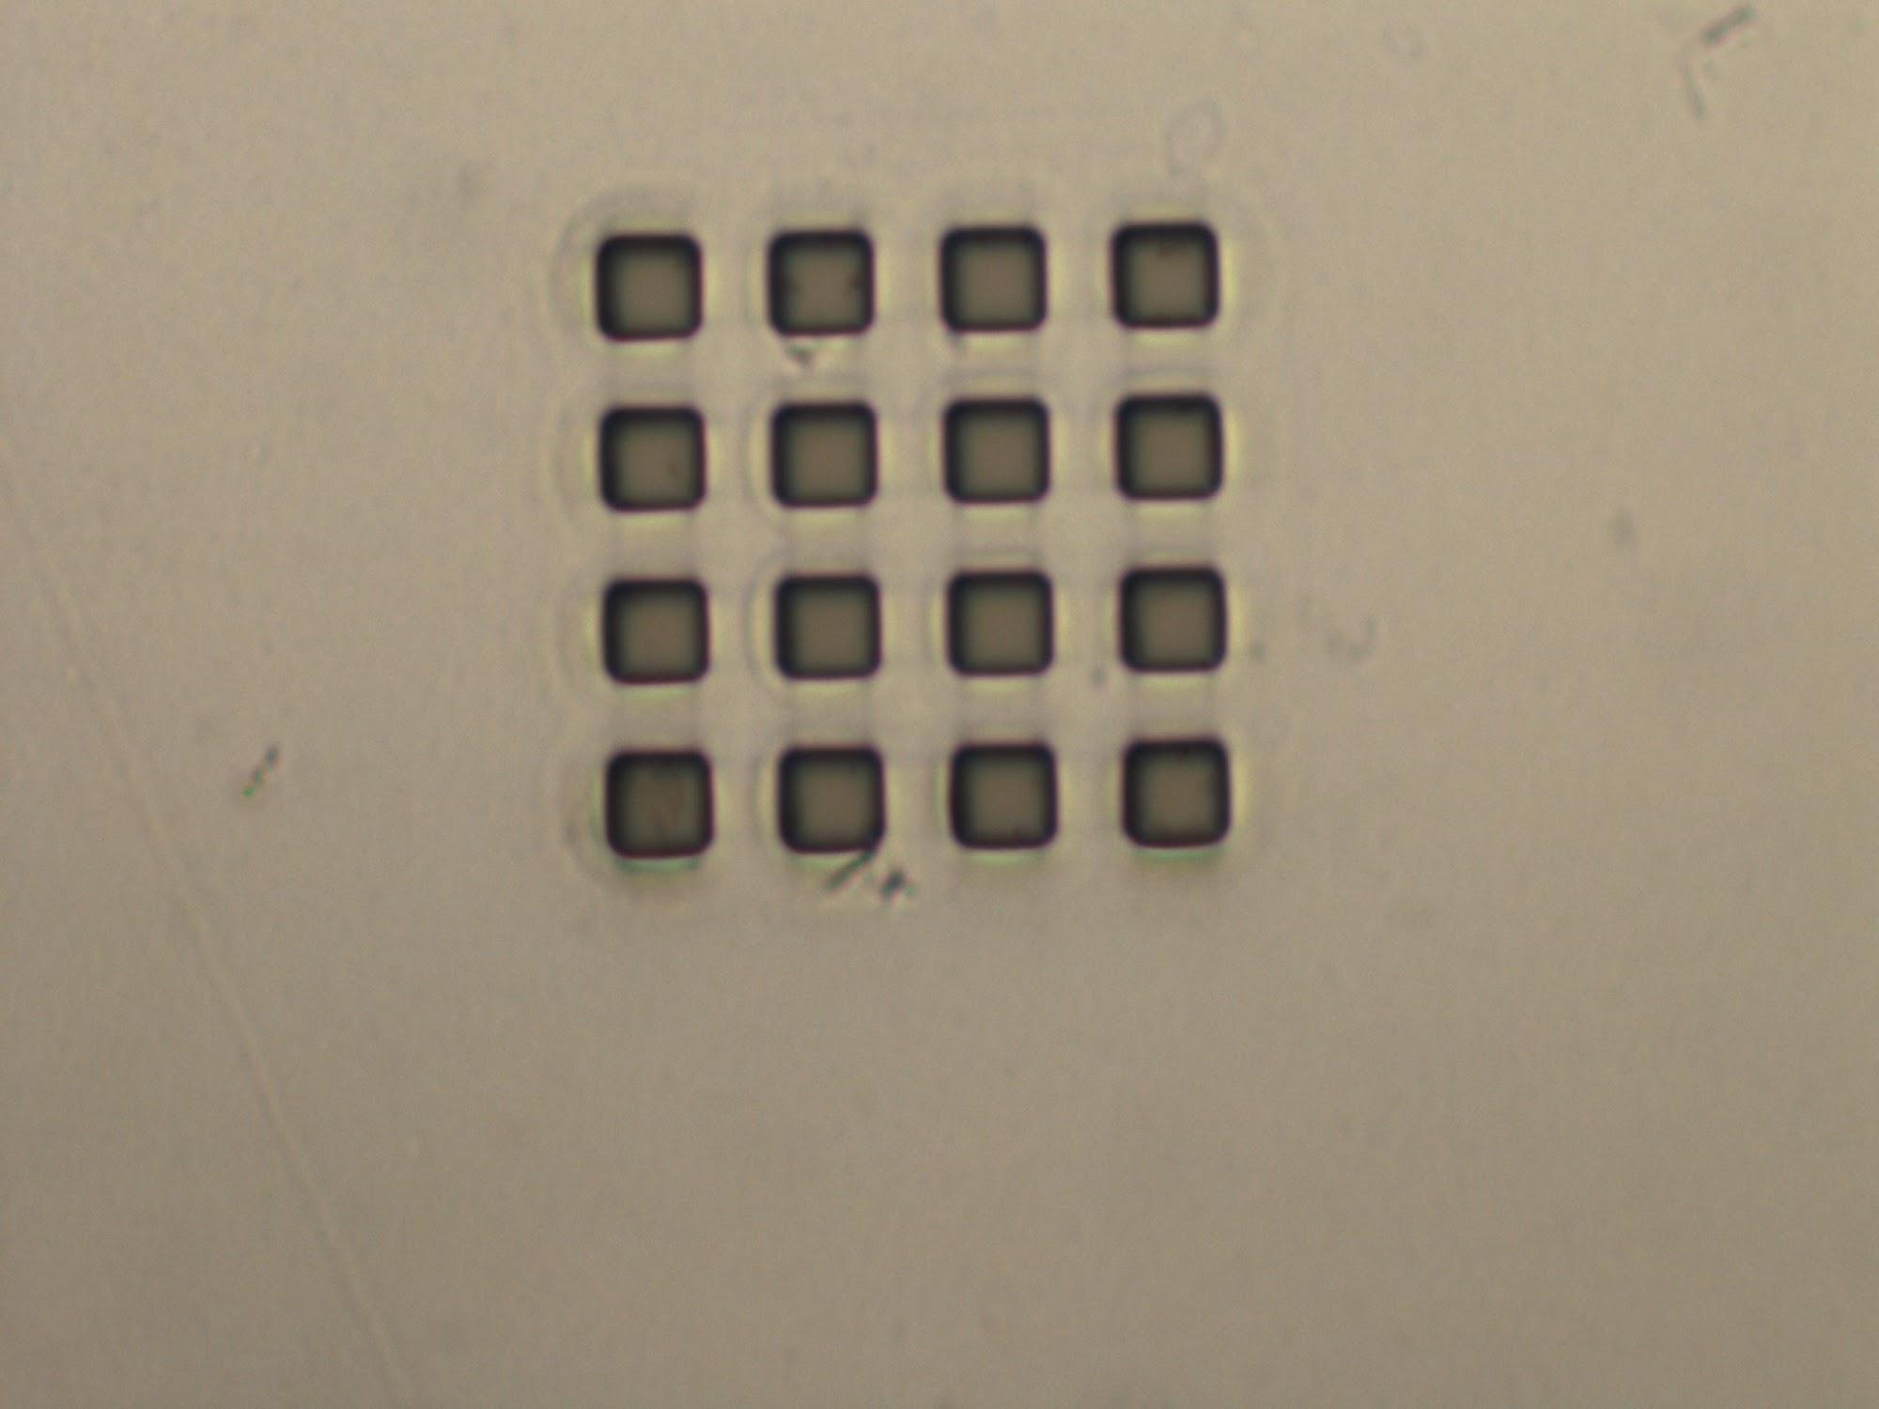
9 to 5 Pillars
10 um features
20 um features

Slide 21
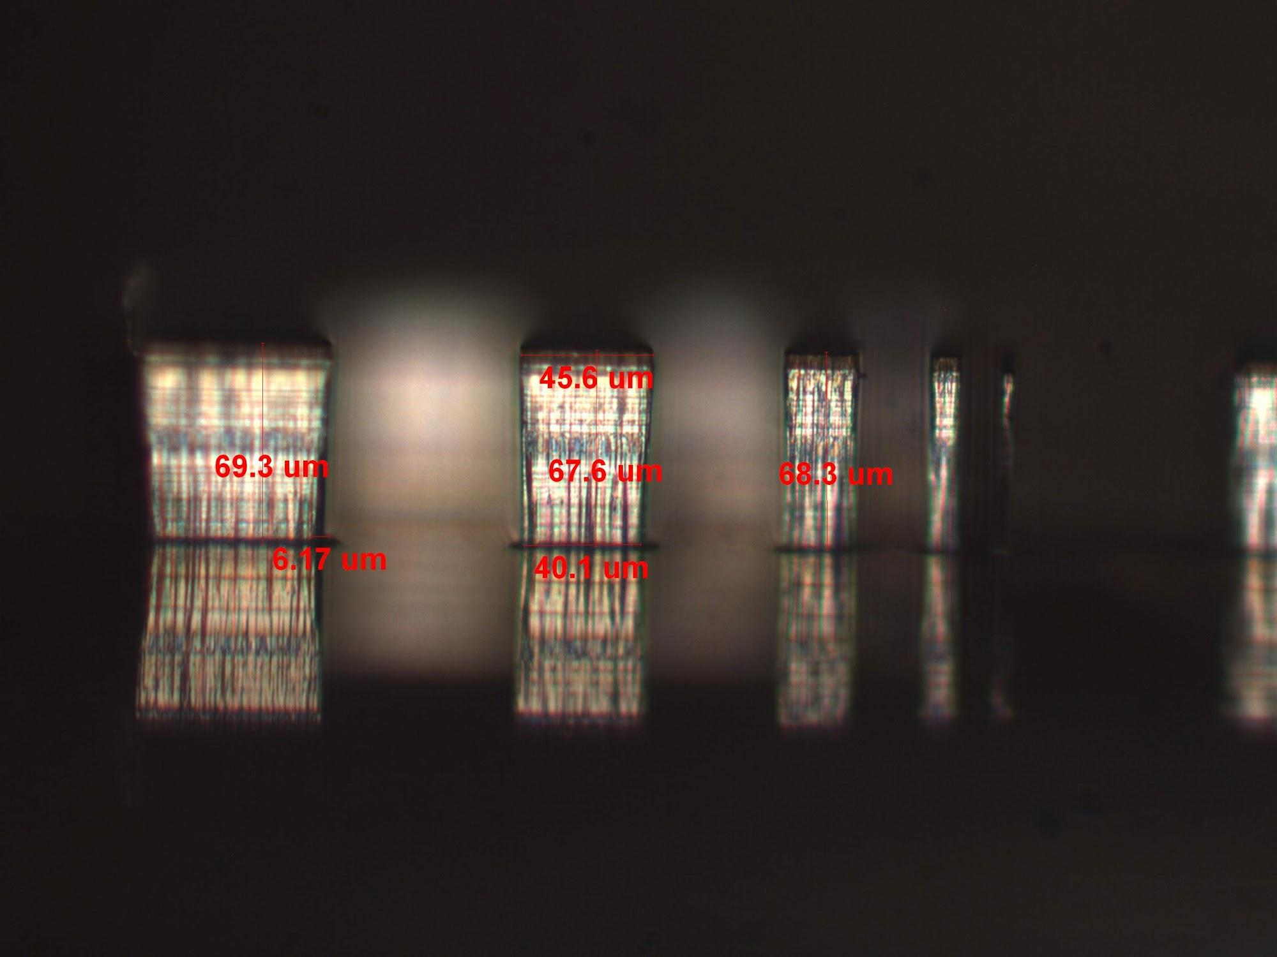
9 to 5 - Details
Si Etch Rate: 0.57 um per cycle
Pr Etch Rate: 4.17 nm per cycle
10 um Pillar height: 68 um
Pillar Sidewall Angle: 2.61°
Pillar Undercut Ratio: 21.94 rise / 1 undercut um
Black grass: Present on top of features
None between pillars
Date: 4/23/2013
9 to 5 Yield Table
Cycles: | 30 | 60 | 120
Etch Depth | 19 um | 34 um | 68 um
10 um Yield | 100% | 100% | 98.2%
20 um Yield | 100% | 100% | 100%

Slide 22
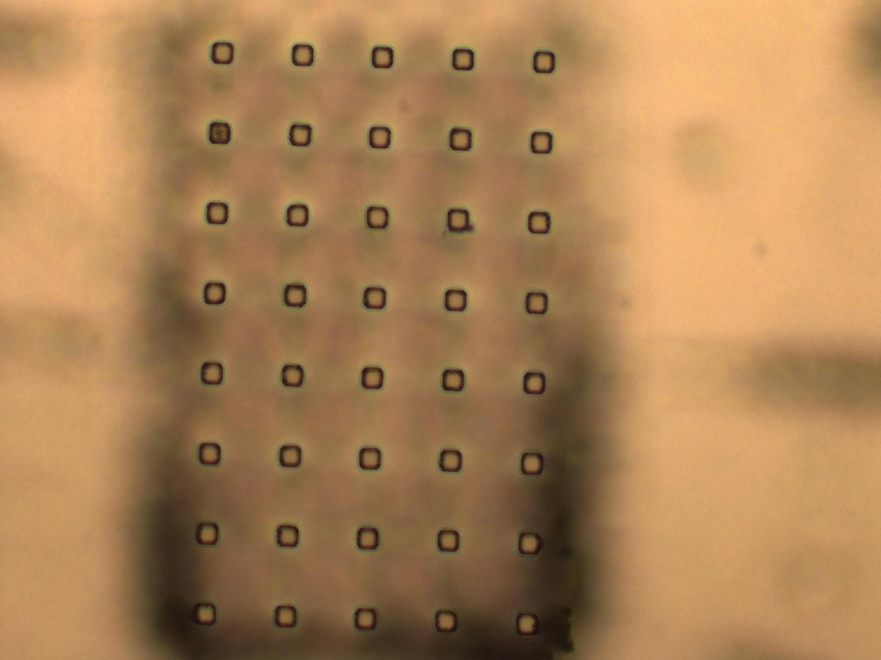
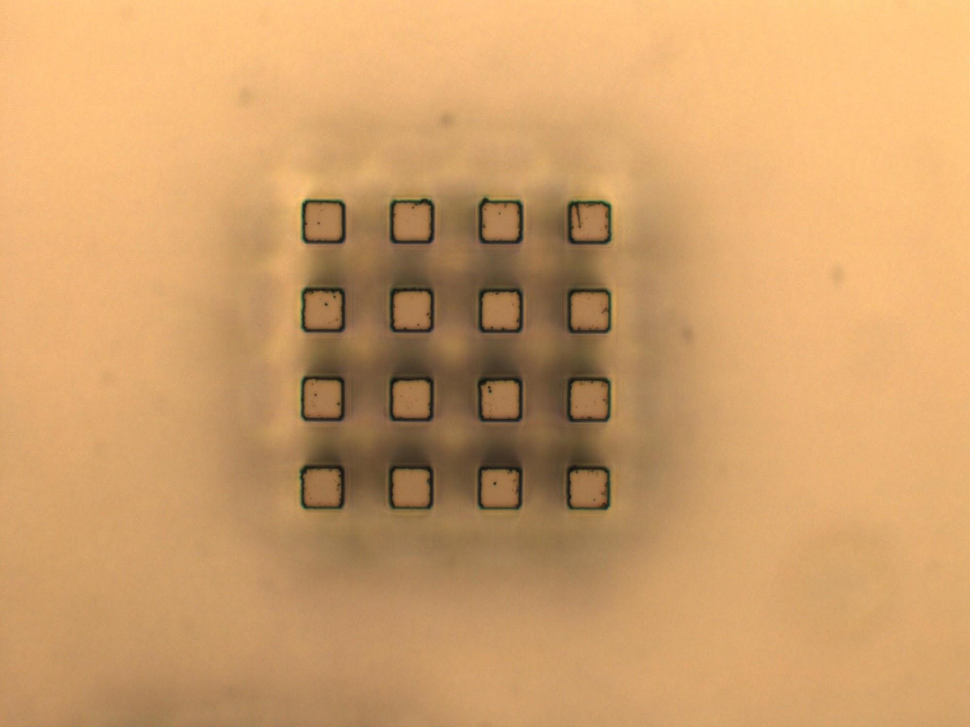
10 to 5 Pillars
10 um features
20 um features

Slide 23
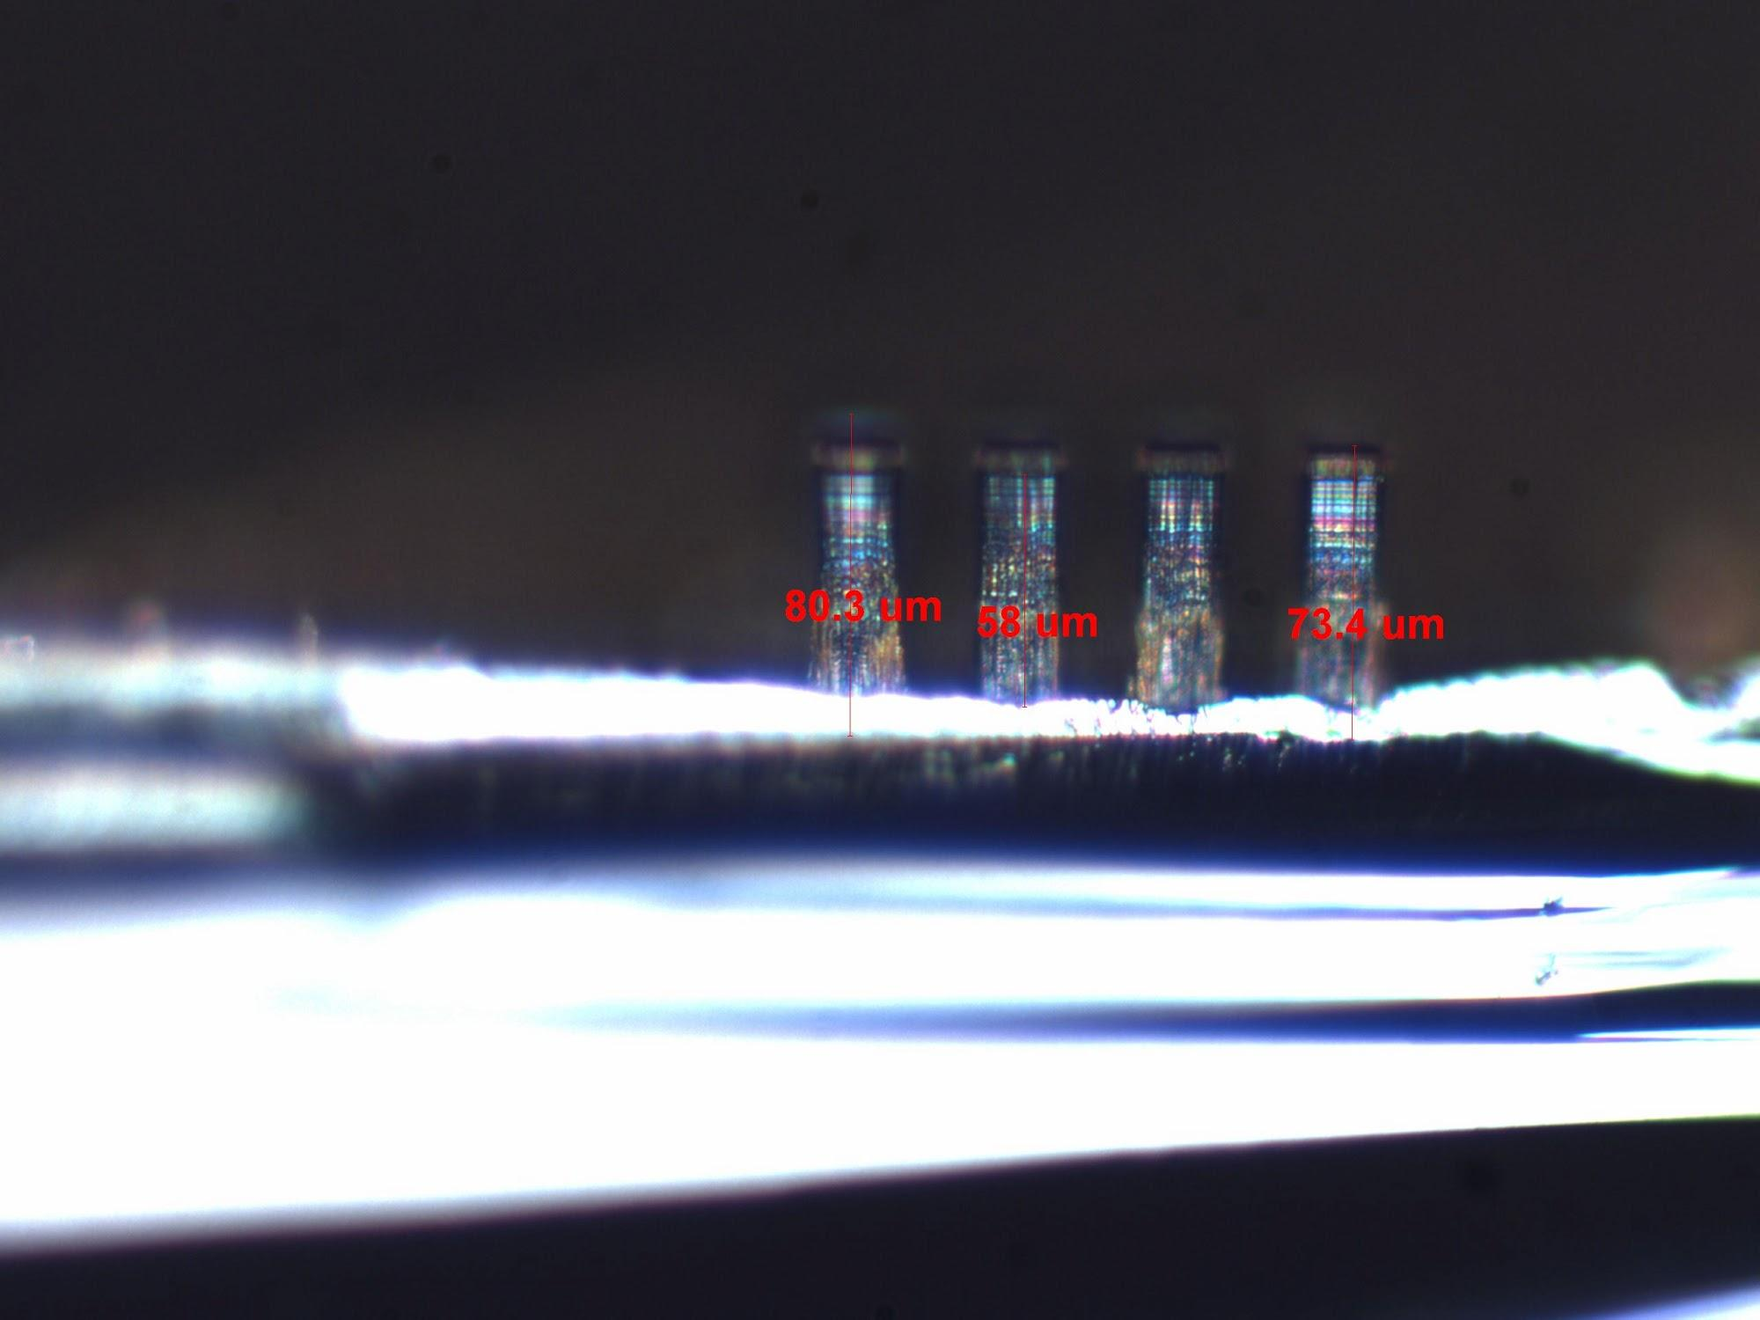
10 to 5 - Details
Si Etch Rate: 0.604 um per cycle
Pr Etch Rate: 5.58 nm per cycle
10 um Pillar height: 72 um
Pillar Sidewall Angle: 2.918°
Pillar Undercut Ratio: 19.62 rise / 1 undercut um
Black grass: Trace amounts on wafer edge
Date: 4/23/2013
10 to 5 Yield Table
Cycles: | 30 | 60 | 120
Etch Depth | 18 um | 36 um | 72 um
10 um Yield | 100% | 98.7% | 84%
20 um Yield | 100% | 100% | 100%

Slide 24
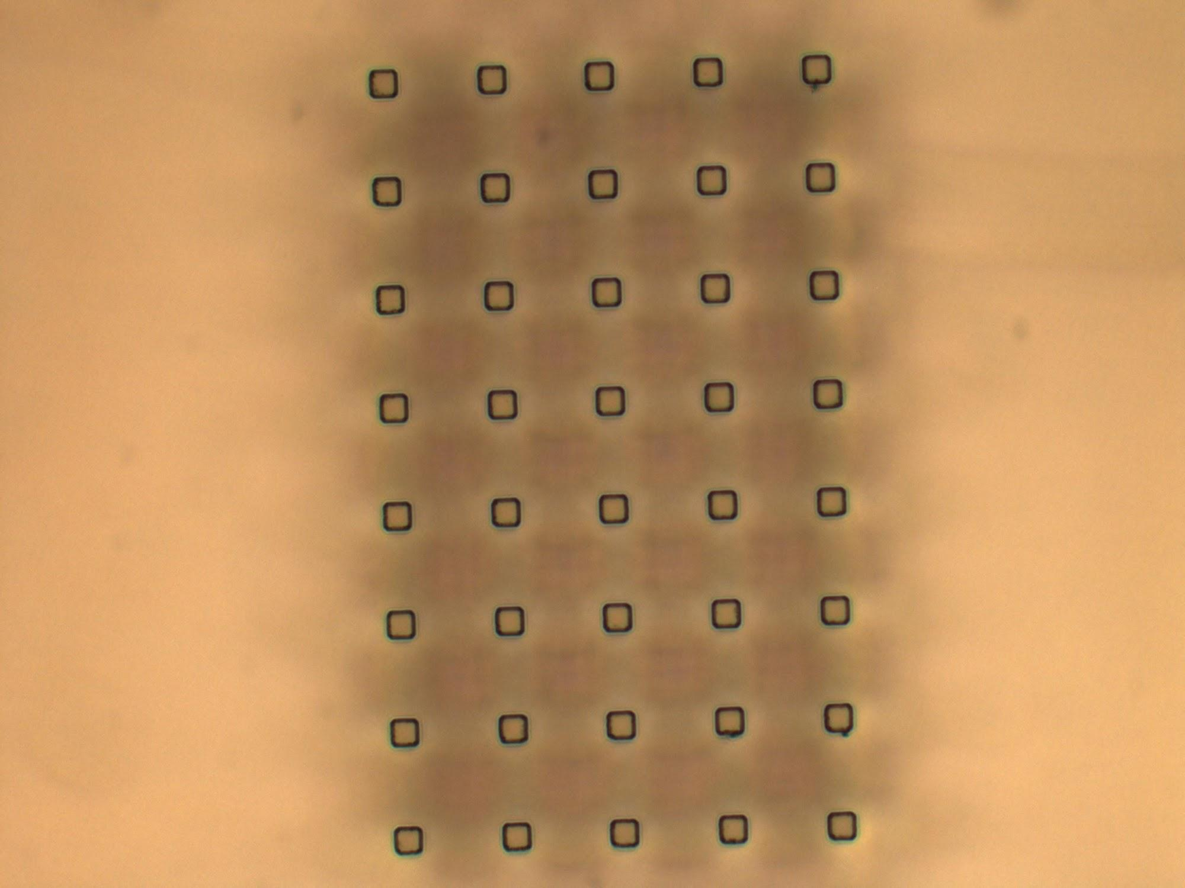
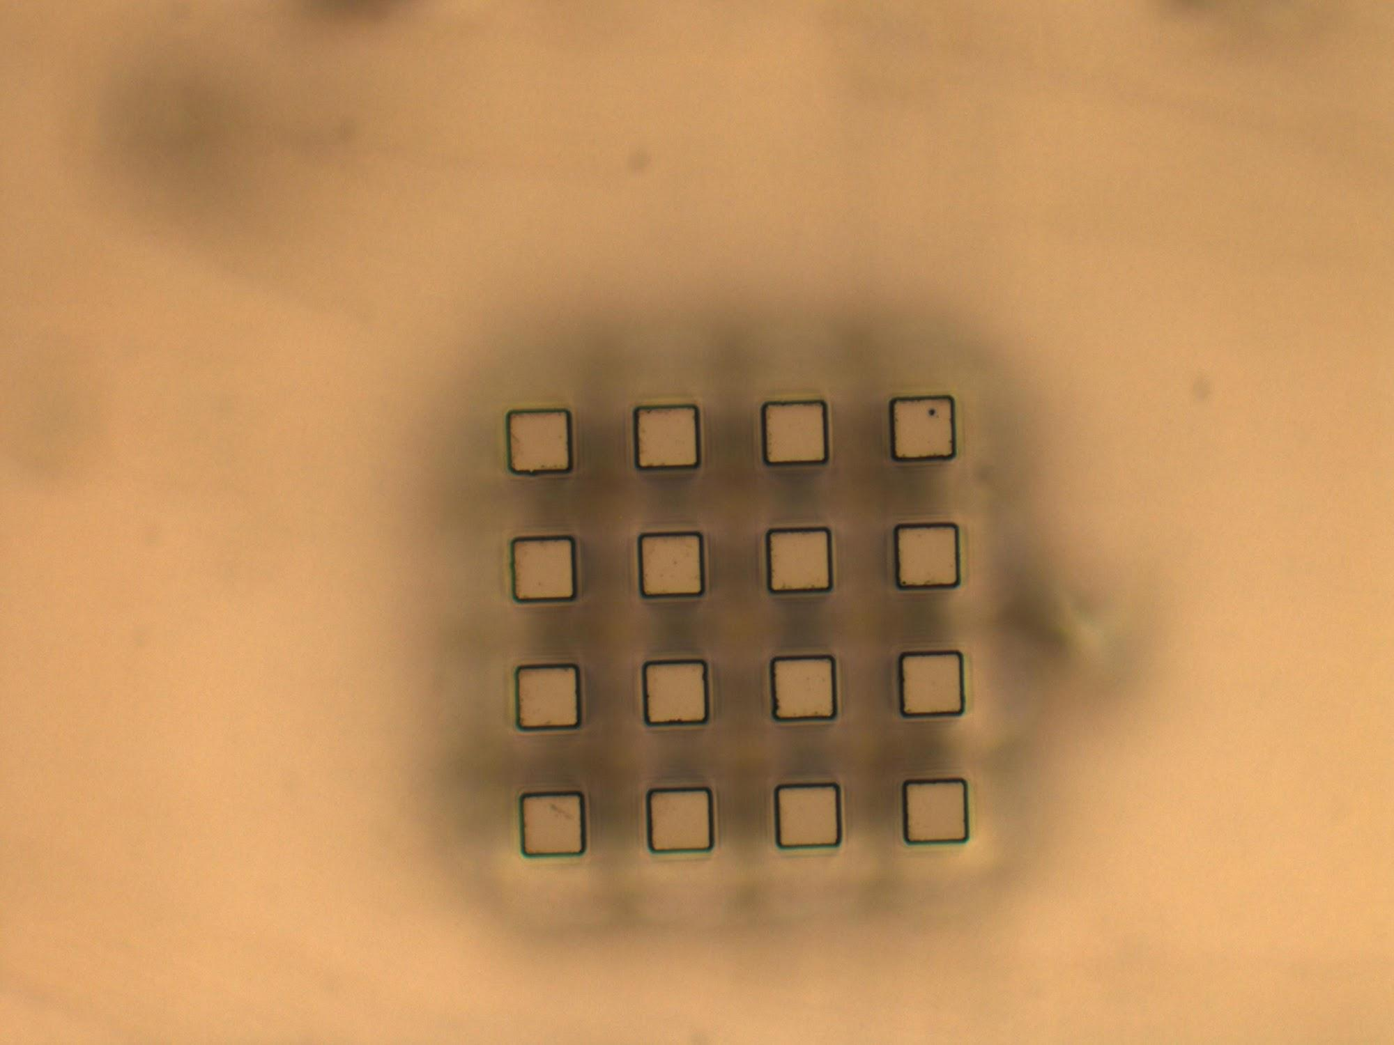
11 to 5 Pillars
10 um features
20 um features

Slide 25
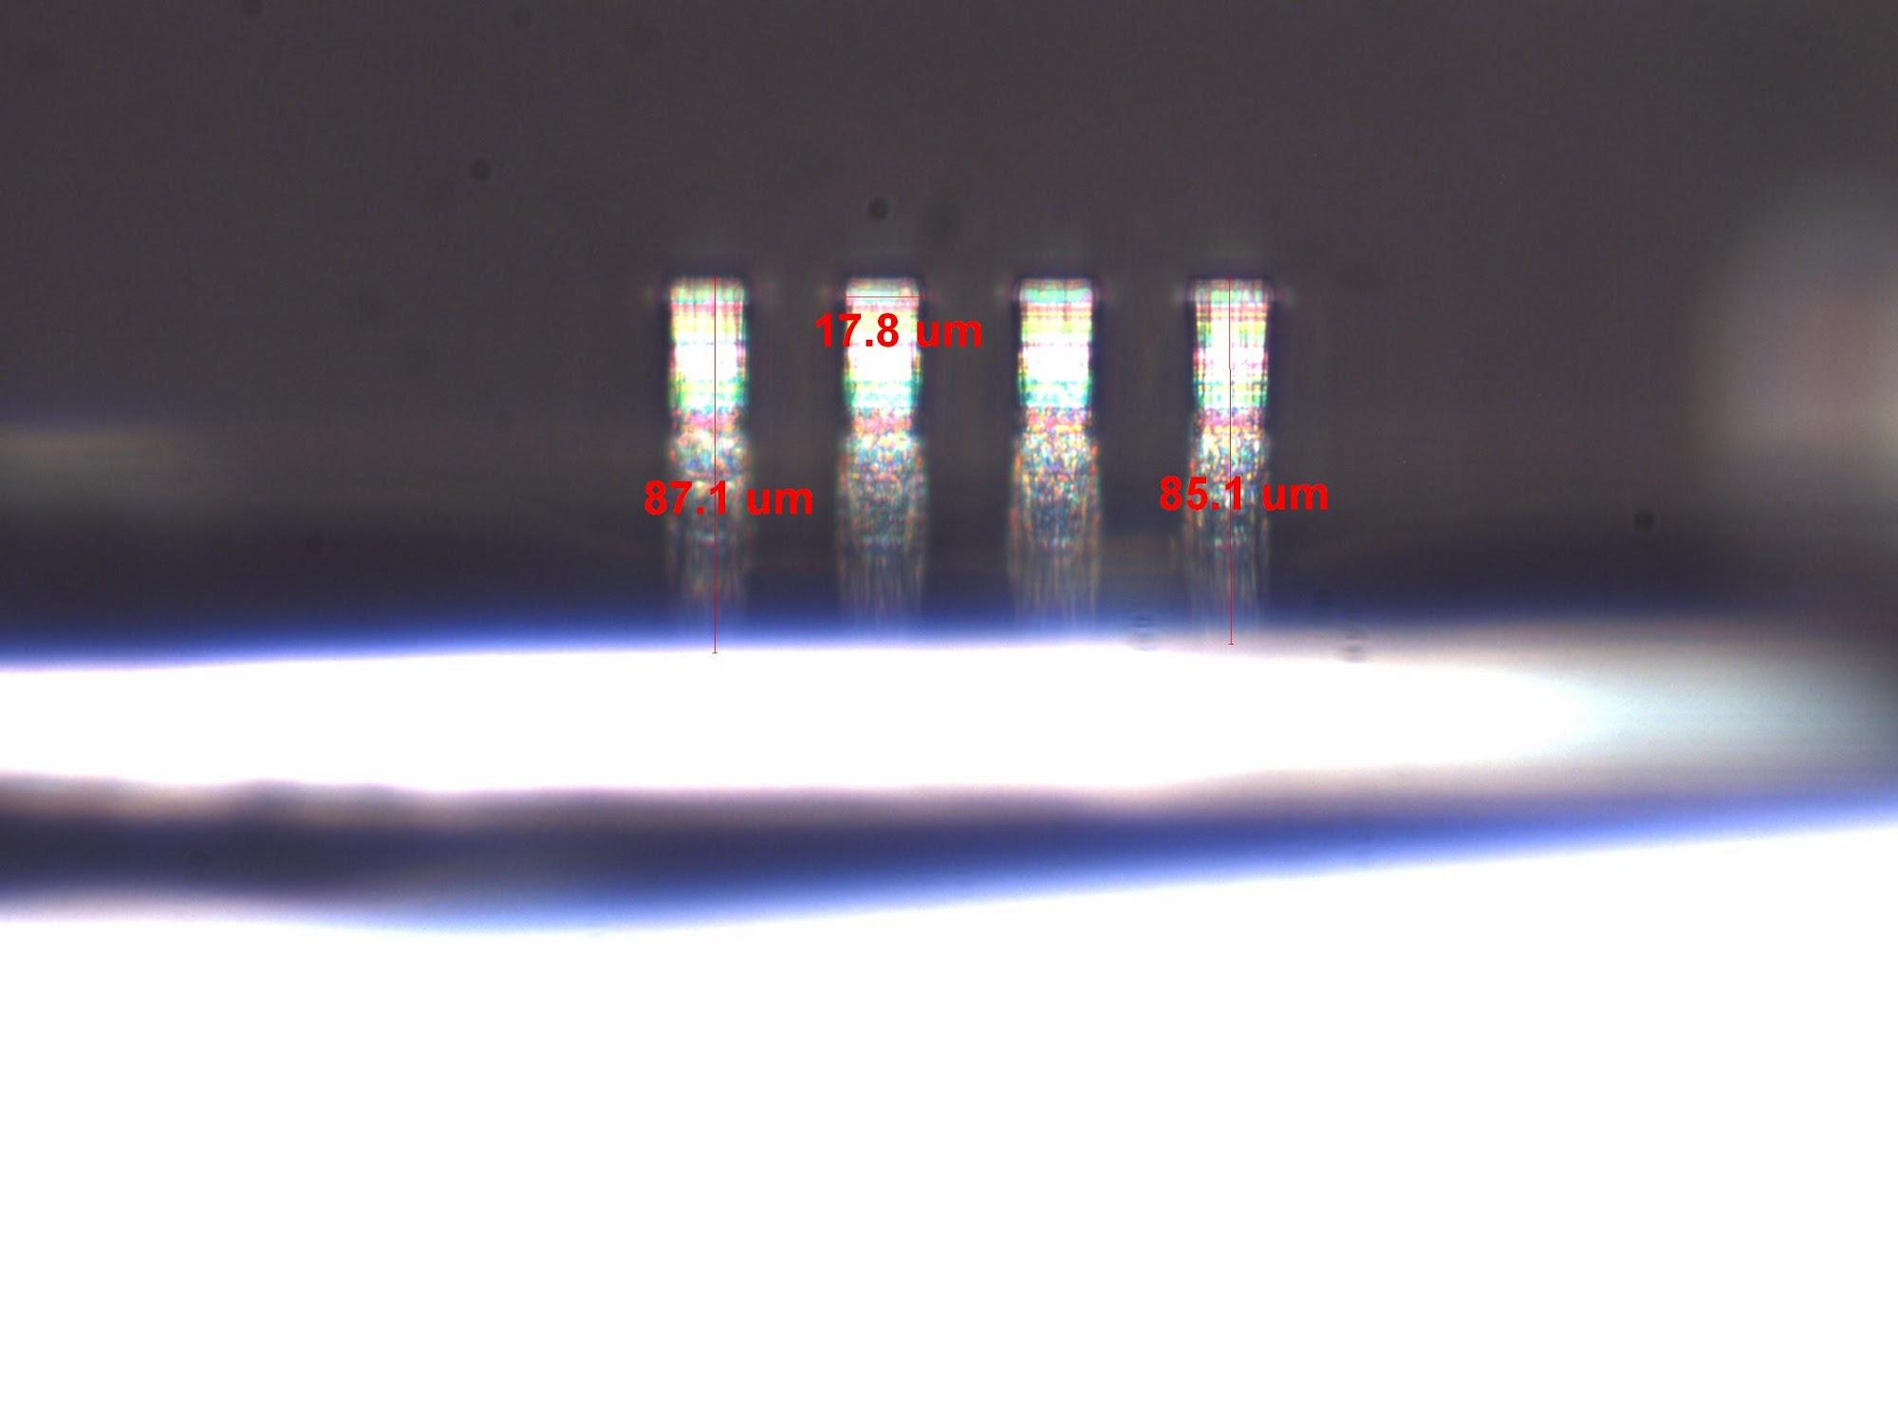
11 to 5 - Details
Si Etch Rate: 0.717 um per cycle
Pr Etch Rate: 7.08 nm per cycle
10 um Pillar height: 86 um
Pillar Sidewall Angle: 2.743°
Pillar Undercut Ratio: 20.87 rise / 1 undercut um
Black grass: None
Date: 4/23/2013
11 to 5 Yield Table
Cycles: | 30 | 60 | 120
Etch Depth | 21.5 um | 43 um | 86 um
10 um Yield | 100% | 97% | 96.5%
20 um Yield | 100% | 100% | 100%

Slide 26
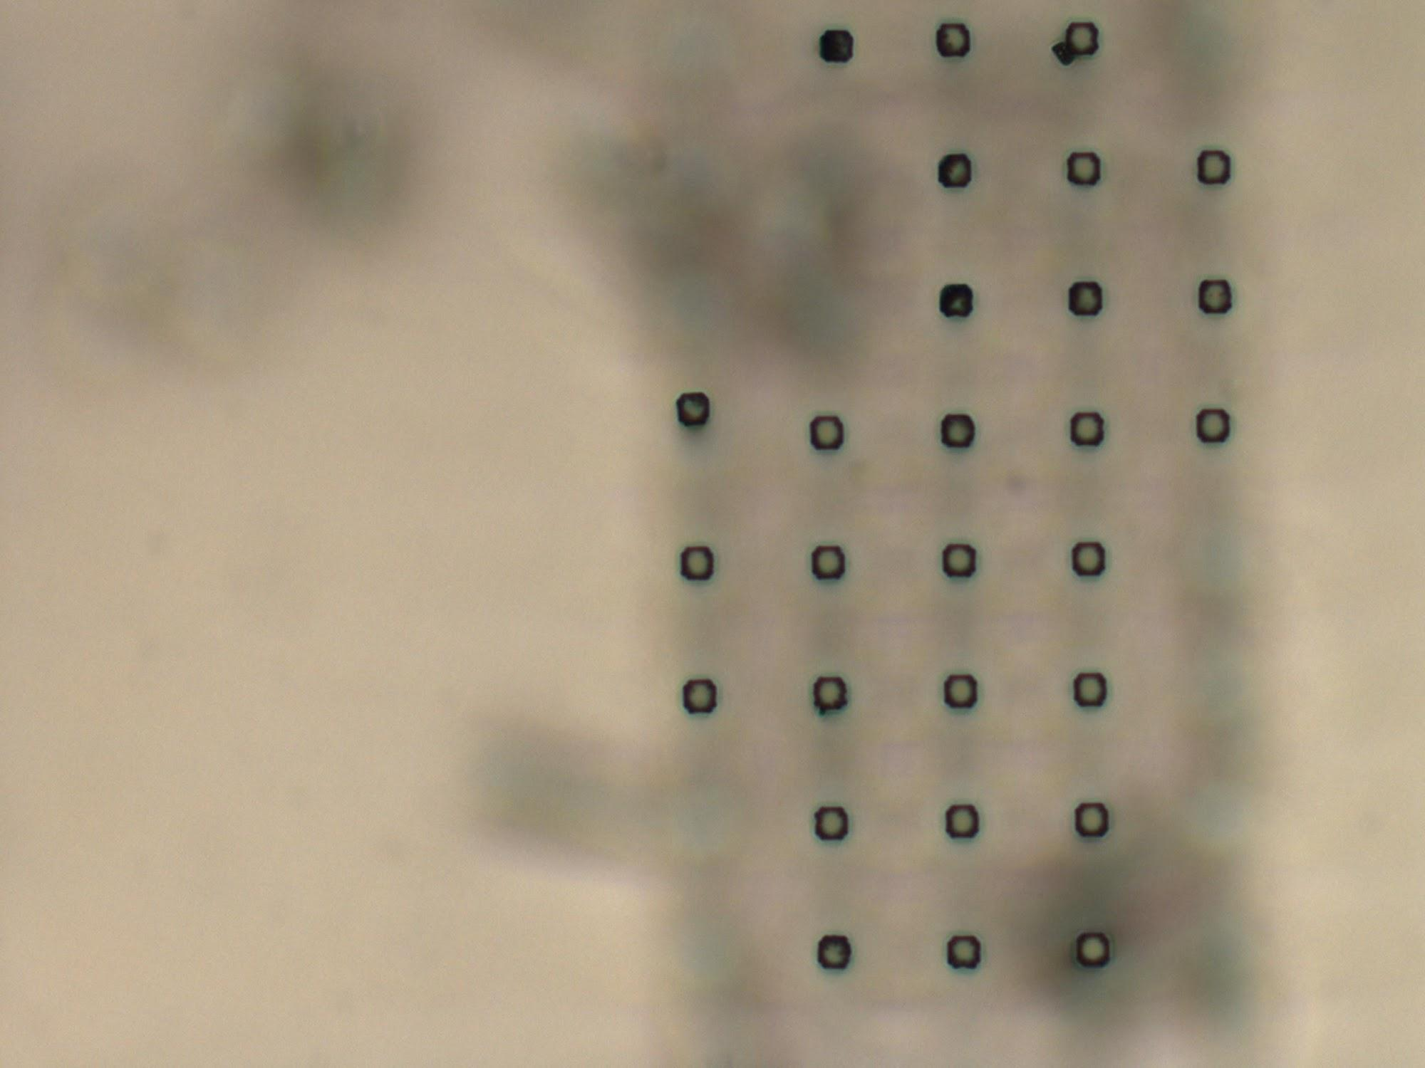
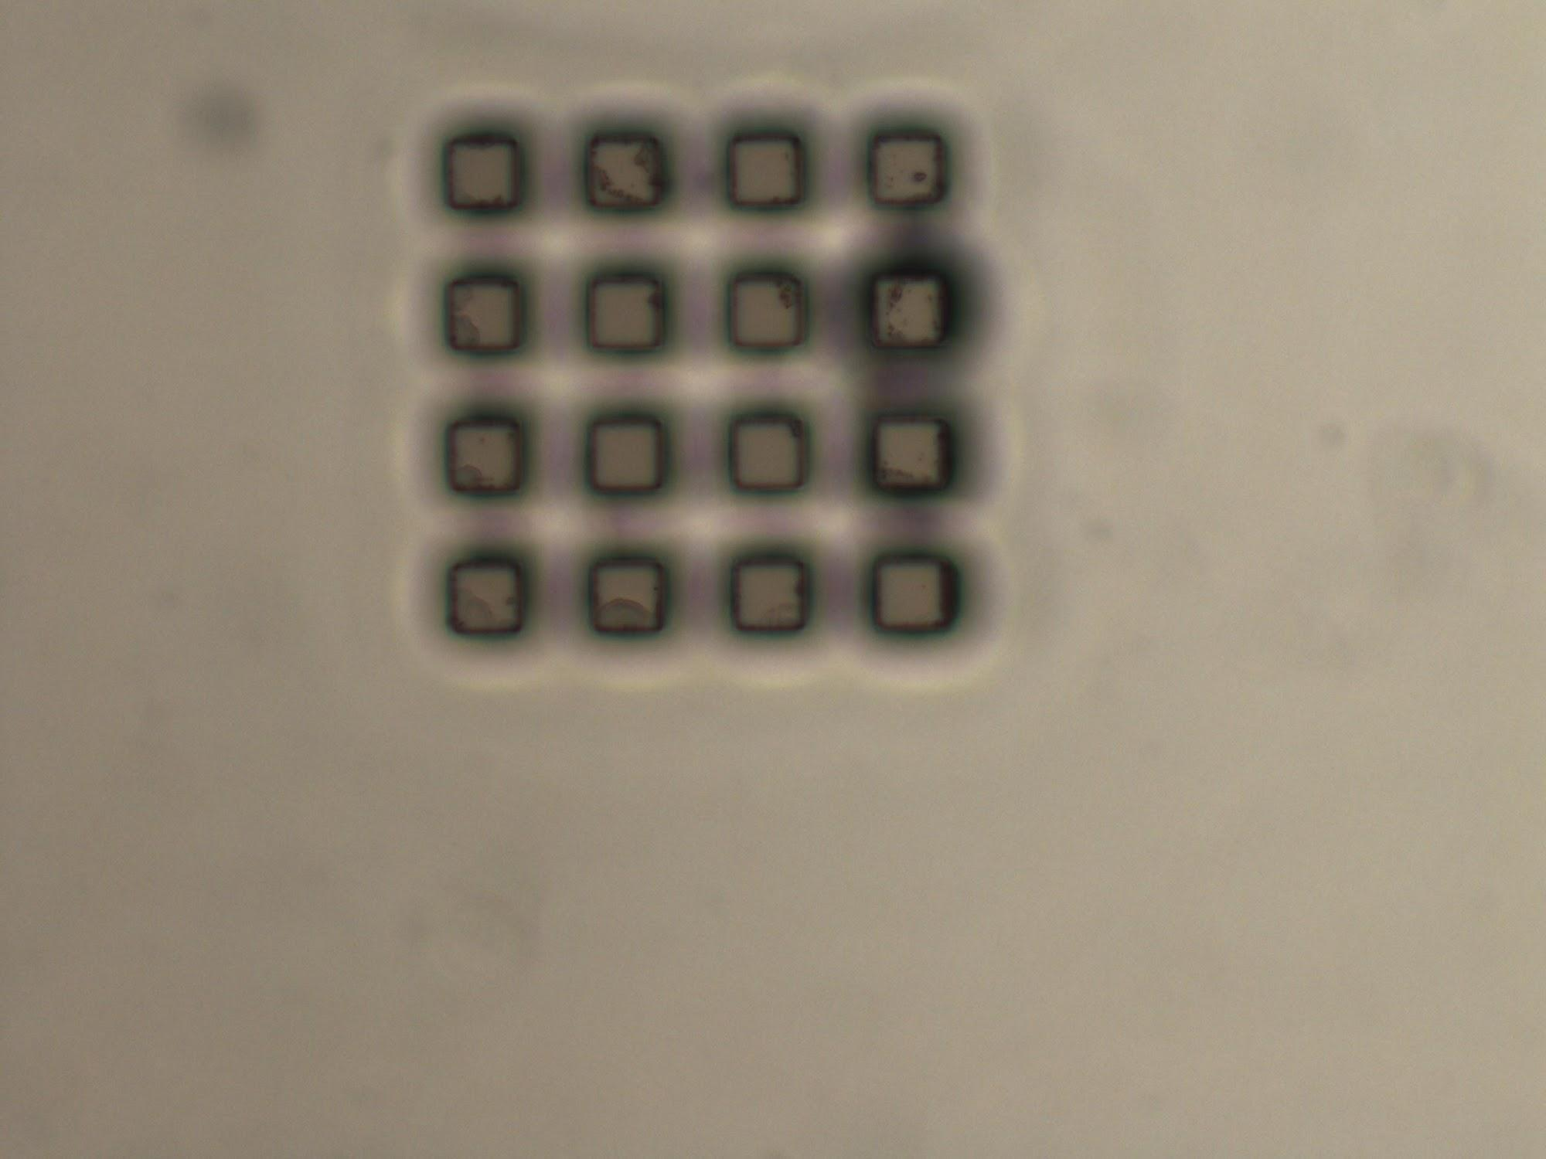
12 to 5 Pillars
10 um features
20 um features

Slide 27
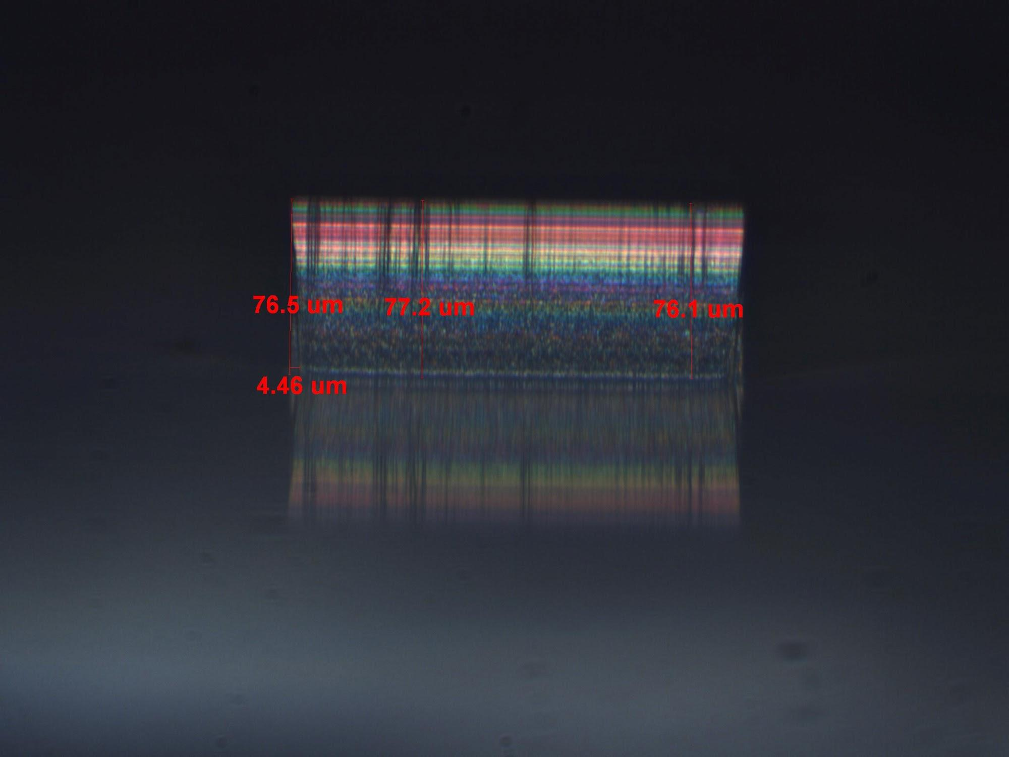
12 to 5 - Details
Si Etch Rate: 0.73 um per cycle
Pr Etch Rate: 11.67 nm per cycle
10 um Pillar height: 88 um
Pillar Sidewall Angle: 3.797°
Pillar Undercut Ratio: 15.07 rise / 1 undercut um
Black grass: None
Date: 4/23/2013
12 to 5 Yield Table
Cycles: | 30 | 60 | 120
Etch Depth | 22 um | 44 um | 88 um
10 um Yield | 100% | 70% | 26.67%
20 um Yield | 100% | 100% | 92%

Slide 28
Comparisons
Etch:Dep Time Parameter | 9:5 |  | 10:5 |  | 11:5 |  | 12:5
 | Trenches | Pillars | Trenches | Pillars | Trenches | Pillars | Trenches | Pillars
Percent Wafer Area Etched | 5% | 97% | 5% | 97% | 5% | 97% | 5% | 97%
Black Grass | Present - Large Amounts | Present on tops of features | Present - Medium Amounts | Trace amounts on edge of wafer | Present - Small Amounts | None | None | None
Photoresist to Silicon Etch Ratio (PR : SI) | 0.5886 : 100 Photo : SIlicon Etch Rate in um | 0.7316 : 100 Photo : SIlicon Etch Rate in um | 0.8861 : 100 Photo : SIlicon Etch Rate in um | 0.9238 : 100 Photo : SIlicon Etch Rate in um | 1.118 : 100 Photo : SIlicon Etch Rate in um | 0.9875 : 100 Photo : SIlicon Etch Rate in um | 1.304 : 100 Photo : SIlicon Etch Rate in um | 1.599 : 100 Photo : SIlicon Etch Rate in um
Undercut Rise/run | -51.21 / 1 Rise/run um Overcut | 21.94 / 1 Rise/run um | 92.26 / 1 Rise/run um | 19.62 / 1 Rise/run um | 63.14 / 1 Rise/run um | 20.87 / 1 Rise/run um | 51.11 / 1 Rise/run um | 15.07 / 1 Rise/run um
Large Area Etch Depths for 200 cycles* pillars are extrapolated data | 158 um | 113,33 um | 158 um | 120 um | 172 um | 143.33 um | 139 um | 146.76 um
 | Comparison : Trenches etch 1.394X as much as pillars (158/113.33) |  | Comparison : Trenches etch 1.317X as much as pillars (158/120) |  | Comparison : Trenches etch 1.2X as much as pillars (172/143.33) |  | Comparison : Trenches etch 0.95X as much as pillars (139/146.76)
Silicon Etch Rate Comparison | 0.79 um / cycle | 0.57 um / cycle | 0.79 um / cycle | 0.604 um / cycle | 0.805 um / cycle | 0.717 um / cycle | 0.69 um / cycle | 0.73 um / cycle
 | Comparison : Trenches etch 1.38X more per cycle than pillars |  | Comparison : Trenches etch 1.308X more per cycle than pillars |  | Comparison : Trenches etch 1.124X more per cycle than pillars |  | Comparison : Trenches etch 0.945X more per cycle than pillars

